Slide 1
Wonderful writing
Spring 2026

Slide 2
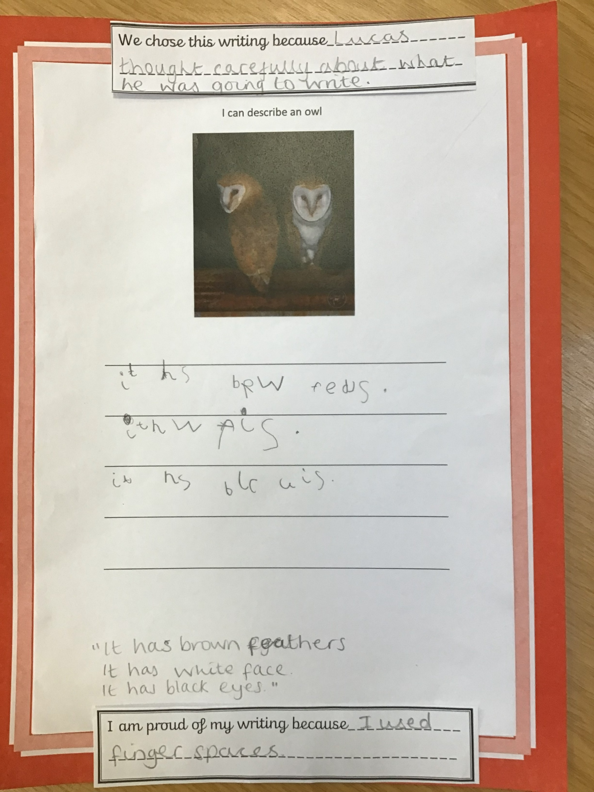
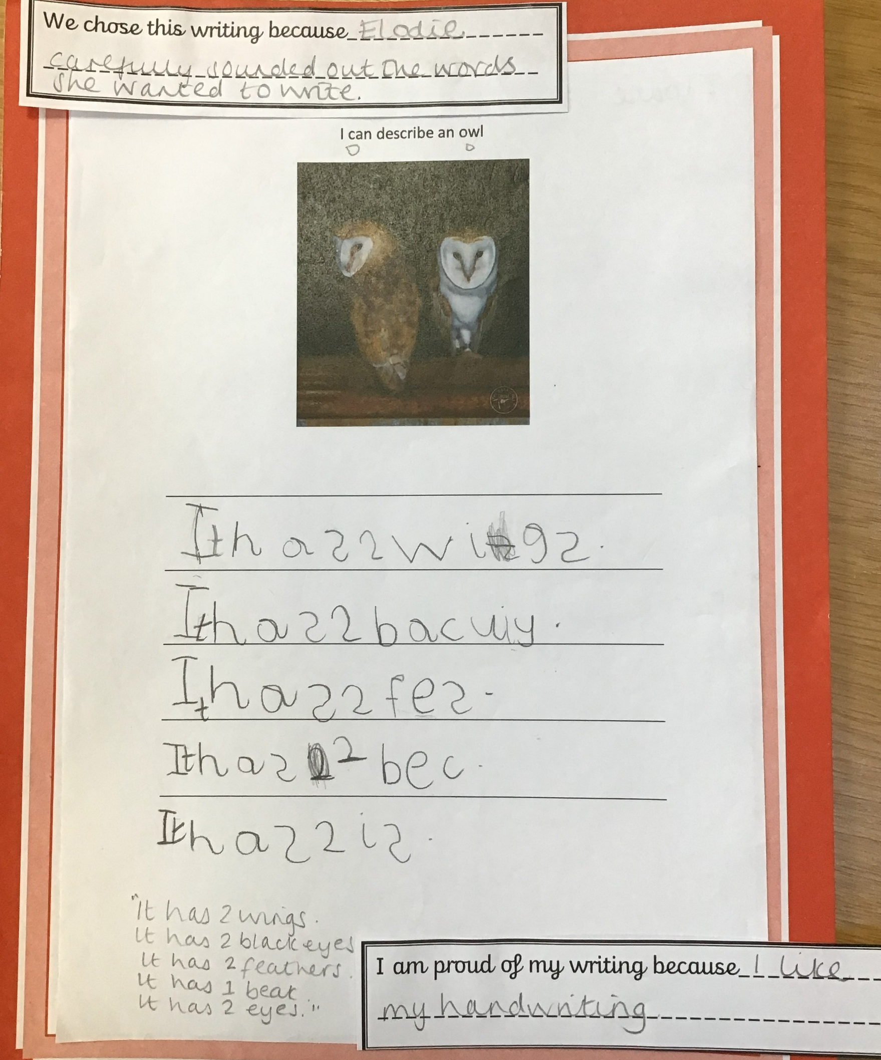
Chestnut Class - Elodie and Lucas

Slide 3
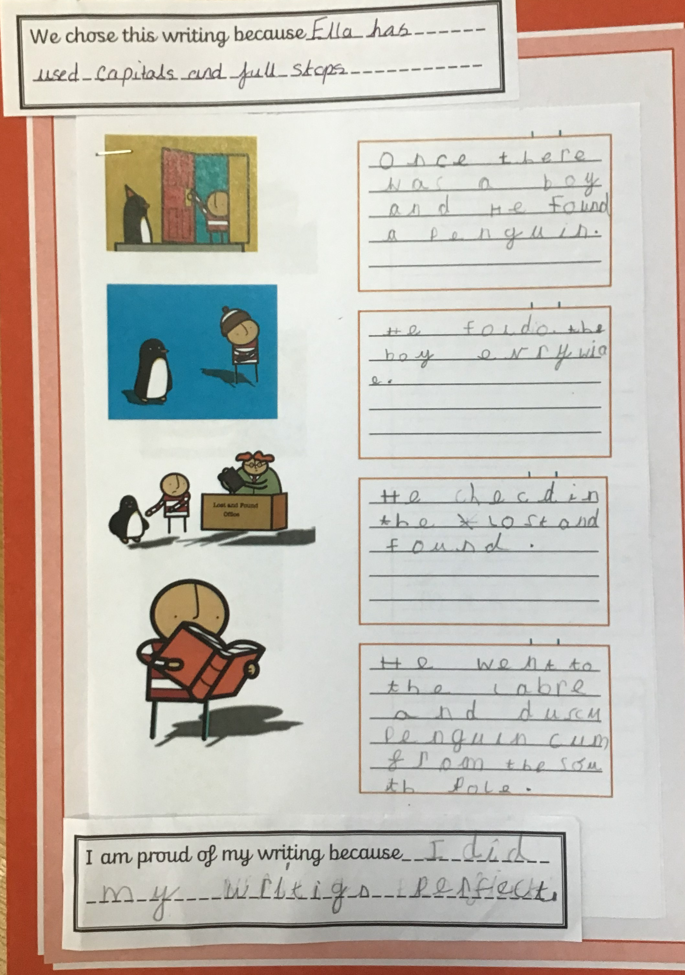
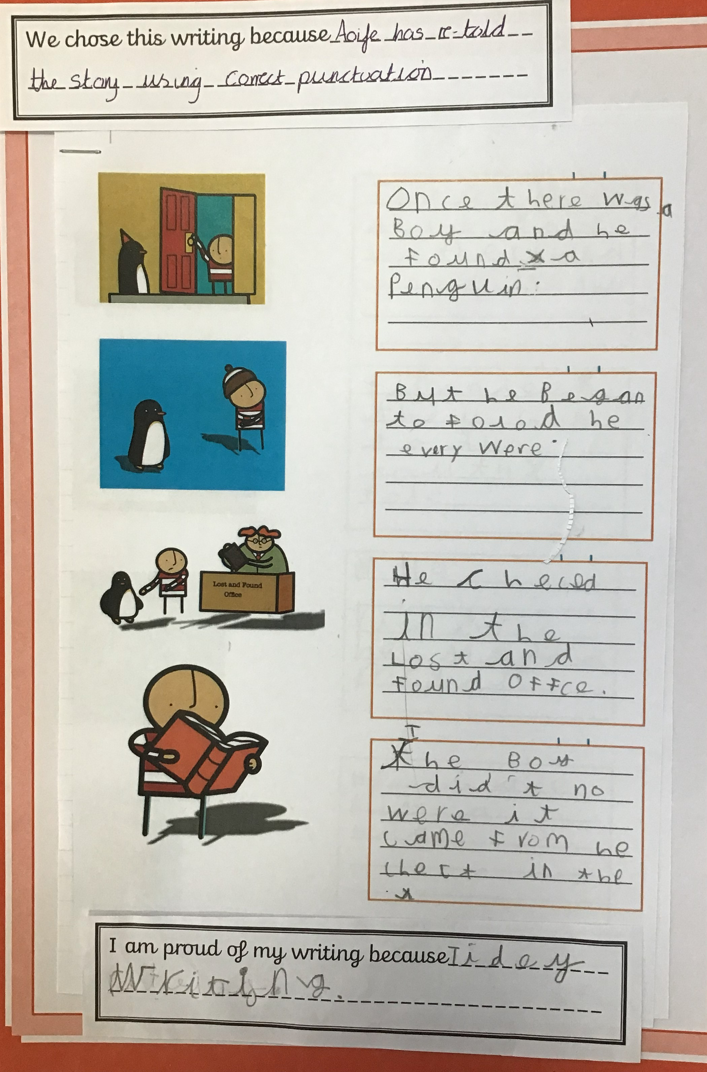
Elm Class –Aofie and Ella

Slide 4
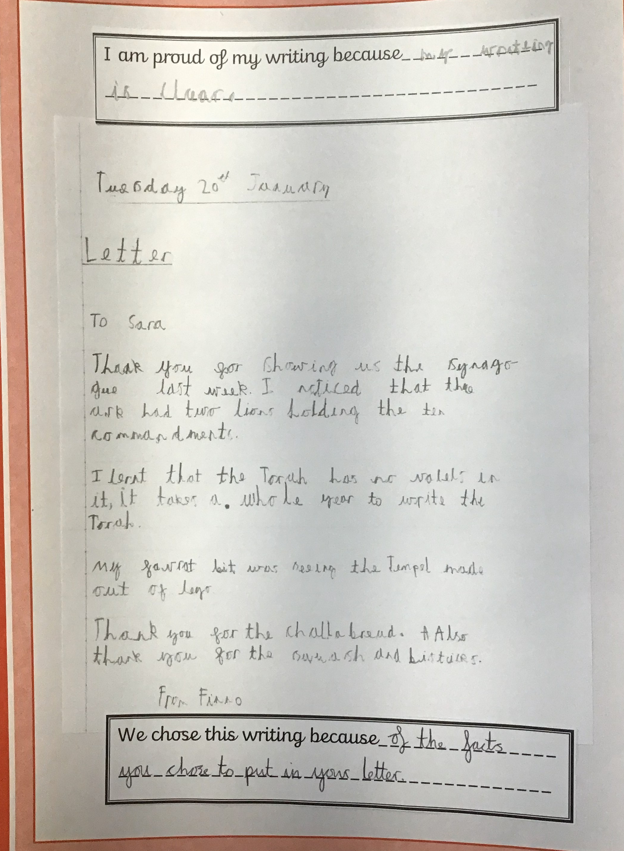
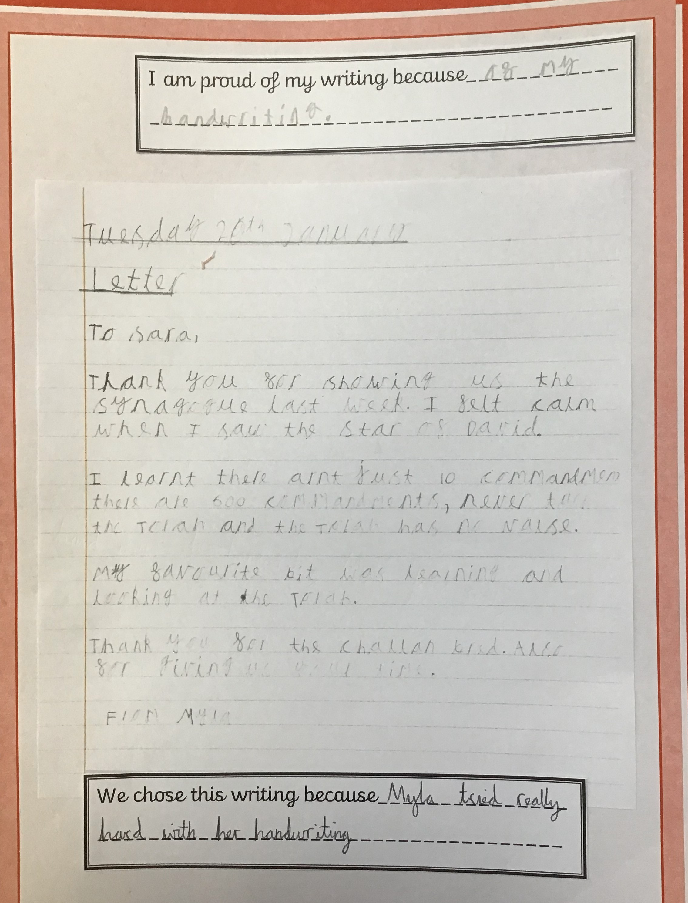
Ash Class – Myla and Finn O

Slide 5
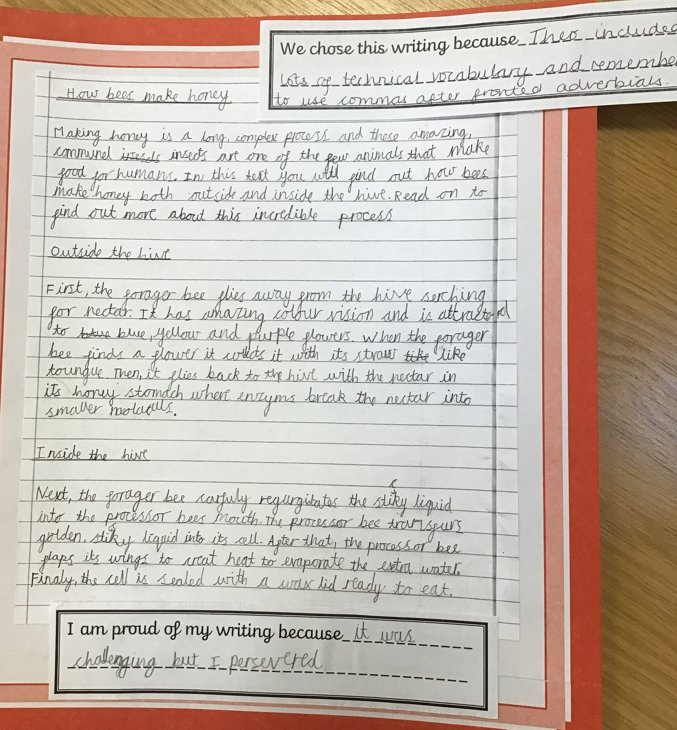
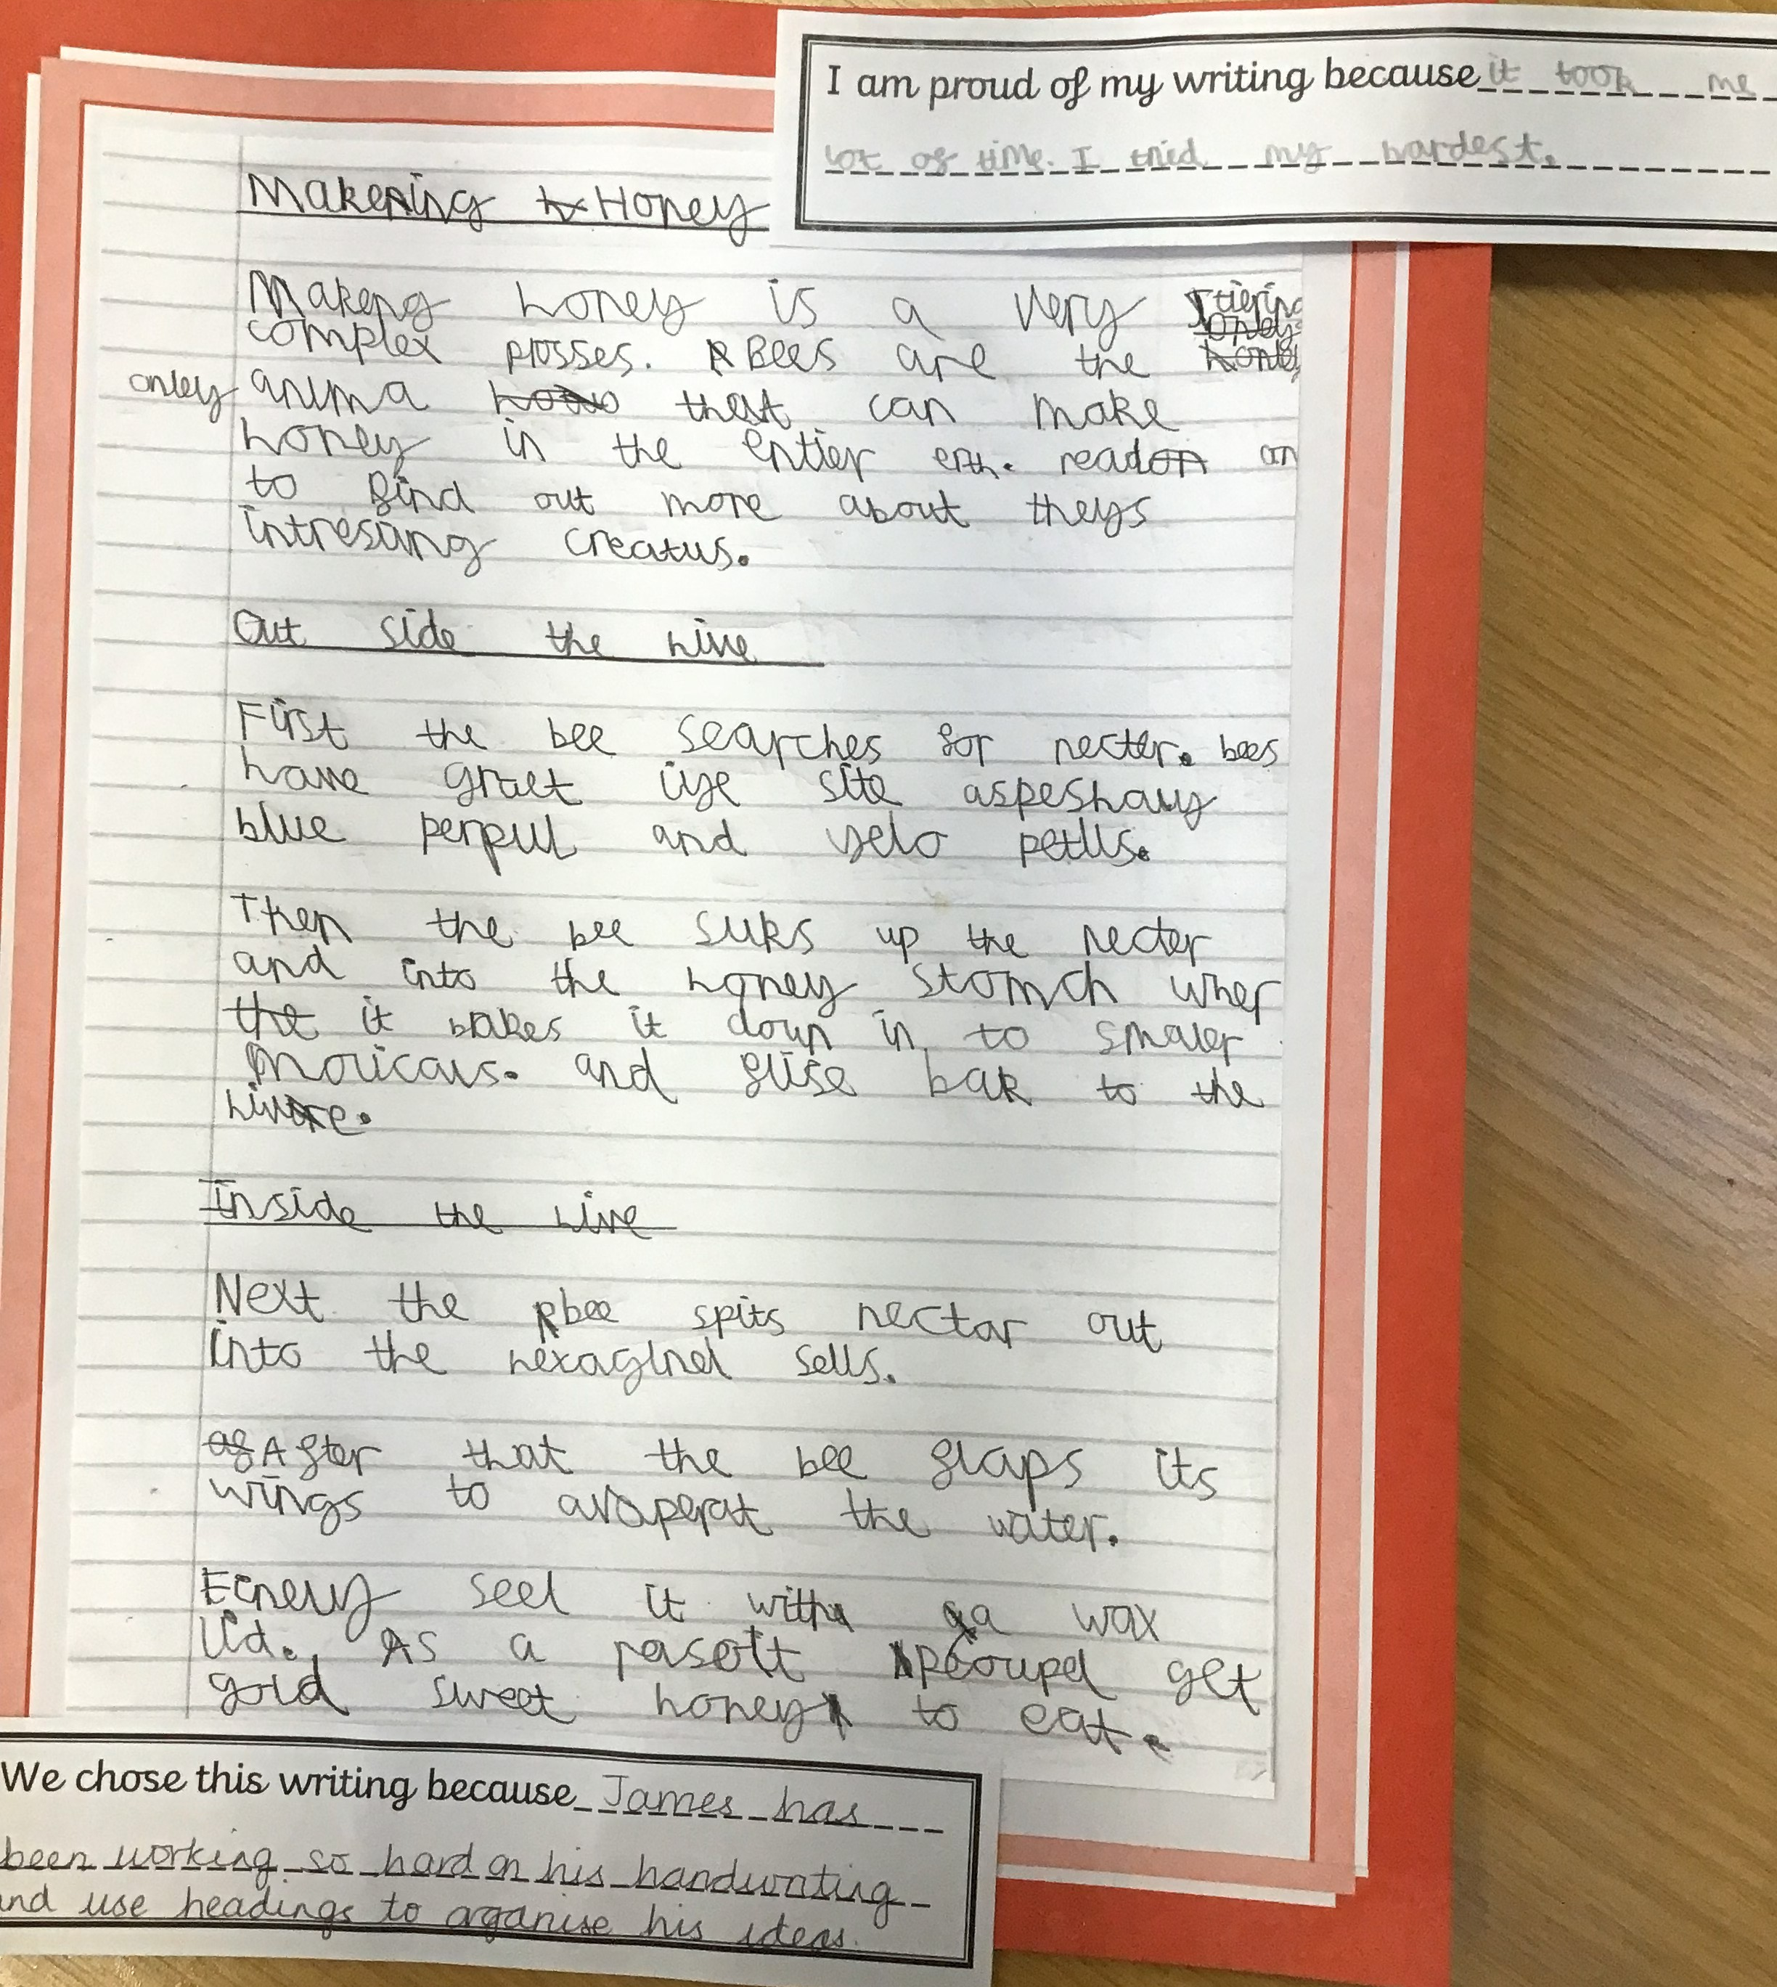
Oak Class – James and Theo

Slide 6
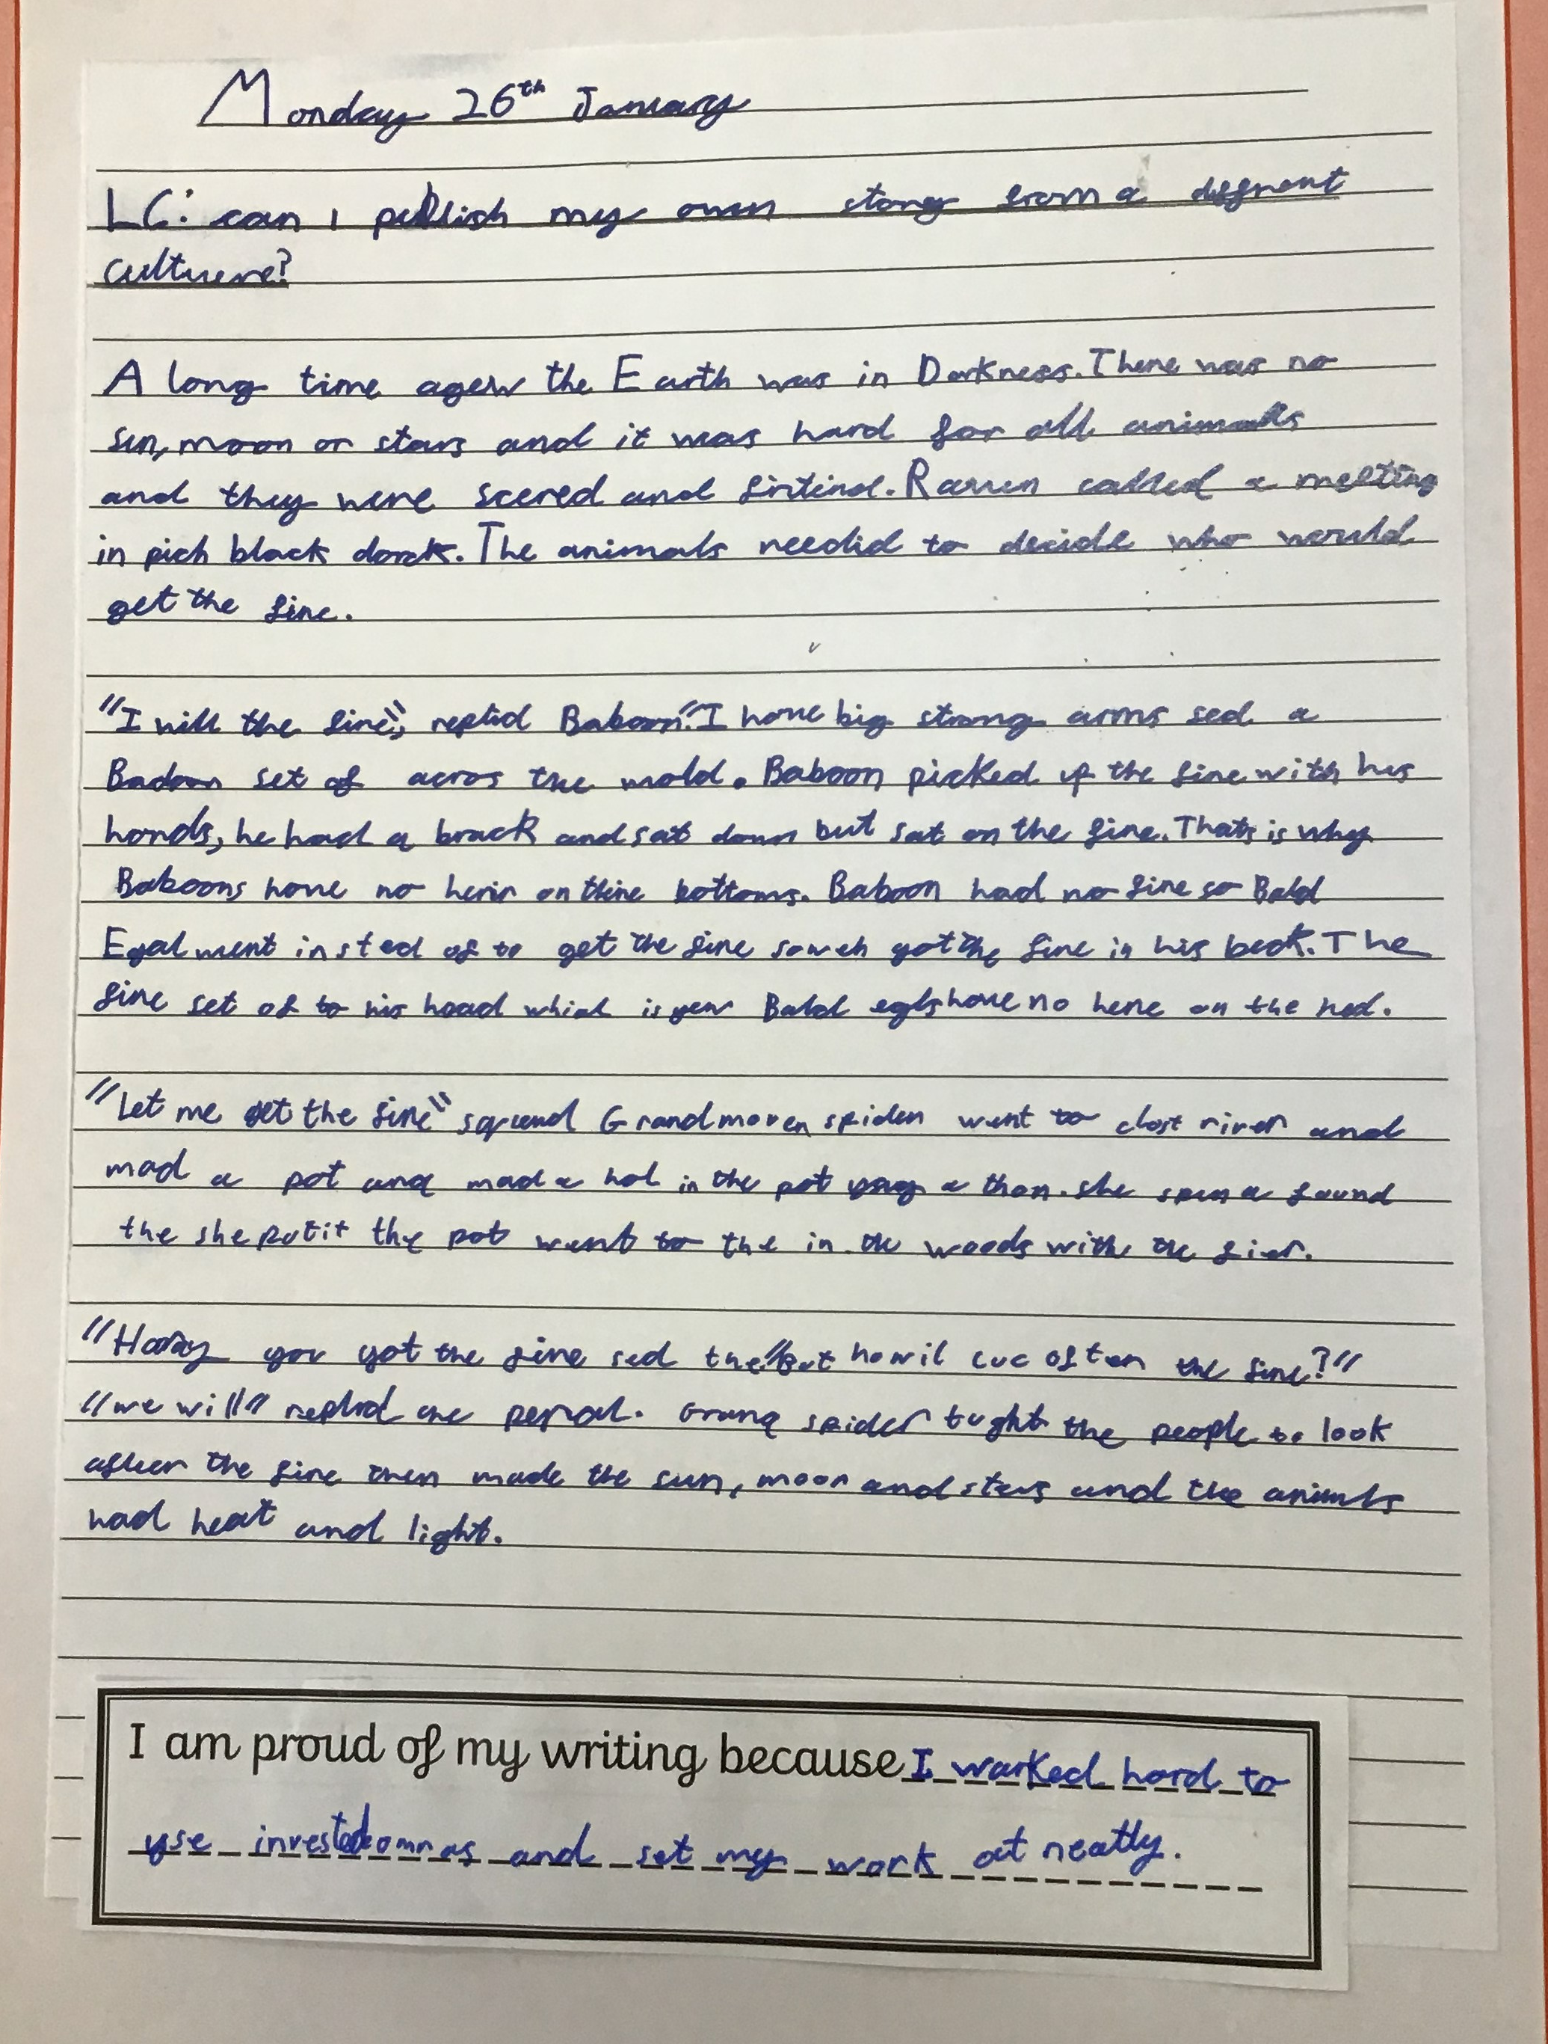
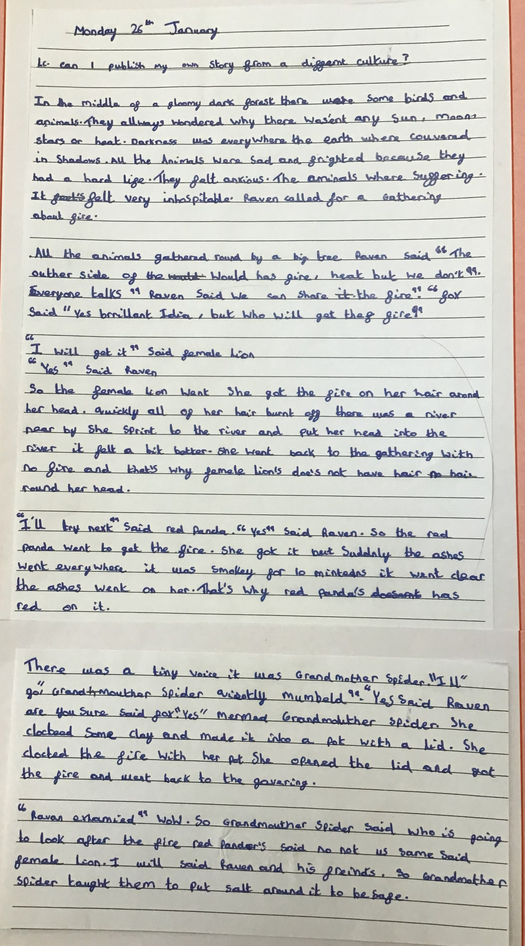
Pine Class – Harper and Hari

Slide 7
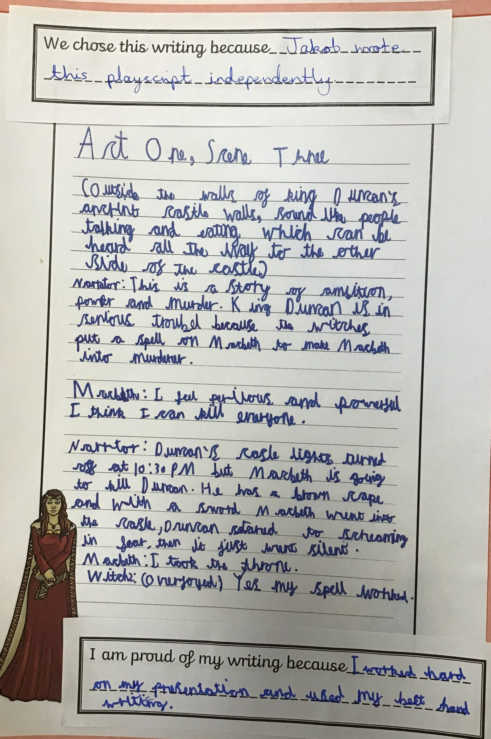
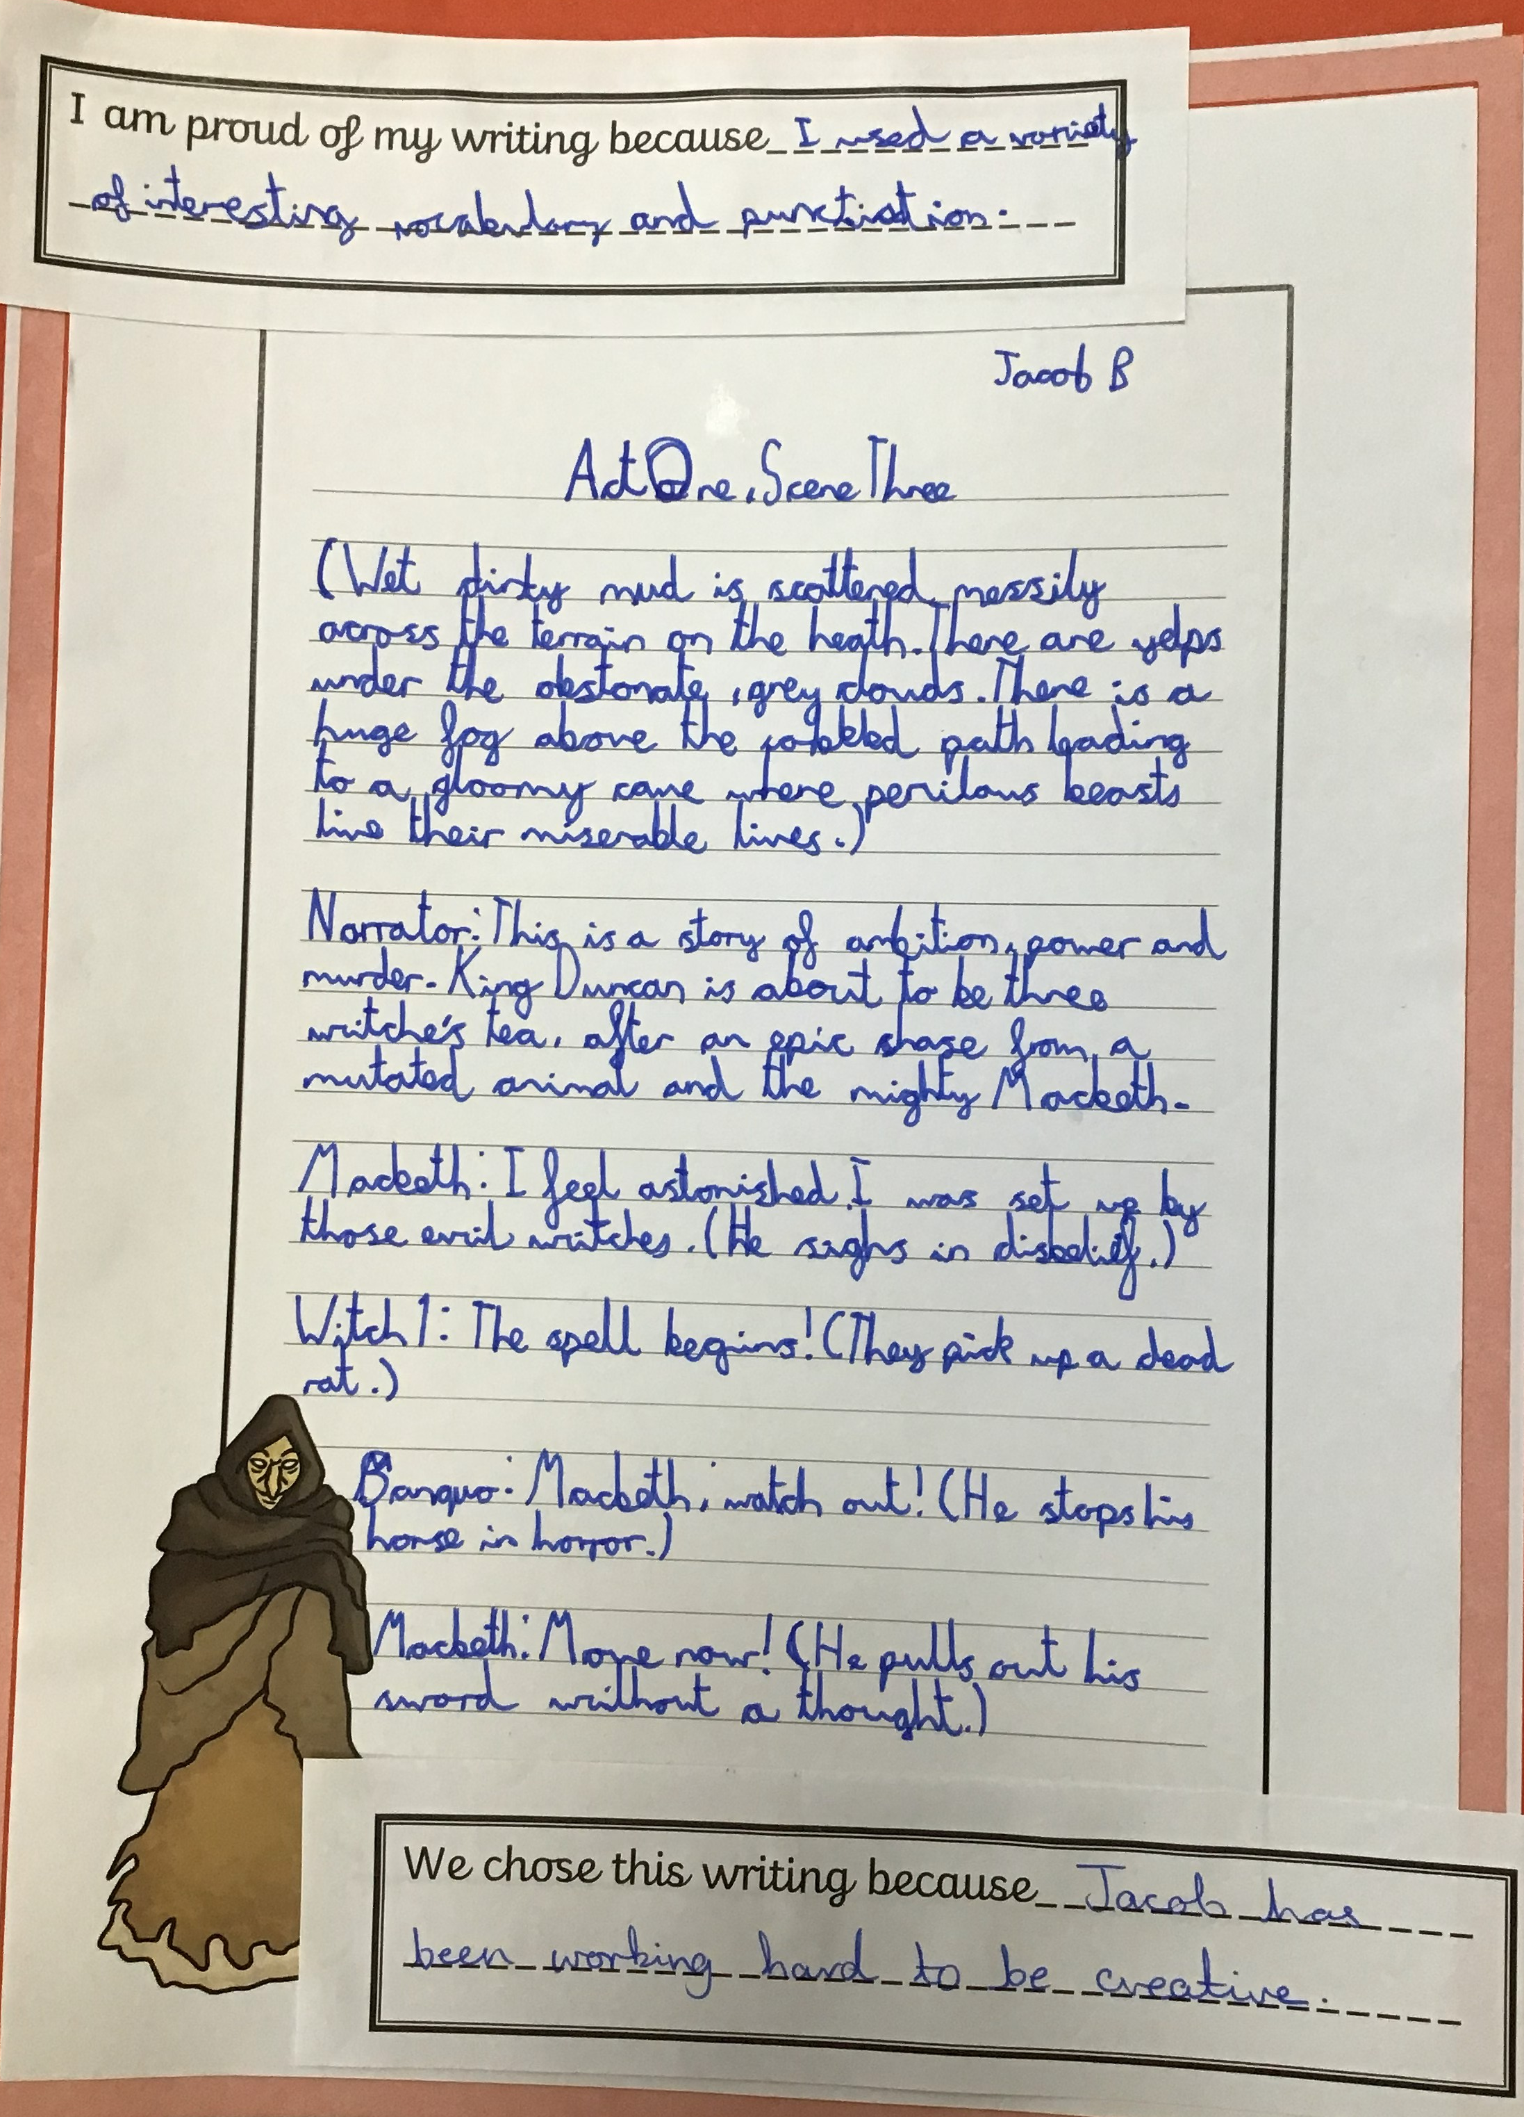
Willow Class – Jakob and Jacob B

Slide 8
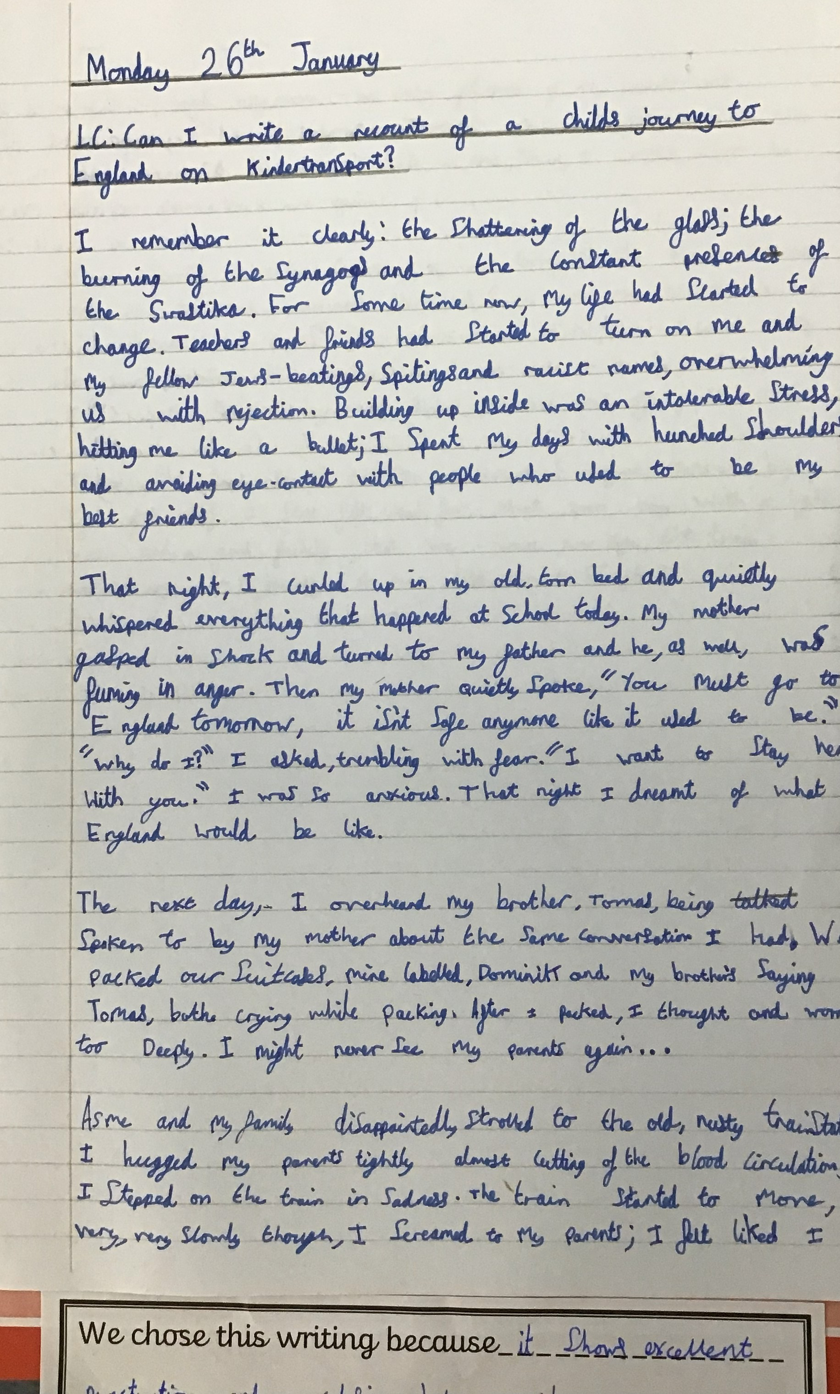
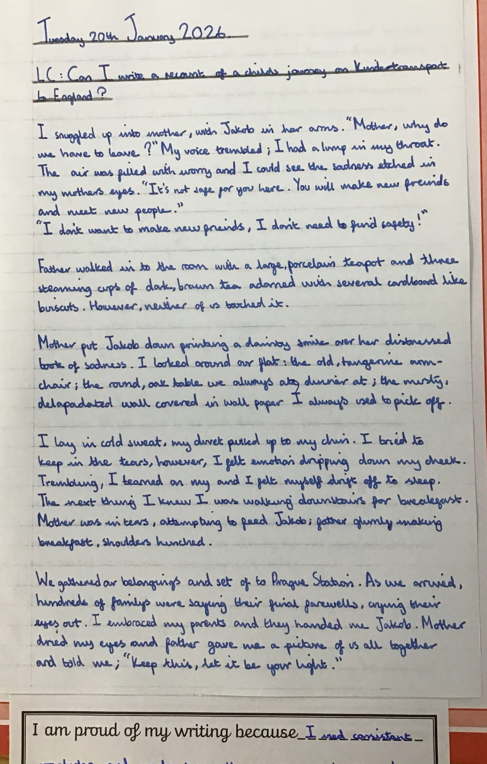
Fir Class –Matilda & Matthew

Slide 9
Thank you God for our school and for freedom to learn.
Help us to make it a place of happiness, thankfulness and peace;
A place where friendships are made and respect is shown to all;
A place where we can have courage to do our best;
A place where we can be honest with each other and ourselves;
And a place where we all work together to be the best that we can be.
Amen

