Slide 1
Year 3 Maths workshop
16.1.24

Slide 2
Has maths changed?
https://whiteroseeducation.com/parent-pupil-resources/maths/maths-with-michael#watch
Further videos in this series will be on the website after the workshop

Slide 3
What is maths mastery?
Mastering maths means pupils acquiring a deep, long-term, secure and adaptable understanding of the subject.
The phrase ‘teaching for mastery’ describes the elements of classroom practice and school organisation that combine to give pupils the best chances of mastering maths.
Achieving mastery means acquiring a solid enough understanding of the maths that’s been taught to enable pupils to move on to more advanced material.

Slide 4
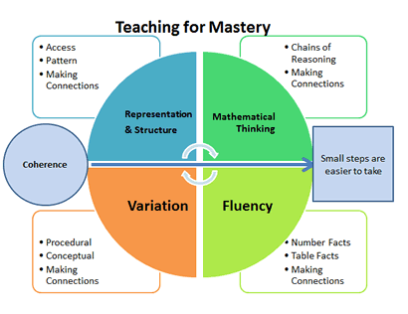
Five big ideas in teaching mastery

Slide 5

Ways not to overload working memory in maths
Subitise – recognise number patterns/groups and not only use counting
Know whole numbers
Learn number bonds etc. constantly even when you know them so that they are instantly remembered/pictured/represented in your long term memory for recall
Learn times tables over and over for instant recall and understanding.
Know equal parts of a whole number are fractions. Use the phrase ‘part of a whole’ in different ways e.g. a Lego brick is part of the whole model
Partition numbers using ones, tens, hundreds, thousands, hundred thousands. Know place value.

Slide 6
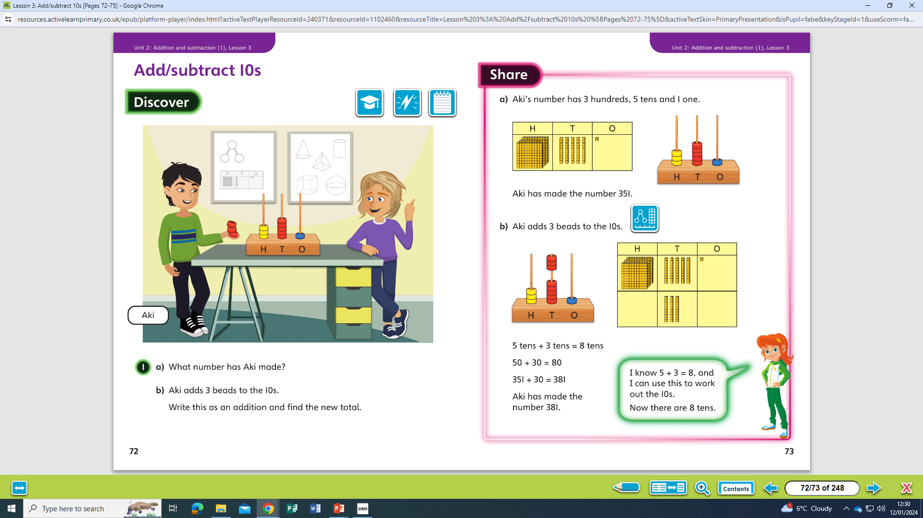
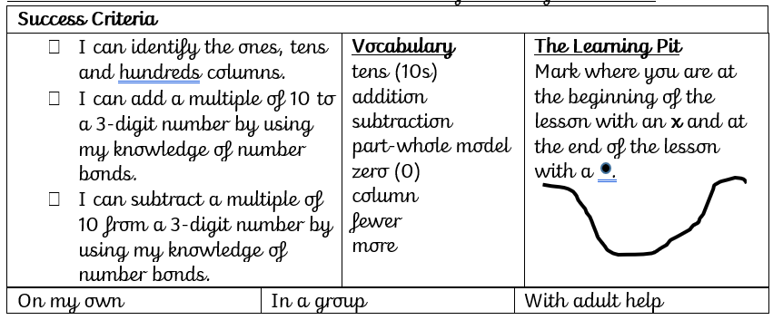
A mastery lesson using Powermaths
How do mathematicians add and subtract 10s from 3-digit numbers? (no exchange) Year 3, Unit 2, lesson 3
We will start by recapping previous learning. Then, introducing the session. We will complete the Discover activity, look at the picture together, share our methods and then complete the learning pit on our success criteria.
Children complete these as paired/individual work. Whole class discussion and view text book solution. Share. Drawing attention to the representations and encouraging children to draw, use models when solving a problem.

Slide 7
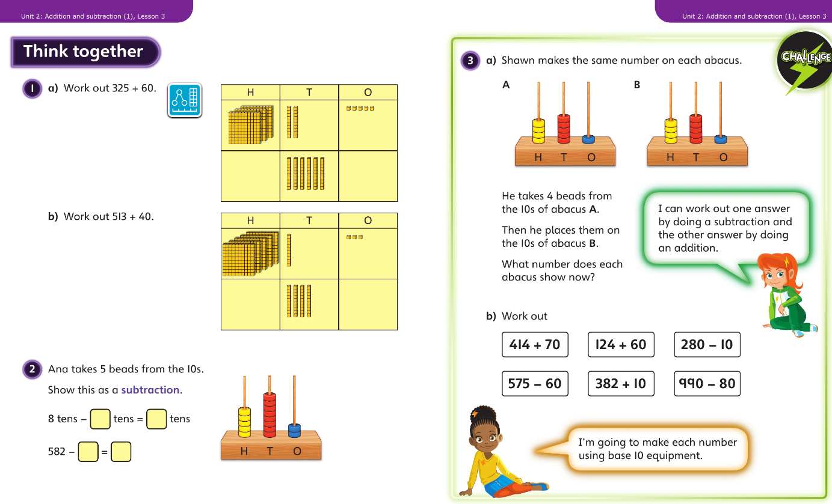
Children complete 'Think together' questions with their talk partners or individually, checking answers with the teacher once complete through a whole-class discussion. Children are encouraged to share their ideas, whether correct or not, to find the best way of solving the problems.

Slide 8
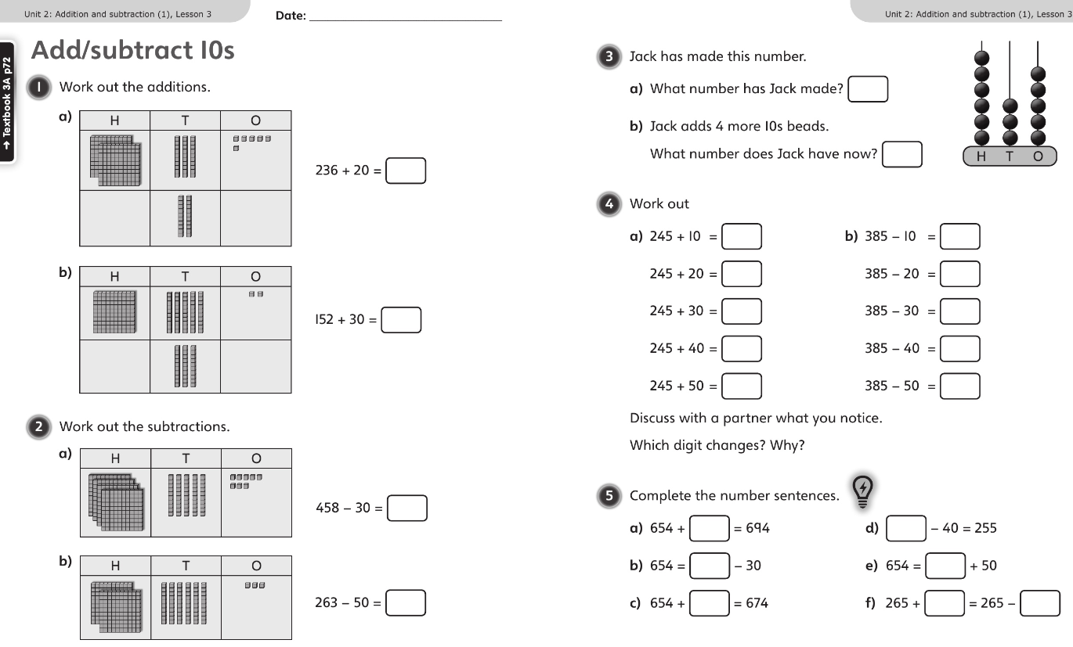
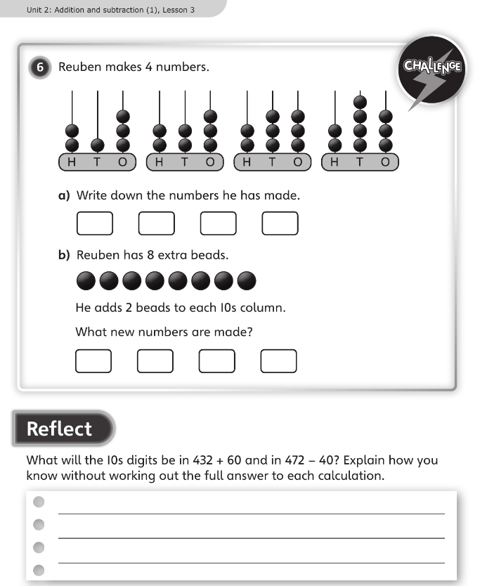
Most children should now feel confident enough to complete the questions in the workbook independently.
Some may work in a small group with an adult if needed.

Slide 9
Representations/equipment
Subitise
Tens frame
Number lines
100 square
Part whole model
Bar models
Base 10/dienes, ones, hundreds
Place value counters

Slide 10
Maths home learning support
Supporting and encouraging children with regular routines and good study habits
Managing time, working through problems step by step
Using maths in everyday life E.G. telling the time, using money, measuring
Using maths vocabulary with child and encouraging child to use it in a sentence

Slide 11
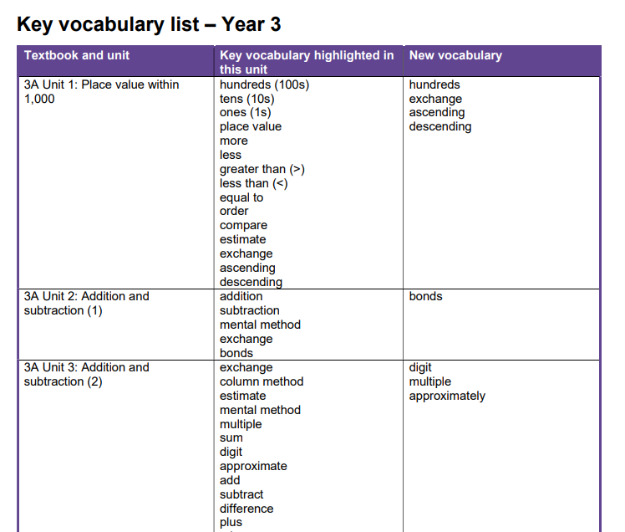
Vocabulary and using whole sentences
Practice explaining, saying and using maths vocabulary. For each year group and unit vocabulary on website.

Slide 12
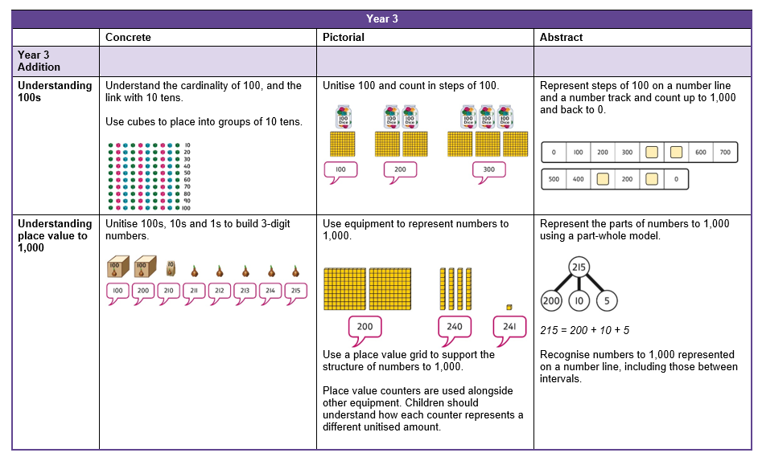
Calculation policies

