Slide 1

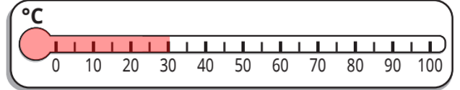
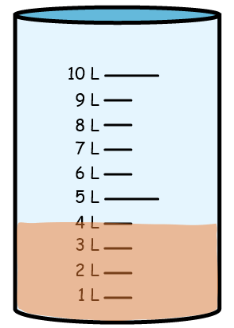
Year 2 | Week 1 | Day 1
1) What temperature is shown?
There are litres of juice.
3) Write the heights in order from shortest to tallest.
4) How many sides does
this shape have?
91 cm
70 cm
88 cm

Slide 2
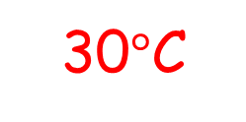
Year 2 | Week 1 | Day 1
30$°$C
1) What temperature is shown?
There are litres of juice.
3) Write the heights in order from shortest to tallest.
4) How many sides does
this shape have?
4
91 cm
70 cm
88 cm
70 cm
88 cm
91 cm
5 sides

Slide 3

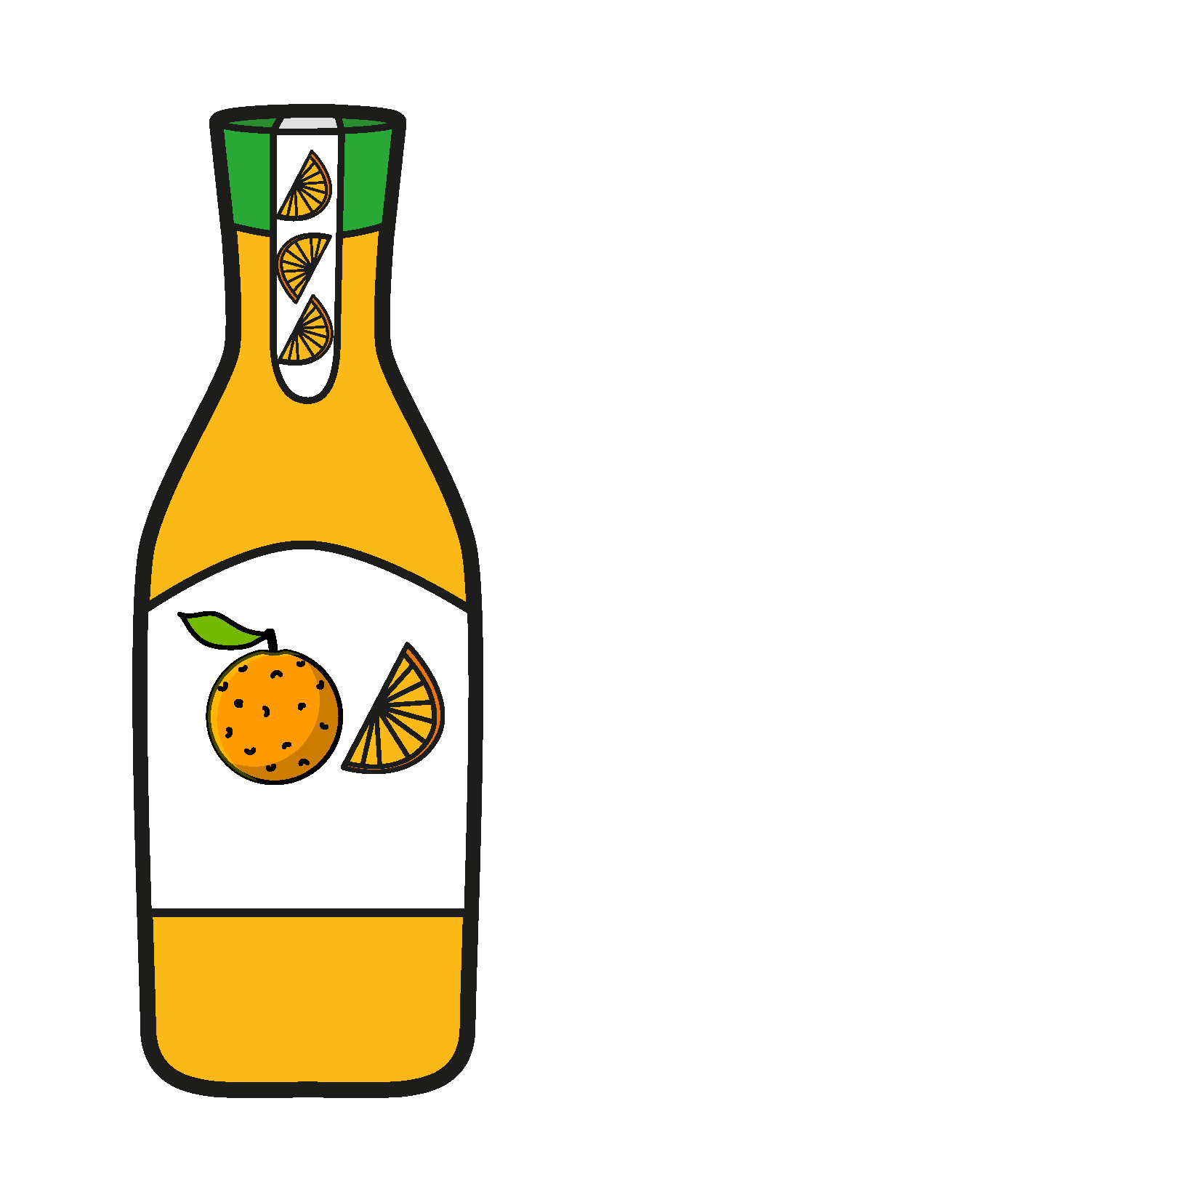
Year 2 | Week 1 | Day 2
1) The whole is
2) How much juice is there altogether?
3) A pencil is 20 cm long.
A pen is 8 cm longer.
How long is the pen?
4) How many vertices does this shape have?
5
10
5
2 l
2 l
2 l

Slide 4
Year 2 | Week 1 | Day 2
1) The whole is
2) How much juice is there altogether?
3) A pencil is 20 cm long.
A pen is 8 cm longer.
How long is the pen?
4) How many vertices does this shape have?
10
part
5
whole
10
5
part
6 litres
2 l
2 l
2 l
28 cm
6 vertices

Slide 5
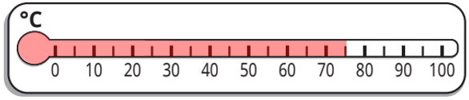
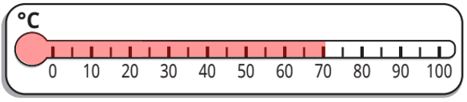
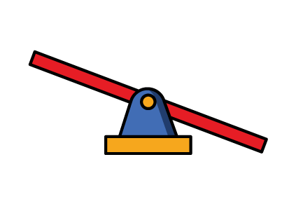

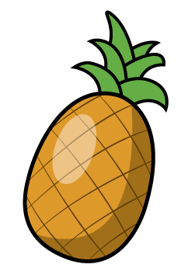
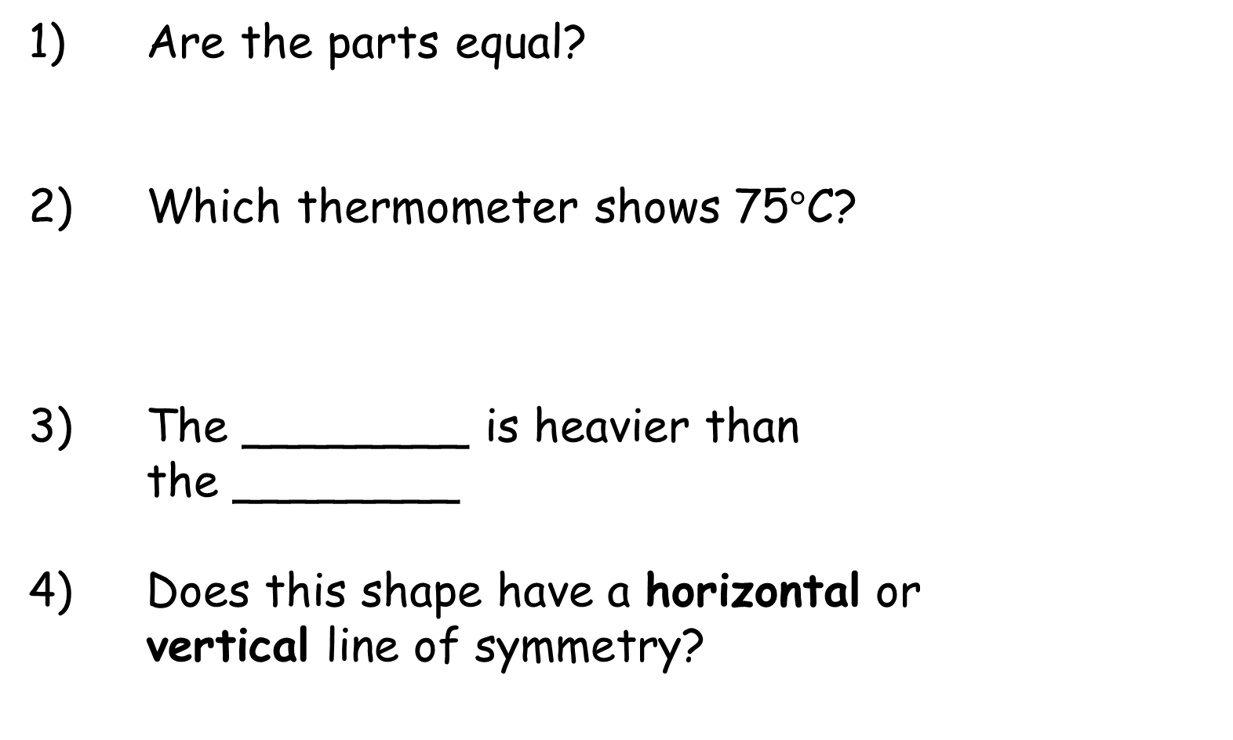
Year 2 | Week 1 | Day 3
1) Are the parts equal?
2) Which thermometer shows 75$°\text{C}$?
3) The ________ is heavier than the ________
4) Does this shape have a horizontal or vertical line of symmetry?
A
B

Slide 6
Year 2 | Week 1 | Day 3
1) Are the parts equal?
2) Which thermometer shows 75$°\text{C}$?
3) The ________ is heavier than the ________
4) Does this shape have a horizontal or vertical line of symmetry?
Yes
A
B
pineapple
lemon
vertical

Slide 7

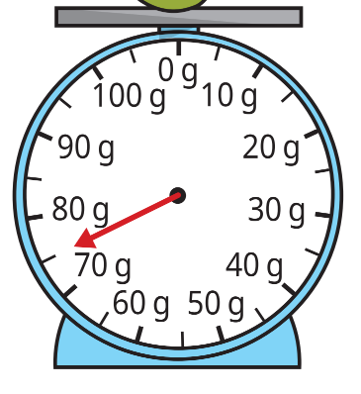

Year 2 | Week 1 | Day 4
1) The whole has been split
into ____ equal parts.
2) The parts are and
3) The bananas weigh
g.
4) How many faces does this shape have?
6
4 | 2

Slide 8
Year 2 | Week 1 | Day 4
1) The whole has been split
into ____ equal parts.
2) The parts are and
3) The bananas weigh
g.
4) How many faces does this shape have?
two
4
2
6
4 | 2
60
6 faces

Slide 9
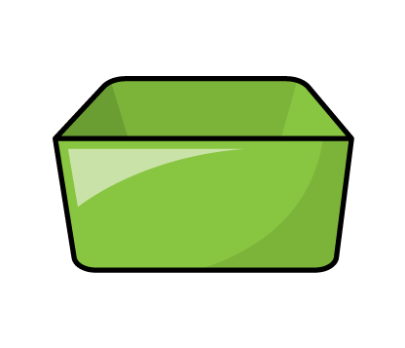
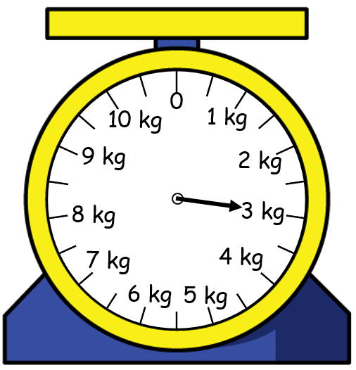

Year 2 | Week 1 | Day 5
1) Half of 20 is equal to
2) Does this shape have equal or unequal parts?
3) The box weighs kg
4) How many edges does this shape have?

Slide 10
Year 2 | Week 1 | Day 5
10
1) Half of 20 is equal to
2) Does this shape have equal or unequal parts?
3) The box weighs kg
4) How many edges does this shape have?
unequal parts
3
8 edges

