Slide 1


Year 2 | Week 2 | Day 1
1) Which shapes have been split into quarters?
2) Which shape has not been split into halves?
3) The mass of a carrot is 40 g.
The mass of a strawberry is 30 g less.
What is the mass of the strawberry?
4) A cube has vertices

Slide 2
Year 2 | Week 2 | Day 1
1) Which shapes have been split into quarters?
2) Which shape has not been split into halves?
3) The mass of a carrot is 40 g.
The mass of a strawberry is 30 g less.
What is the mass of the strawberry?
4) A cube has vertices
10 g
8

Slide 3


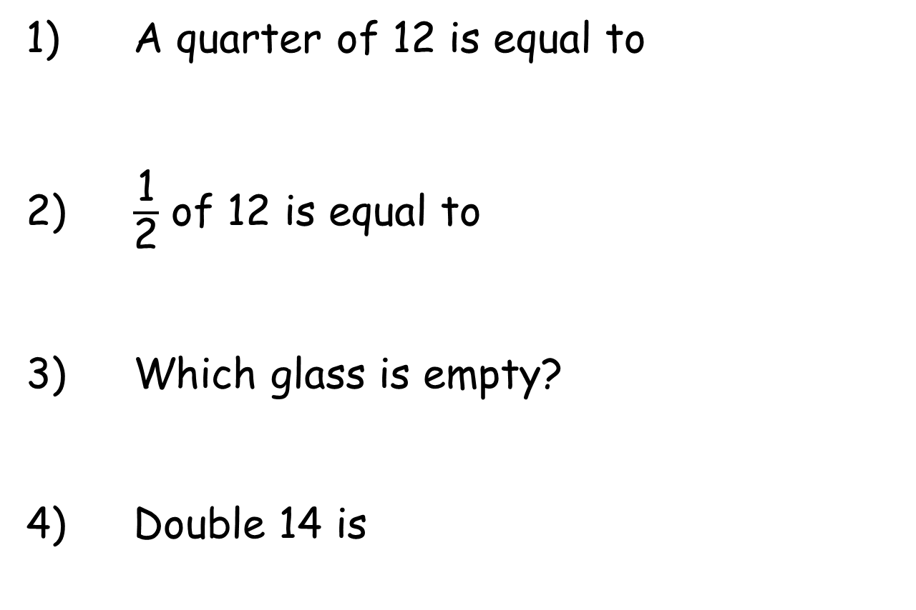
Year 2 | Week 2 | Day 2
1) A quarter of 12 is equal to
2) $\frac{\text{1}}{\text{2}}$ of 12 is equal to
3) Which glass is empty?
4) Double 14 is
A
B

Slide 4
Year 2 | Week 2 | Day 2
1) A quarter of 12 is equal to
2) $\frac{\text{1}}{\text{2}}$ of 12 is equal to
3) Which glass is empty?
4) Double 14 is
3
6
A
B
28

Slide 5
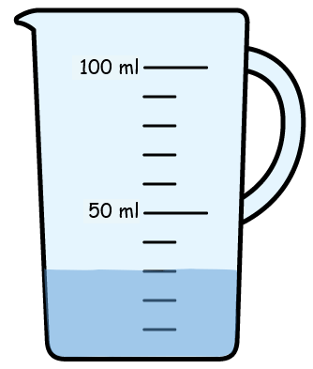
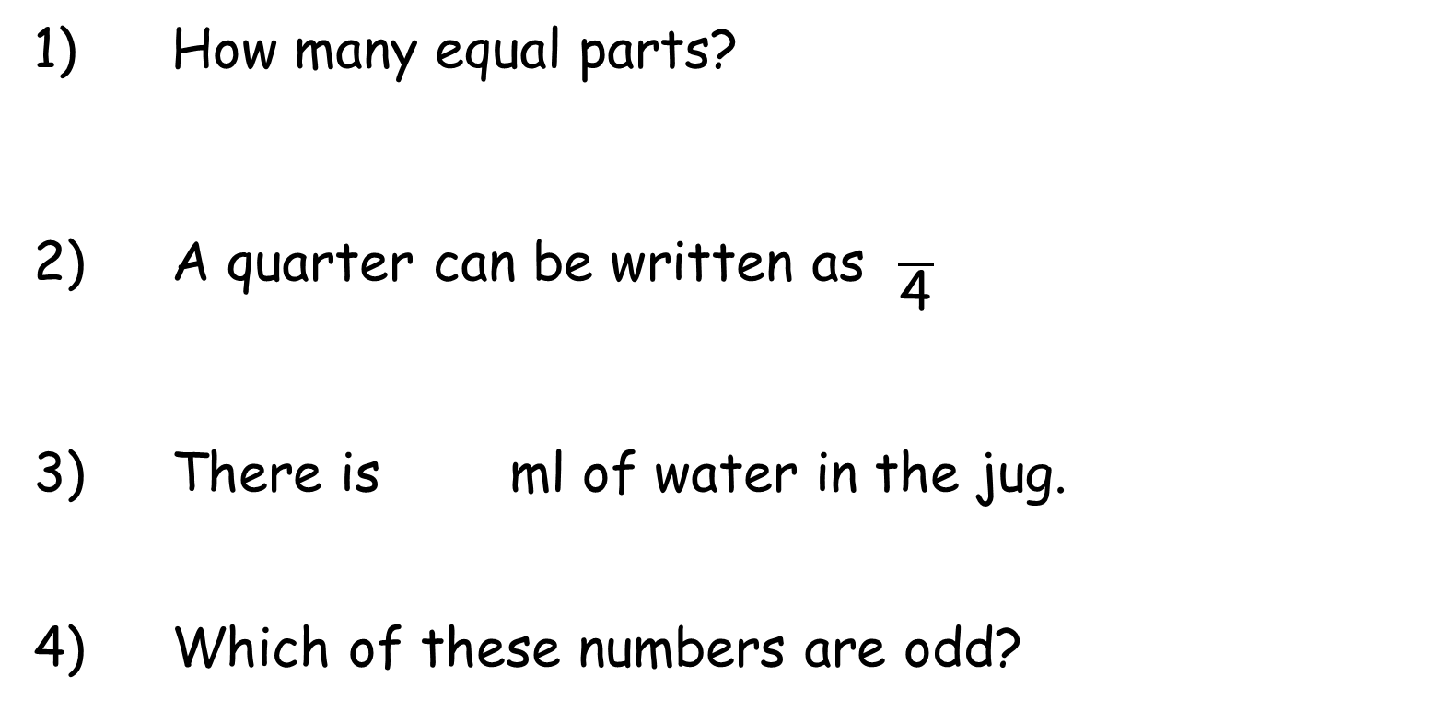
Year 2 | Week 2 | Day 3
1) How many equal parts?
2) A quarter can be written as $\frac{}{\text{4}}$
3) There is ml of water in the jug.
4) Which of these numbers are odd?
4
7
13
21
20

Slide 6
Year 2 | Week 2 | Day 3
1) How many equal parts?
2) A quarter can be written as $\frac{}{\text{4}}$
3) There is ml of water in the jug.
4) Which of these numbers are odd?
3 equal parts
1
30
4
7
7
13
13
21
21
20

Slide 7
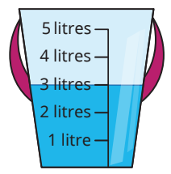
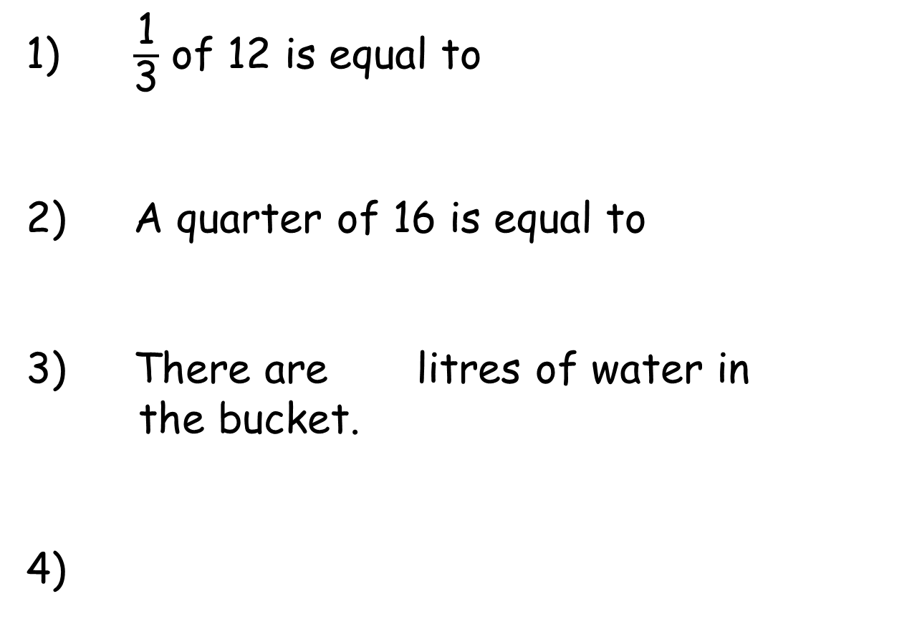
Year 2 | Week 2 | Day 4
1) $\frac{\text{1}}{\text{3}}$ of 12 is equal to
2) A quarter of 16 is equal to
3) There are litres of water in
the bucket.
4)
5 litres
4 litres
3 litres
2 litres
1 litre
10 | 20 |  | 40

Slide 8
Year 2 | Week 2 | Day 4
1) $\frac{\text{1}}{\text{3}}$ of 12 is equal to
2) A quarter of 16 is equal to
3) There are litres of water in
the bucket.
4)
4
4
5 litres
4 litres
5
3 litres
2 litres
1 litre
10 | 20 |  | 40
30
50
60

Slide 9
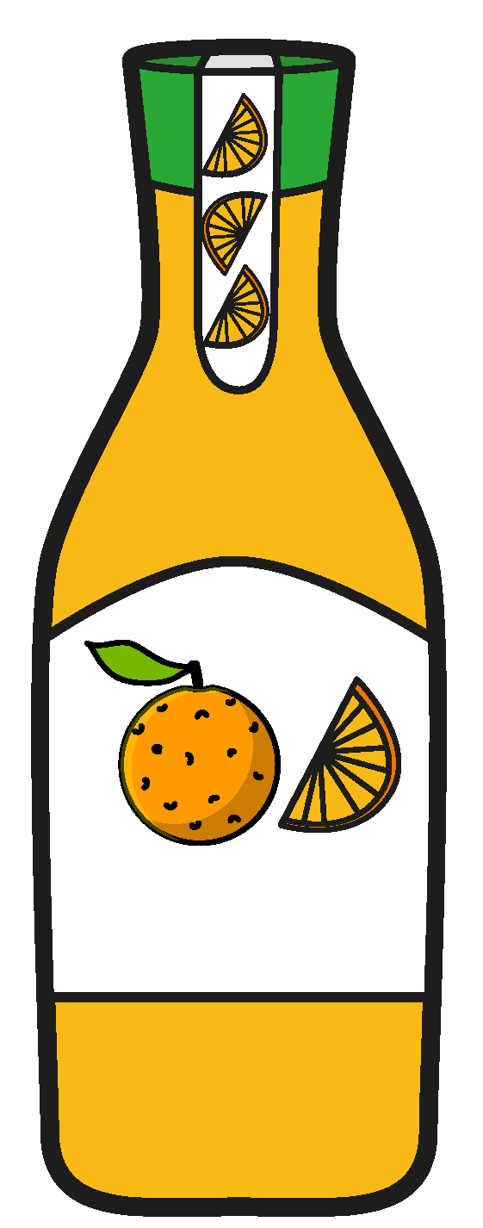
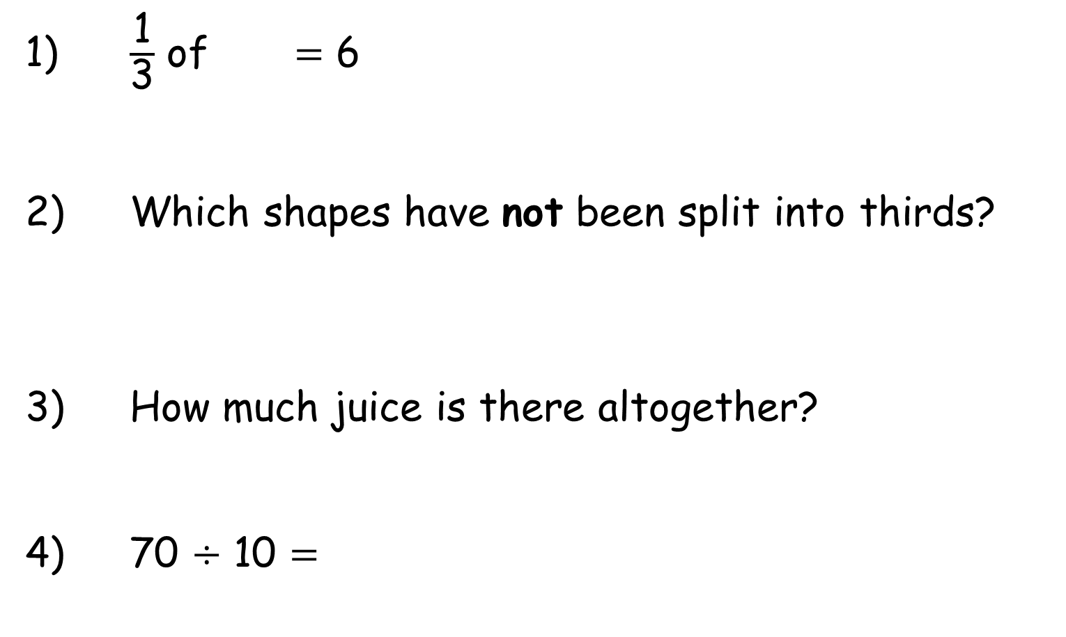
Year 2 | Week 2 | Day 5
1) $\frac{\text{1}}{\text{3}}$ of $=$ 6
2) Which shapes have not been split into thirds?
3) How much juice is there altogether?
4) 70 $÷$ 10 $=$
2 l
2 l
2 l
5 l

Slide 10
Year 2 | Week 2 | Day 5
1) $\frac{\text{1}}{\text{3}}$ of $=$ 6
2) Which shapes have not been split into thirds?
3) How much juice is there altogether?
4) 70 $÷$ 10 $=$
18
11 litres
2 l
2 l
2 l
5 l
7

Slide 11
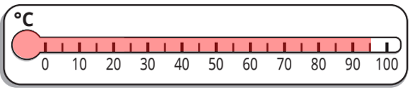
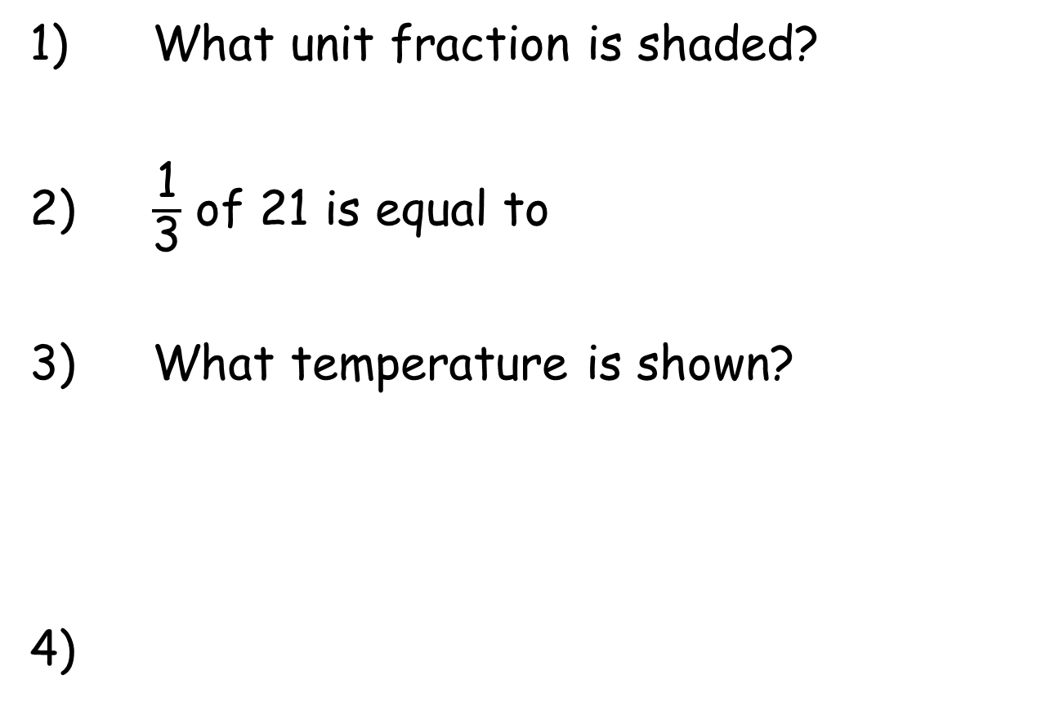
Year 2 | Week 3 | Day 1
1) What unit fraction is shaded?
2) $\frac{\text{1}}{\text{3}}$ of 21 is equal to
3) What temperature is shown?
4)
35 | 30 | 25

Slide 12
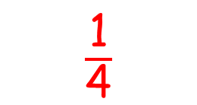
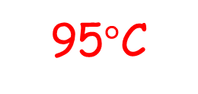
Year 2 | Week 3 | Day 1
1) What unit fraction is shaded?
2) $\frac{\text{1}}{\text{3}}$ of 21 is equal to
3) What temperature is shown?
4)
$\frac{\text{1}}{\text{4}}$
7
95$°\text{C}$
35 | 30 | 25
20
15
10

Slide 13
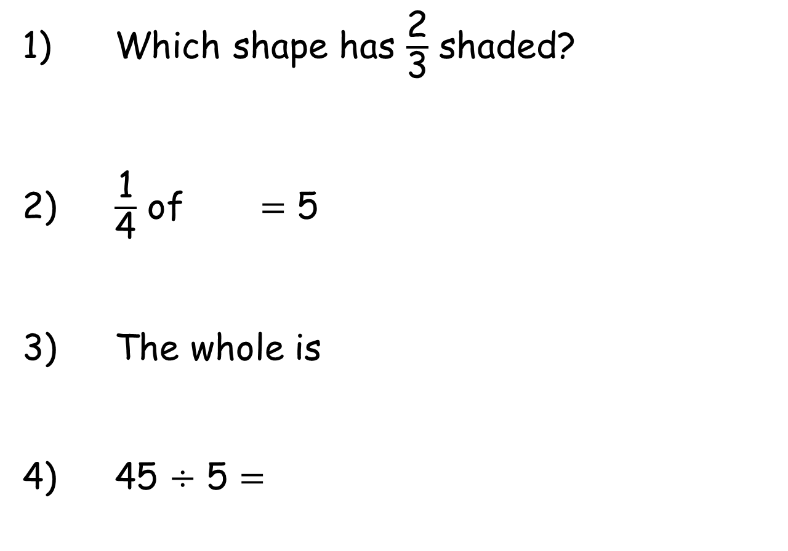
Year 2 | Week 3 | Day 2
1) Which shape has $\frac{\text{2}}{\text{3}}$ shaded?
2) $\frac{\text{1}}{\text{4}}$ of $=$ 5
3) The whole is
4) 45 $÷$ 5 $=$
12
10 | 2

Slide 14
Year 2 | Week 3 | Day 2
1) Which shape has $\frac{\text{2}}{\text{3}}$ shaded?
2) $\frac{\text{1}}{\text{4}}$ of $=$ 5
3) The whole is
4) 45 $÷$ 5 $=$
20
whole
12
10 | 2
12
part
part
9

Slide 15





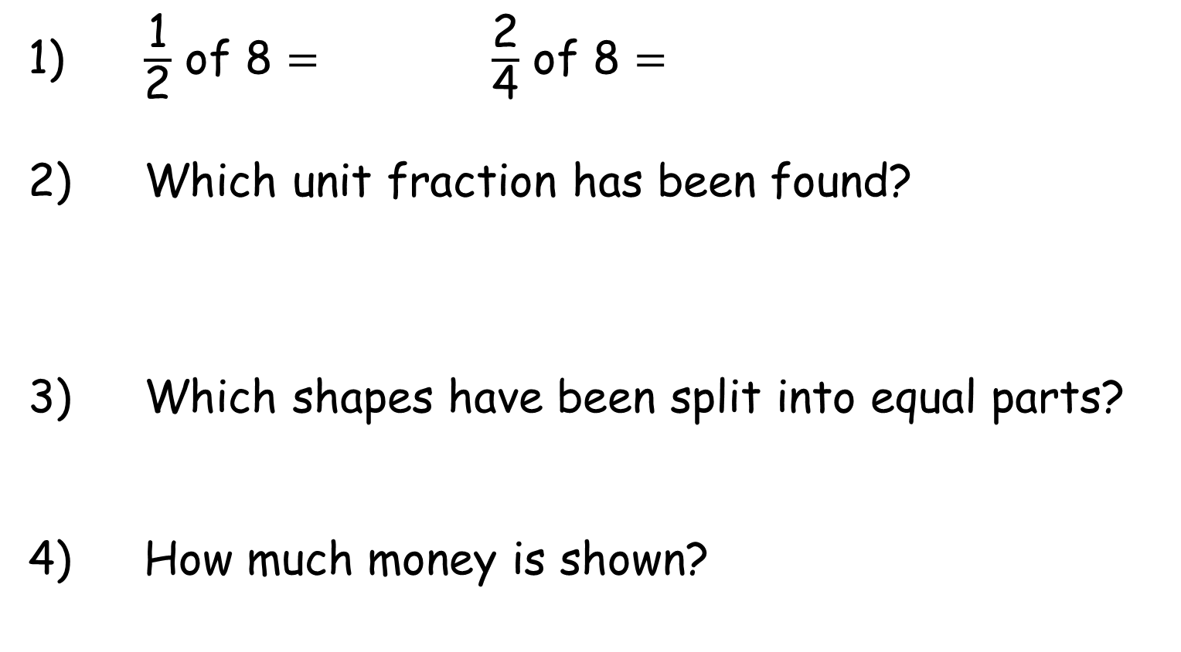
Year 2 | Week 3 | Day 3
1) $\frac{\text{1}}{\text{2}}$ of 8 $=$ $\frac{\text{2}}{\text{4}}$ of 8 $=$
2) Which unit fraction has been found?
3) Which shapes have been split into equal parts?
4) How much money is shown?

Slide 16
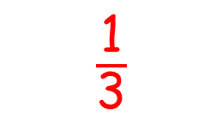
Year 2 | Week 3 | Day 3
1) $\frac{\text{1}}{\text{2}}$ of 8 $=$ $\frac{\text{2}}{\text{4}}$ of 8 $=$
2) Which unit fraction has been found?
3) Which shapes have been split into equal parts?
4) How much money is shown?
4
4
$\frac{\text{1}}{\text{3}}$
53p

Slide 17


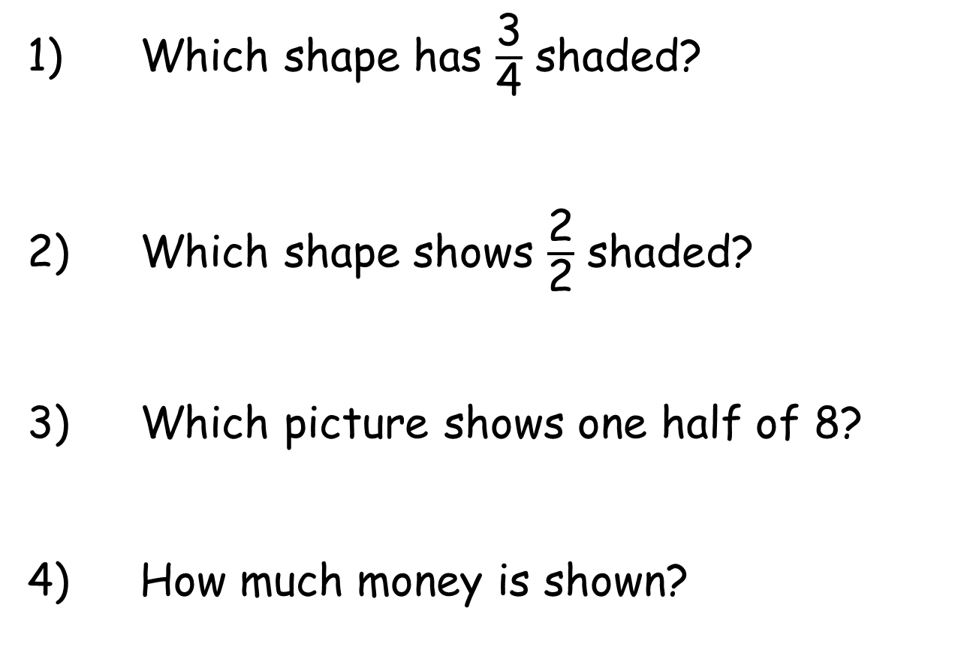
Year 2 | Week 3 | Day 4
1) Which shape has $\frac{\text{3}}{\text{4}}$ shaded?
2) Which shape shows $\frac{\text{2}}{\text{2}}$ shaded?
3) Which picture shows one half of 8?
4) How much money is shown?
A
B

Slide 18
Year 2 | Week 3 | Day 4
1) Which shape has $\frac{\text{3}}{\text{4}}$ shaded?
2) Which shape shows $\frac{\text{2}}{\text{2}}$ shaded?
3) Which picture shows one half of 8?
4) How much money is shown?
A
B
£14

Slide 19



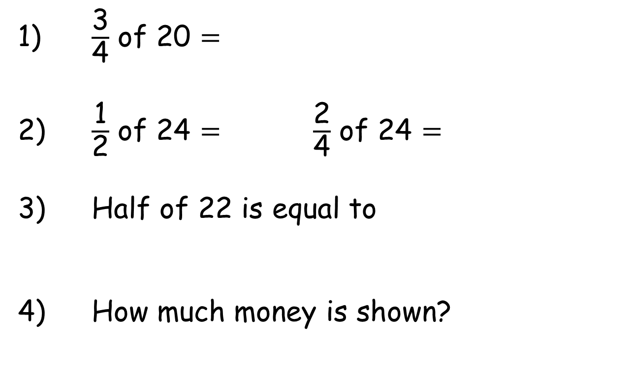
Year 2 | Week 3 | Day 5
1) $\frac{\text{3}}{\text{4}}$ of 20 $=$
2) $\frac{\text{1}}{\text{2}}$ of 24 $=$ $\frac{\text{2}}{\text{4}}$ of 24 $=$
3) Half of 22 is equal to
4) How much money is shown?

Slide 20
Year 2 | Week 3 | Day 5
1) $\frac{\text{3}}{\text{4}}$ of 20 $=$
2) $\frac{\text{1}}{\text{2}}$ of 24 $=$ $\frac{\text{2}}{\text{4}}$ of 24 $=$
3) Half of 22 is equal to
4) How much money is shown?
15
12
12
11
£6 and 72p

