Slide 1
Welcome to our Parent Reading Workshop

Slide 2
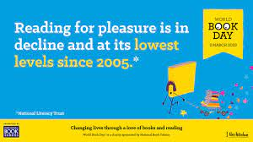
The survey of 71,400 children and young people by the National Literacy Trust early in 2023 has revealed that fewer than one in three children (28%) aged eight to 18 read daily for enjoyment.

Slide 3
Impact of reading
Amount of reading | 20 mins | 5 mins | 1 min
Number of minutes per year | 3600 | 900 | 180
Number of words per year | 1.8 Million | 282,000 | 8000
Hours read by the end of primary school | 851 | 212 | 42
Performance on tests | 90% | 50% | 10%

Slide 4
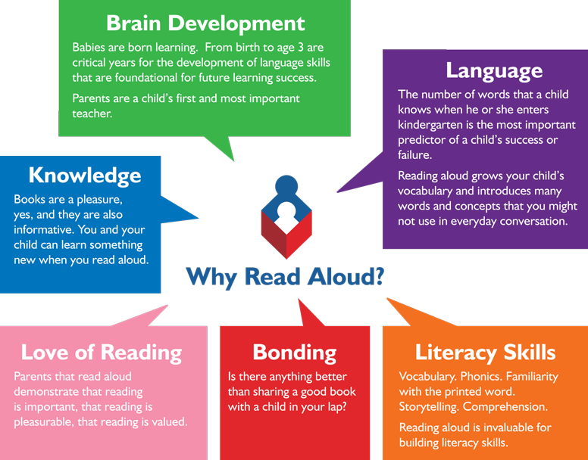
Reading from an early age and securing phonics
Reading from an early age is important.
In order to get children fluent in reading, their phonic knowledge must be embedded.
Read to children from day zero!

Slide 5
What is fluency and why is it important?
Fluent reading supports reading comprehension. When pupils read fluently, their cognitive resources can be redirected from focusing on decoding and onto comprehending the text.
For a child to be fluent, phonic knowledge is important.
When a child is fluent, we can focus on understanding and comprehension.
When comprehension is secure, the child will enjoy what they read.

Slide 6
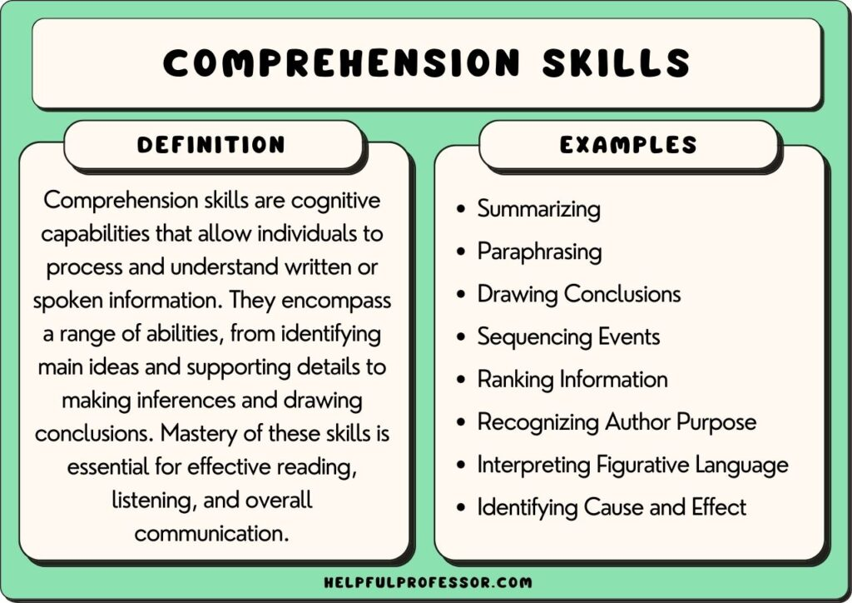
What is comprehension?
This refers to the understanding of a text.
There are cases of where children are able to read thanks to secure phonics knowledge and the ability to decode but do not understand what they have read.

Slide 7
Reading with your older child
Your child should read to you. You could ask questions to check their understanding of the text.
Adults should also read books to children – including books that cannot be read by them independently.
Activities to build on fluency: – let’s have a go by looking at a page from our class reader.
Understand new vocabulary.
Clarify meaning, asking ‘who’ , ‘what’, ‘where’, ‘when’, ‘why’ and ‘how’ questions.
Make predictions and explain ideas.

Slide 8
Three ways you can help build fluency at home…
Read and follow – the adult reads the text and the child follows along with their finger. This helps the child with word recognition and models to them how they should read with fluency.
My turn, your turn – take turns reading a page, paragraph or sentence. Here you are modelling how to read with fluency, flow and expression.
Echo Reading – as you read, the child copies. It is important here to pace yourself and read at a rate that your child can keep up with.

Slide 9
What you can do to help develop comprehension…
  Talking a lot at home… about everything
  Develop cultural capital by going out (this does not have to cost money)
  Reading together and discussing books together
  Why do you like this book?
  What do you think will happen next?
  What do you think about this character?

Slide 10
Whole-class reading at St. Nicolas’

Slide 11
Vocabulary -
Interpreting words in context and deciphering the meaning of words unknown based on the context they are written.
Mr Ali loathes wearing a tie as he finds it uncomfortable.
We may not know the meaning of the word ‘loathe’ here but based on the context and other evidence within the sentence, we can guess it means ‘doesn’t like’. How have I arrived at this conclusion?

Slide 12
Inference is an interpretation that goes beyond the literal information given and relies on the evidence within the text as well as background knowledge.
The bike lay on the floor next to her as she held her leg and cried.
We could infer that the girl fell off her bike.

Slide 13
Predict – what has or what will happen based on information stated or inferred (linked closely to inference). Again, background knowledge here is important.
Beowulf snatched his sword from the armoury and ran towards the mountains.
  What do predict Beowulf is going to do? What evidence have you used to make your prediction?
Predictions, like inferences are neither right or wrong, they may be strong (with secure evidence to back them up) or weak (with little or poor evidence to back them up).

Slide 14
Retrieve
Retrieval of information is often the information out of the text that they have just read. E.g.
What was the character’s name?
What did they eat for dinner?
What colour was the car?
What time did…
Summary -
Summarise main ideas from more than one paragraph
  What is the main point of the first paragraph?
  What heading would be appropriate for this paragraph?

Slide 15
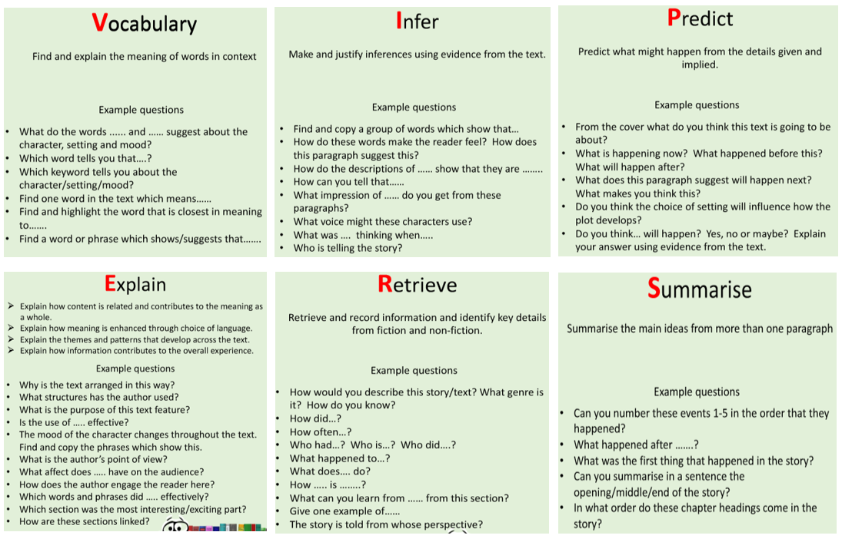
Questions you can ask at home…

Slide 16
What reading at home looks like
Reading is best in a quiet space
Find a time that works best for you and your child – routines!
Children need to be reading aloud to an adult – this is still important higher up the school as helps fluency – though doesn’t need to be every night!
Don’t make it a stressful experience – 1 page is better than no page!
Ask questions after your child has read.
Encourage children to re-read books, this develops their fluency.
Read books to your children (audio books in the car, a book on the go before bed).

Slide 17
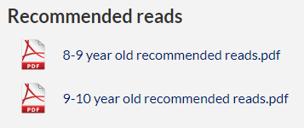
How to encourage reading at home
Show that you love reading – be a good role model
Take your child to the library regularly
Book swaps between friends
Expose children to texts beyond novels. E.g. comics, magazines, non-fiction books
Read to a pet
Take control of how screen time is used
Give children books that matter to them (hobbies, authors and characters, texts that excite them)
The year 5 class page has recommended reads

Slide 18
In your packs…
Example questions you can ask at home 8-9 year old recommended reads 9-10 year old recommended reads Top tips for reading with your child at home

Slide 19
Any questions?

