Slide 1
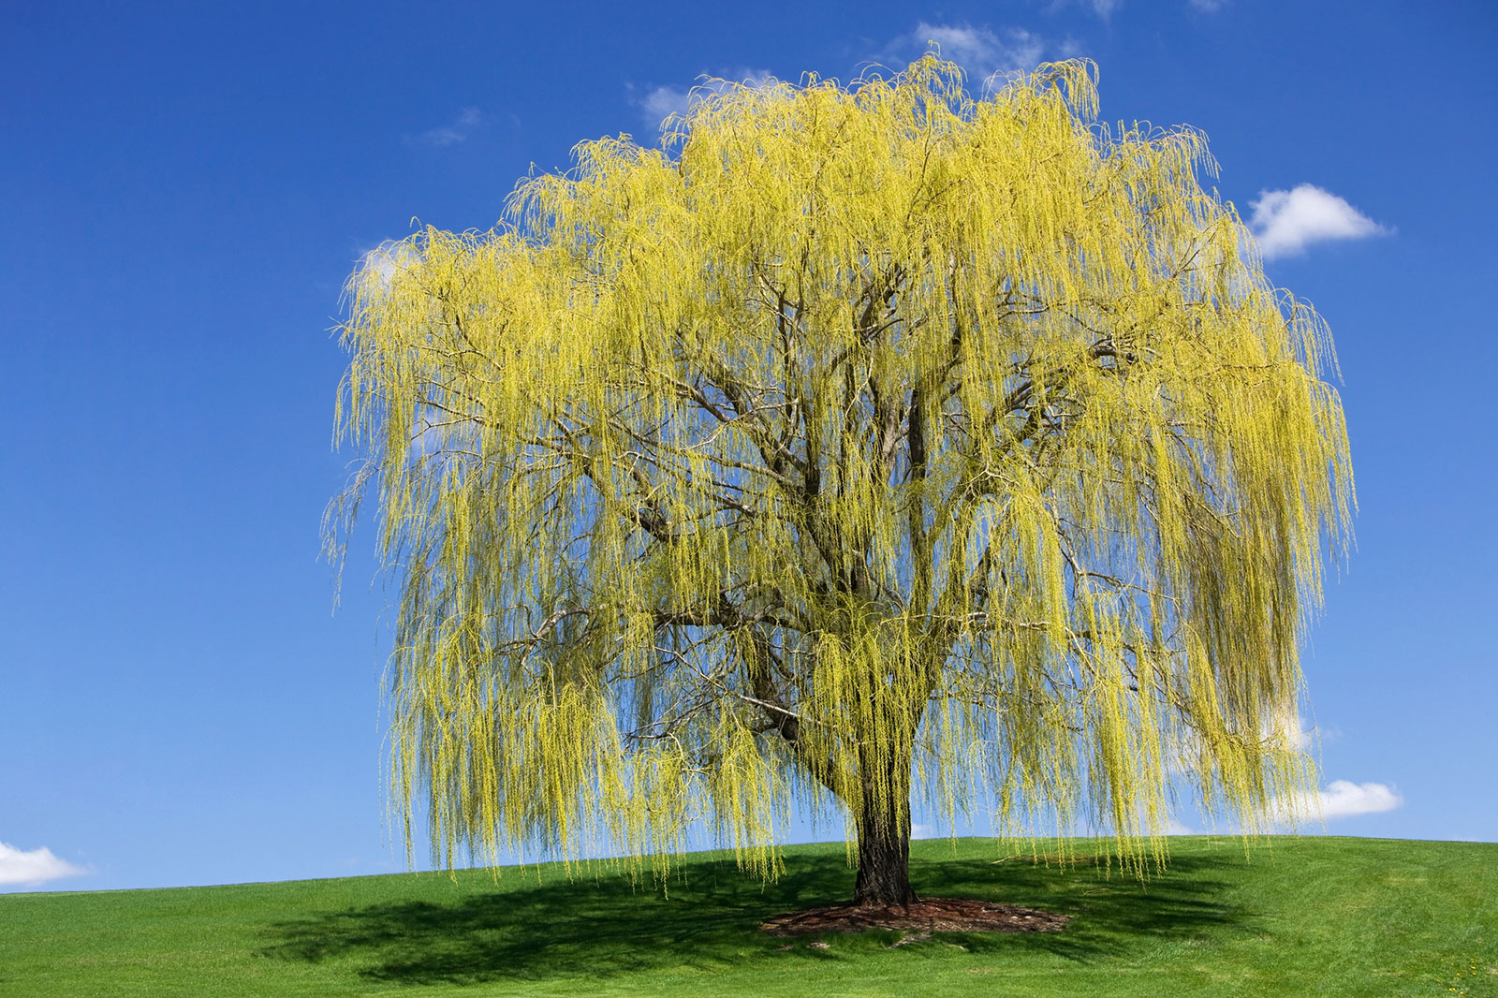


Welcome to Willow class

Slide 2
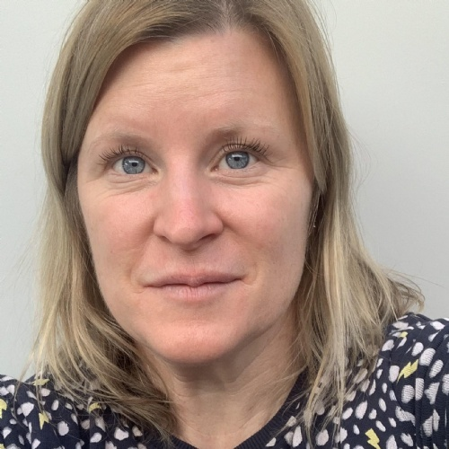
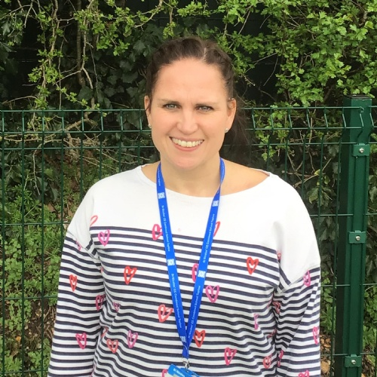
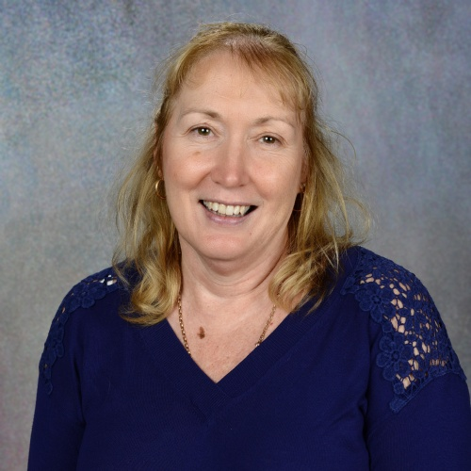
Who will be working with your child?
Mrs Barnes – Tuesday to Friday
Mrs Louth - Monday
Mrs Brown - Class TA

Slide 3




A few things to look forward to…
Trips – Maidenhead mosque, Winchester Science museum
Sculpture inspired by Augusta Savage’s body of work.
In maths we have the new topics of percentages, non-metric units e.g., inches, pounds and pints and interpreting complex timetables.
In RE we will explore Christianity, Islam and non-religious world views
The Tudors, The Ancient Greeks, Rivers and Map Skills
Engaging class reads

Slide 4

Working together equally keeps the triangle strong: supporting good learning and mental health.
We can’t do it without you!

Slide 5
RE trips to local places of worship
Each class will be visiting local places of worship for observation of religious practices.
This first hand learning is beneficial to the children as they learn from what they observe.
We visit to observe, not to participate in. Like our school vine we explore that everyone is different, we are all human, we are all unique and we grow and change in our thoughts, ideas and beliefs.

Slide 6


Reading
“Reading is the key that opens doors to many good things in life”
— Ruth Bader Ginsburg
Stories help children to understand the world around them and explore emotions, challenging topics and perspectives.
Reading to your child helps them to learn more vocabulary and promotes discussion.
Reading together is a great way to have that meaningful emotional and physical connection with your child every day.
By having bedtime stories as part of your nightly routine, you’re encouraging better sleeping habits. More time reading also means less time in front of a screen, which has been proven to make sleep more difficult.
We encourage ALL children to read and as a school we are committed to ensuring every child ‘finds that book’ that turns them into a reader.

Slide 7
Reading at home
We expect children to read every day at home – and this is to be recorded in the planner.
From September, we will be sending children home with levelled books until the end of year 4.
We have made this decision to ensure children are exposed to a wide diet of books. When selecting the books, we used the ‘windows, mirrors and doors’ approach, ensuring that children can see their own identities reflected in what they read, gain insight into the experiences of others, and explore different worlds and perspectives.
We will also continue to encourage children to read their library books and books from home – these can be recorded in the planner too.

Slide 8
Home learning
Key home learning
St Nic’s children read every day. Library day on Mondays
Arithmetic/times tables/number bonds – 99 club on Fridays
Handwriting
Spellings – tested on Tuesdays
Going the extra mile
2 tasks set each week. Normally an English or math focus.
Goes out Tuesday and back in the following Monday

Slide 9
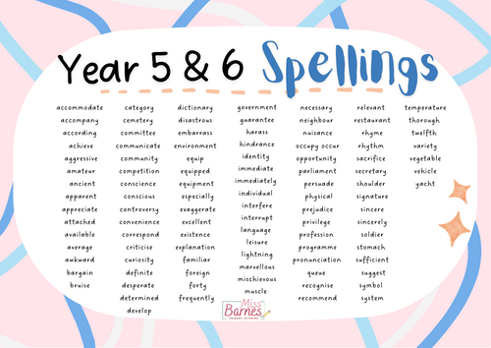
Spelling at home
Each half term, children will receive a list of key spellings they need to spell by the end of the half term. They will be assessed on these spellings throughout the term. You will be able to see how well they achieved at the end of each half term.
Please practise with your child as much as possible. You will receive a list of strategies to help your child learn these spellings.
Sometimes, we may send some extra spelling home as part of the weekly home learning. We will let you know (via the home learning book) if this happens.

Slide 10
From September, on our class page you will find…
Photos of activities and learning
Our termly curriculum newsletters
Going the extra mile
Our curriculum overview
Our website has a great source of information which includes: our calendar, what we do, term dates, birthday book wish list…

Slide 11
General reminders
Use the planner to communicate with us – encourage your child to show us their planner if there is a note.
Any urgent communications to go through the office please – email or phone.
Should you have any concerns, please contact the class teacher first – this can be done through emailing the school office.
Planners and levelled reading books to be in school everyday.
Birthday books instead of sweets – book wish list is on the school website.
Children should have a named bottle of water in school every day.
Please label all clothes with your child’s name so we can return if lost!
Photo permission can be changed via the school office if you wish your child to be in the newsletter and on the class page of the website.
It is expected that children should be in school everyday. Low attendance
(below 90%) is a cause for concern.

Slide 12
We work in partnership with you
Children should be in school ready to learn by 8.45 am each day. Attendance of less that 90% is a safeguarding cause for concern, as defined by OFSTED
Please make an appointment if you would like to discuss anything about your child’s welfare or learning
If it is quick, catch us on the gate after school
If you need a telephone appointment, please book it in with Mrs Ash
If it is to let us know something, please write a note in the planner.

Slide 13
How to share concerns constructively
Should you have any concerns, please contact your child’s class teacher in the first instance, or Ms Holmes or Ms Jones if the class teacher is unable to help, so your concern may be addressed promptly and effectively.
As a team, we are committed to supporting your child to communicate respectfully both in person and online; we ask that as parents, you role model this too.
Thank you.

Slide 14
Thank you.
Any questions?

