Slide 1


Year 4 Residential Trip
Ufton Court

Slide 2
When and where?
Thursday 12th March 2026, returning Friday 13th March 2026.
Ufton Court, Reading, Berkshire
Ufton Court is approximately a 40 minute drive from Taplow.
Children and their luggage should be dropped off at school at the normal time.
You are welcome to wait by the school gates to wave off your child.
Pick up on the Friday is at the usual time of 3.20pm.

Slide 3
Contact Information:
During normal school hours, please contact the school office
Out of hours, a mobile number will be made available for any emergencies

Slide 4
BEFORE THE TRIP
Please ensure that your child can complete their own self care routines (brushing teeth, hair, washing etc).
Please make sure that your child knows how to make a bed.
Please ensure that children are able to settle themselves independently for bedtime.

Slide 5
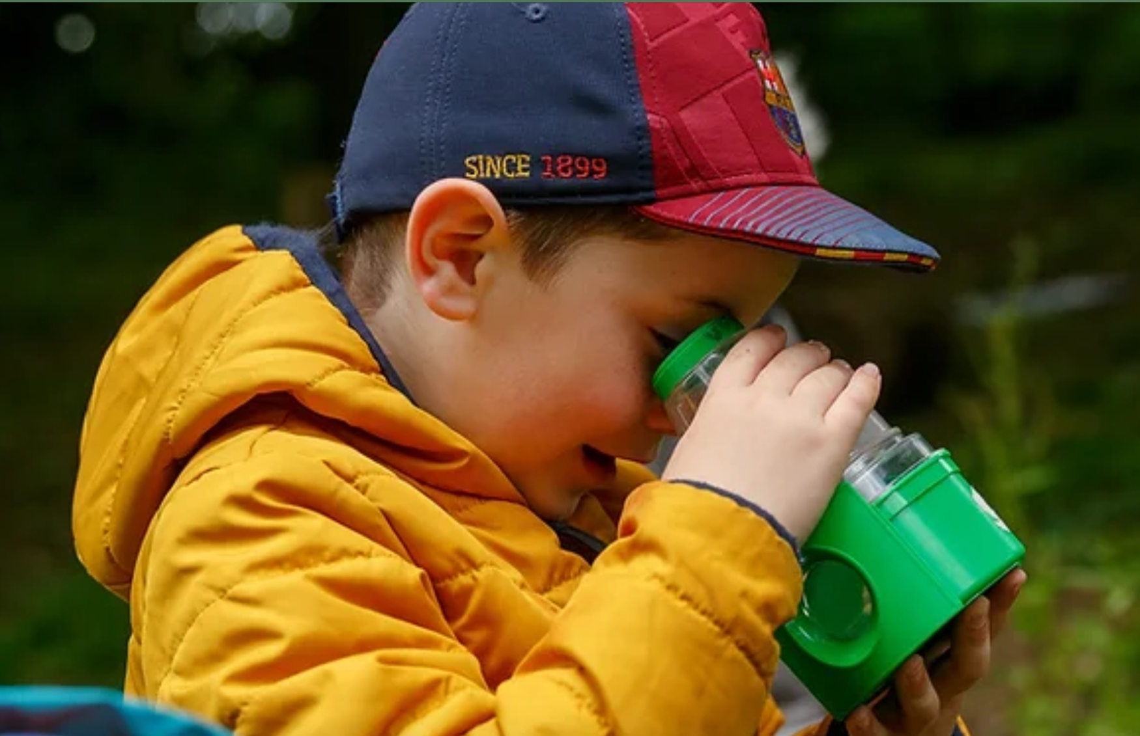

Welcoming you to Ufton Court
Ufton Court, Green Lane, Ufton Nervet, Reading, RG7 4HD | Phone: 0118 983 2099 | uftoncourt.org.uk | Charity Number 1116659

Slide 6
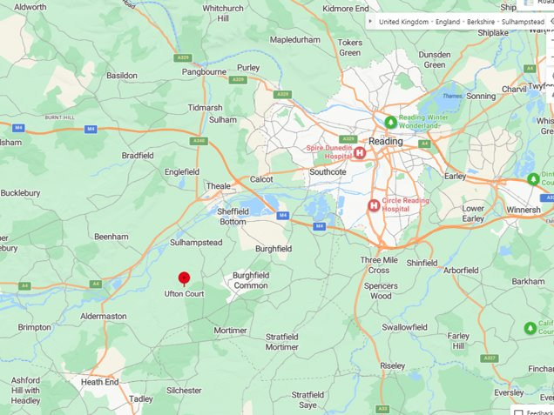

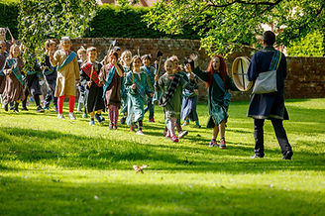
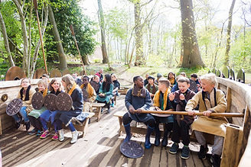
Welcome to Ufton
Our 40 acre site in Berkshire includes ancient woodland, a Viking long ship, Celtic settlement, medieval ponds and Tudor Manor House complete with secret priest holes.
s a

Slide 7
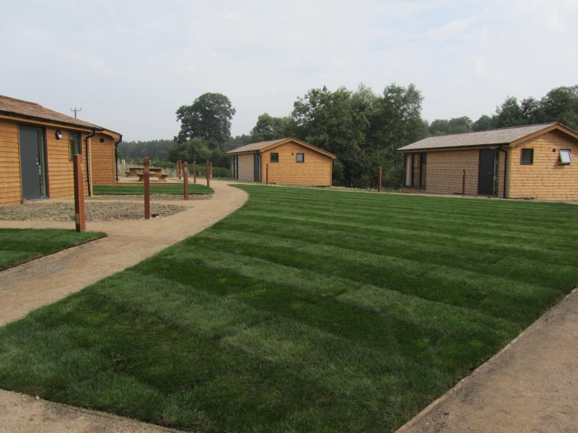
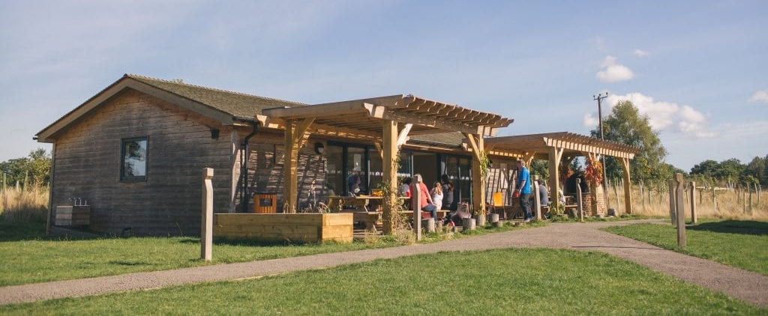
The Adventure Cabins
The Adventure Cabins sleep 38 children and 6 staff​
Set in private and safe woodland.
Ufton Court, Green Lane, Ufton Nervet, Reading, RG7 4HD | Phone: 0118 983 2099 | uftoncourt.org.uk | Charity Number 1116659

Slide 8
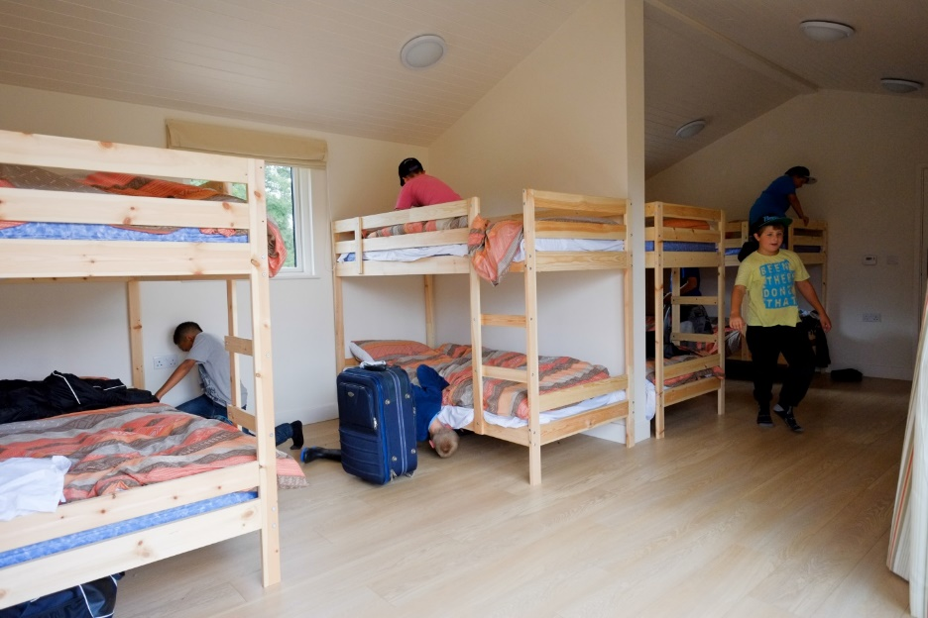
Accommodation
Each cabin has its own bathroom and sleeps roughly 8 children.
Beds are either bunk beds or single beds.
All bedding is provided.
Cabins are alarmed at night, have night lights and main pathways are lit.
Staff sleep in their own cabin.
Communal kitchen and dining cabin so that we can eat together.
Outdoor recreation areas.
Access to extensive woodland and footpaths.
Ufton Court, Green Lane, Ufton Nervet, Reading, RG7 4HD | Phone: 0118 983 2099 | uftoncourt.org.uk | Charity Number 1116659

Slide 9
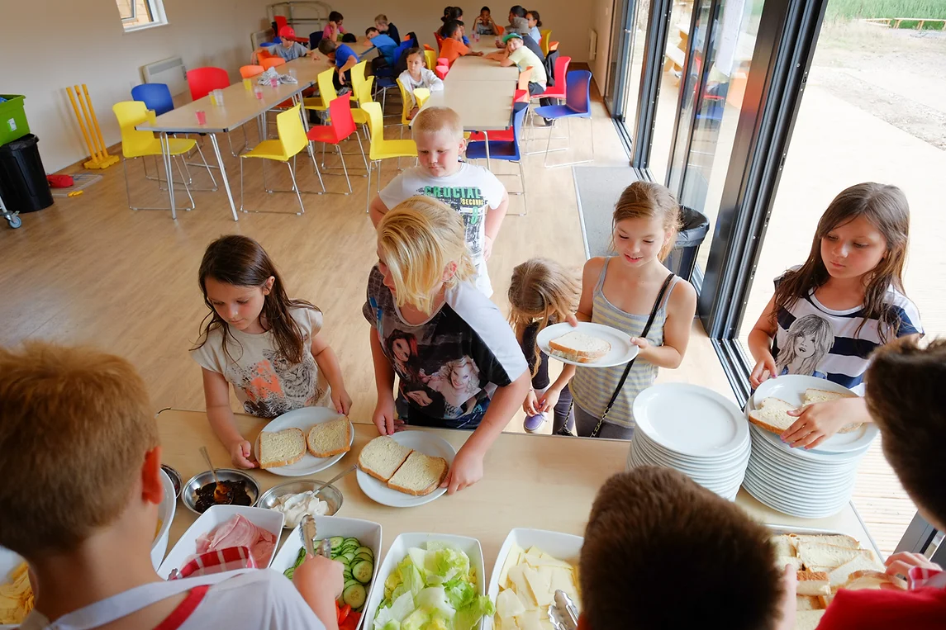
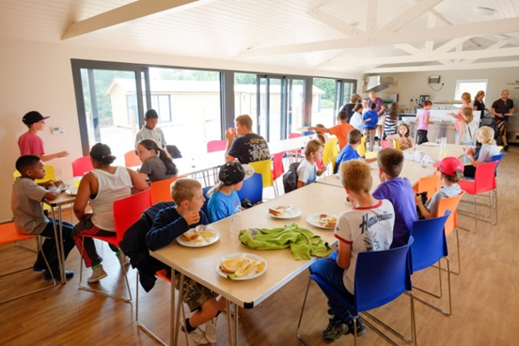
Meal times
Fully catered,​ with self service breakfast.
Nutritious, home cooked food​.
3 meals daily and two snack breaks​.
Group leaves after lunch on the final day.​
Water available all day (all children need to bring their own named water bottle)​.
They are able to cater for all dietary requirements​.
5 star Food Hygiene Rating from Food Standards Agency.
Ufton Court, Green Lane, Ufton Nervet, Reading, RG7 4HD | Phone: 0118 983 2099 | uftoncourt.org.uk | Charity Number 1116659

Slide 10
How we keep children safe
The main gate to the road is always locked and all visitors are required to call in and identify themselves before the gate is opened. Only the emergency services can override the entry system​.
The gate to the cabin site is locked at night.
The cabins have an internal alarm which rings in the teachers’ sleeping cabin at night should any of the children’s push alarms or cabin doors be operated.
Ufton staff live onsite and are ‘On- Call’ for every visit​.
All Ufton staff, without exception, are subject to enhanced record checking to ensure that they are safe to work with children​.
Ufton is situated on private land.
All guests are accompanied by a member of Ufton staff​. All staff and visitors are clearly identifiable with lanyards or Ufton branded uniform.

Slide 11
Activities at Ufton Court
Enjoying the outdoors​
Woodland boogie bash
Low ropes​
Team building carousel
Den building​
Rope & roll
Barrel boarding
Catapults​
Outdoor maths​/science activities​

Slide 12
Skills focus
Connect with the natural environment
Raise environmental awareness
Motivated, independent and resilient learners
Communication and co-operation
Problem solving and teamwork
Patience and kindness

Slide 13
Kit list
Please pack belongings into a holdall, case or rucksack which your children can carry
comfortably by themselves.
General​ Waterproof coat Wellies / outdoor shoes in a plastic bag. ​ Indoor shoes (Only bring slippers if they have non-slip soles – light trainers are more suitable)​ Set of spare clothes, including long trousers and long-sleeved top.​ Spare footwear. Towel​ Water bottle​ Please make sure all kit is named. | ​ Please do not bring​ Food – other than by arrangement for special diets.​ Money or valuables​ Mobile phone​ Any electronic equipment​ Camera Aerosol sprays Make-up​ ​
Ufton Court, Green Lane, Ufton Nervet, Reading, RG7 4HD | Phone: 0118 983 2099 | uftoncourt.org.uk | Charity Number 1116659

Slide 14
Useful Tips
Arrive wearing outdoor shoes and have indoors shoes in a separate bag. This saves a lot of time.​
​
Name all belongings and pack the bag with your child so they know what they’ve got with them.​
​
Do not pack valuable items. There is no need to bring mobile phones or money.​
​
Try to avoid suitcases on wheels, they are hard to carry/wheel across the grounds.
​
Bring suitable clothing, not your best clothing​.
​
Pack a couple of spare plastic bags for wet/muddy shoes and/or clothes​
​
Please do not pack any food items unless agreed with Ufton for dietary requirements​
​
Ufton Court, Green Lane, Ufton Nervet, Reading, RG7 4HD | Phone: 0118 983 2099 | uftoncourt.org.uk | Charity Number 1116659

Slide 15
Questions
Please have a look at the Ufton Court web page: ​​
https://www.uftoncourt.org.uk/parent-s-hub​
If you have any further questions, please ask
us on the gate or email the school office.

Slide 16
https://www.timestables.co.uk/multiplication-tables-check/

