Slide 1
Welcome to year 6

Slide 2
Planners – charters & signing
School rules
Expectations for behaviour + behaviour for learning – class value
Equipment + 7 for success – handwriting pen, pencil, ruler, green pen, purple pen, rubber, highlighter
Incomplete work – class / homework – busy bunch
Roles & responsibilities – privileges for Year 6

Slide 3
Timetable for today
Making the transition to Year 6
School rules
How to manage playground/classroom situations
Class prayer
Class value
RE story + art activity
Diversity survey
Summer home learning
Showcasing your writing skills – a letter to your new teachers
Art – preparation for your first display
2.45 – return to Yr 5 with letters & holiday home learning.

Slide 4
Our school rules
Be kind, polite and respectful to everyone.
Listen to the adults and each other.
Be proud of our school and take care of it.
Move quietly and sensibly around our school.
Wear our school uniform with pride.

Slide 5
What we expect in Year 6
You will be role models to the rest of the school – in behaviour, attitude, demonstrating the school values, in your work & growth mindset in class and around the school.
Be prepared. Have all equipment & be ready to learn from 8.45am
To complete work to a high standard which showcases your ability
Use your growth mindset to solve simple problems
Log your reading each day & complete all home learning to a high standard
To take responsibility for your learning – if you don’t understand, ask for help – use your growth mindset
Develop independence. Preparation for secondary school starts now.

Slide 6
The perks of Year 6 – earned privileges, not rights
To sit on chairs & benches in assembly
To have a responsibility within the school (house captain, ambassador, hall monitor, audio-visual monitor, sports monitor, lower school readers (T,W,TH)
An incredible residential to The River Dart
Opportunities to help run sports day
An amazing end of year production
& much more!

Slide 7
How to respond to difficult situations in class or in the playground

Slide 8
What can you do when another child does or says something to you that you do not like?
1. Tell them to stop and that you do not like it.
2. Take a minute to check how you feel and what to say (breathe!)
3. Try to sort it out by explaining:
‘I didn’t like it when …
It made me feel …
I would prefer it if …’
4. This is putting in a boundary, so you know what to expect. A boundary makes us feel safe and it is important to tell others what that boundary is, so they know and respect it. (Is it ok or not ok?)
5. If they will not listen, walk away and try again later that day.
6.You may want to ask an adult to help.
7. You may help someone else because you see it happening.
8. If the other child keeps repeating what you do not like, tell an adult.
What if you are the child being told?
You need to listen carefully and respond to show you understand
‘I heard that you didn’t like….
It made me feel…
I am sorry…’
Do this and we will grow to have healthy friendships.

Slide 9
What are your hopes?
What are your worries?

Slide 10
Our Class Prayer
Dear God
You are the vine and the light of the world.
We thank you for another day of life, for giving us a place to learn and for making us all unique.
We know that you are always there to listen to us and that we are your branches. Please guide us down the right path. Help us to be optimistic, resilient and the best that we can be.
Amen

Slide 11
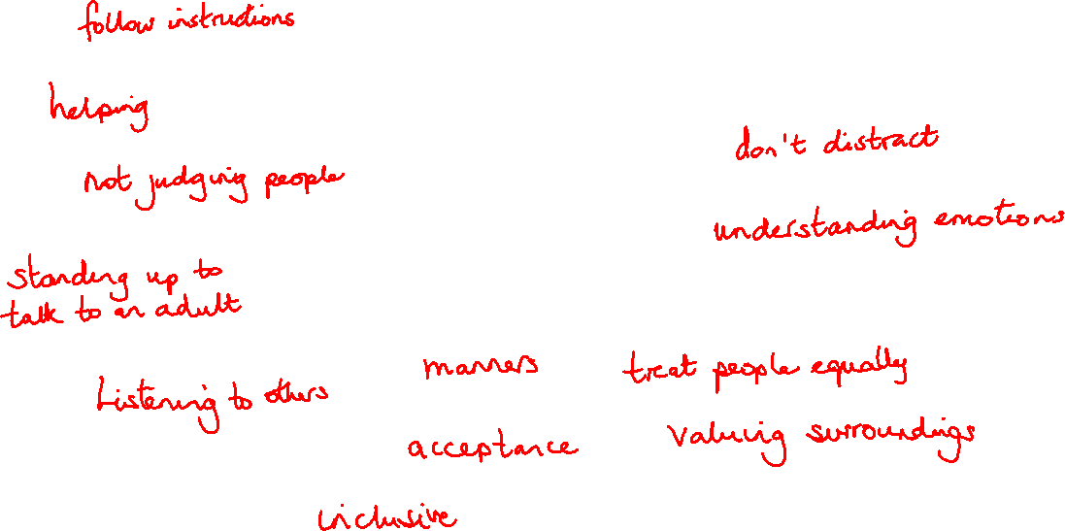
Our class value
RESPECT
What do you think respect is?

Slide 12
Moses and the burning bush : Exodus 3
How does Moses show respect?

Slide 13
Letter to your future teachers
To help us get to know you a little & see your writing, we would like you to plan your ideas and begin to write a letter to us.
Use your planning sheet to write your ideas and then write your letter.
Think about the tone you should use for your writing:- formal/semi-formal/informal?
You can hand in your letter by the end of the week if not completed today.

Slide 14
St Nicolas School
Rectory Road
Taplow
SL6 0ET
7th July 2026
Dear Mrs Flynn and Mrs Warrington,
Yours sincerely,

Slide 15
Art activity: A bush with flames coming out of it. The flames will show what respect is. At the base of the bush, will be 32 sandals, each of which represent how you show respect.
What is respect?
You will each get a flame and some tissue paper.
1. Write your message in the middle of the flame and decorate the perimeter of the flame with scrunched up tissue paper, which you will glue on.
Symbol of how Moses showed respect to The Lord
2. Colour in your sandal in and write RESPECT along the straps. (These represent the respect Moses showed the Lord, when he removed his shoes)

Slide 16
What can I do to prepare this summer?
Practise your times tables to 12 x 12 as number sentences and with division – even if you know them, use the summer holidays to practise and maintain fluency. You don’t need to be good at maths to learn your tables, but knowing your tables will make you better at maths & more able to cope with the expectations of Year 6.
Read every day – fiction & non-fiction. This will develop your vocabulary, spelling, grammar, comprehension, knowledge & imagination. Good readers make good writers.
Develop your growth mindset – if you don’t know the answer to a question, google it. Don’t say you’re bored – find something to do – read or help a grownup.
Develop your independence at home. Do you need an adult to do it for you, or can you do it yourself? Making your bed, putting clothes away, tidying your room, packing your bag, helping with jobs around the house, washing up. Helping in the garden etc.
Look ahead to what we will be learning about & begin to develop your knowledge through reading, visiting museums etc. Museums are free and can be a fun dayout.

Slide 17
Home learning

Slide 18
Any questions?

Slide 19
Any suge
Any suggestions/ hopes for Year 6?

Slide 20
Sunset silhouettes of WW2
Daily Challenge #34 / Easy Art / Power Lines At Sunset Painting - video Dailymotion

Slide 21



