Slide 1
Welcome to year five Willow
With Mr. Meikle-Masters, Mrs. Brown, Mrs. Hudson and Mrs. Cross

Slide 2

Teachers
Mr. Meikle-Masters
Mrs. Brown and Mrs. Hudson
Mrs. Cross – Thursday mornings

Slide 3
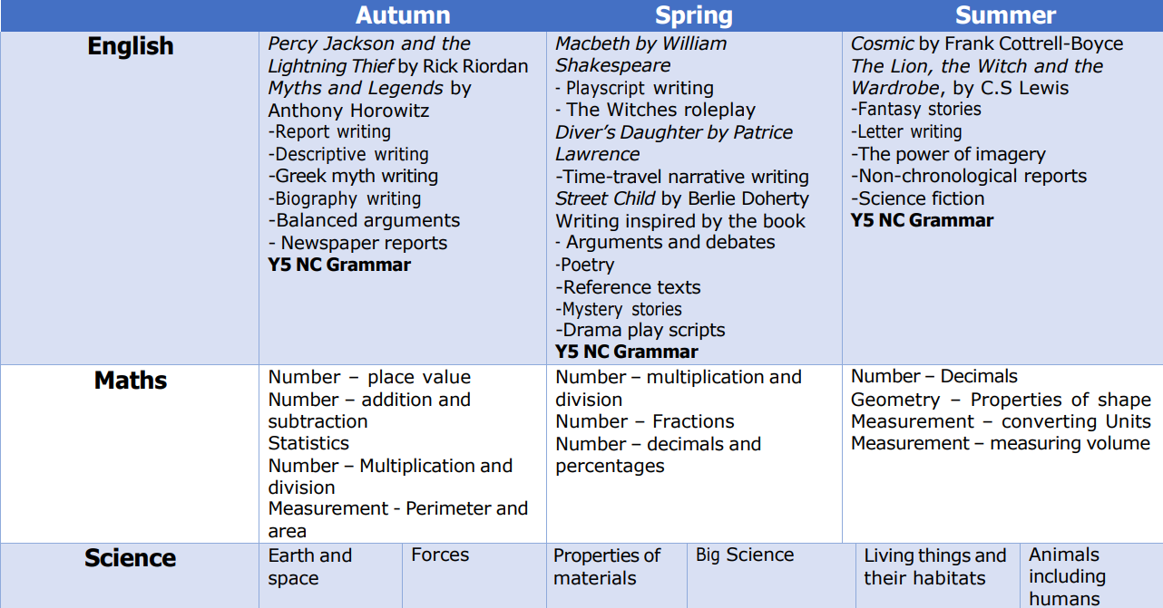
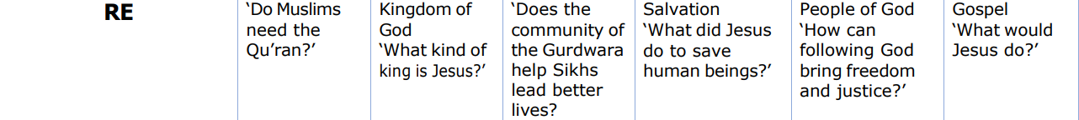
Our learning this year

Slide 4
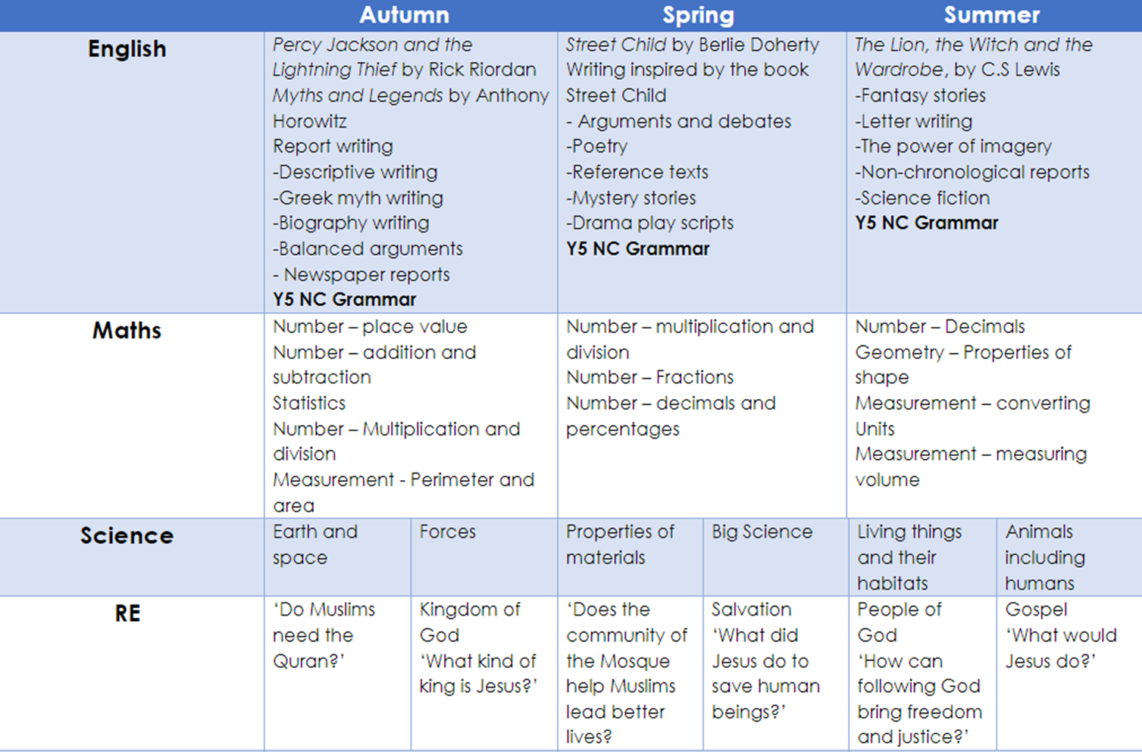
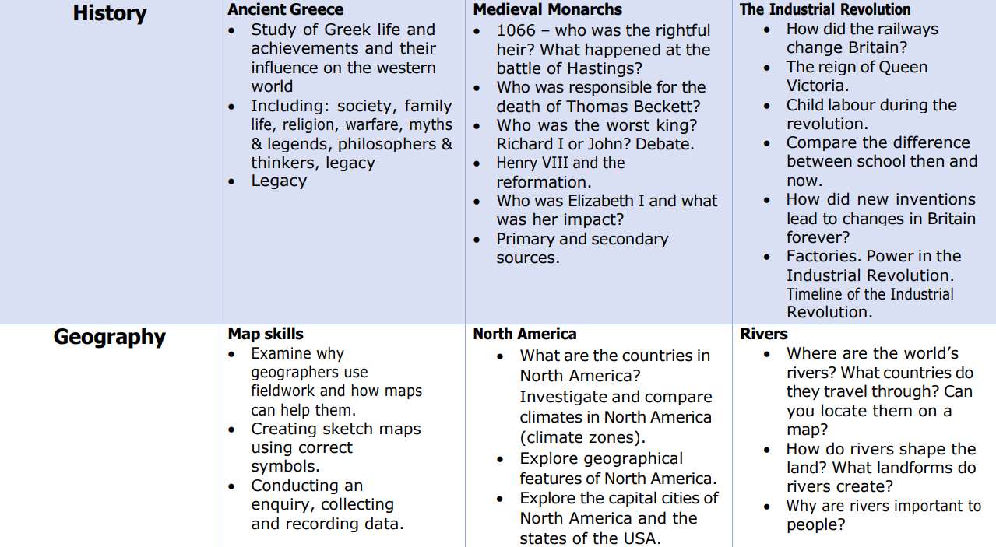
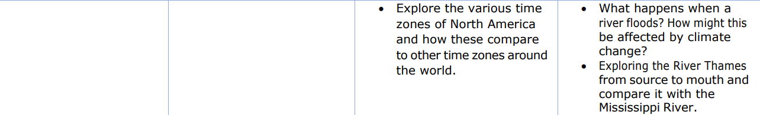
Our learning this year

Slide 5
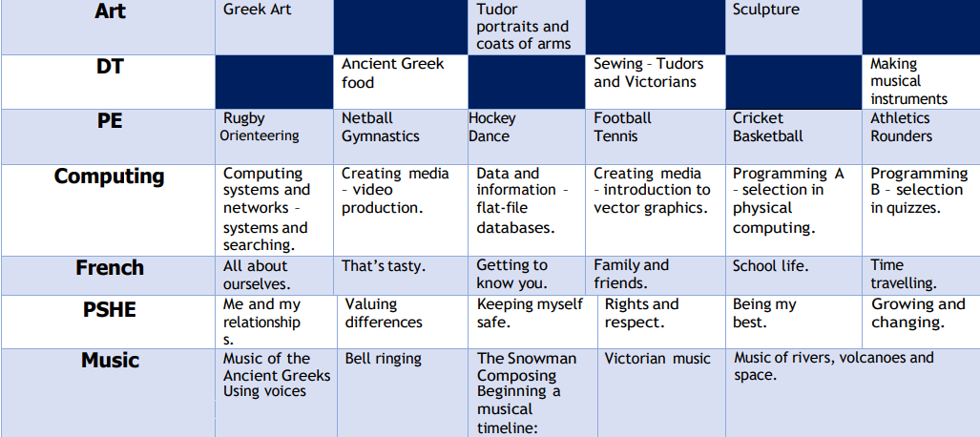
Our learning this year
Wood carving

Slide 6
We have a growth mindset in Willow Class
Never give up
Mistakes are good
We learn from each other
Every day is a new day
Teamwork
Supporting each other to do well

Slide 7
Our expectations
You are a role model to others in the school
You must keep your trays and locker clean and tidy
You must ask if you need help
If there is a problem please come and speak to one of the Year 5 team
Be the best that you can be
Work hard
Always try your best
Excellent handwriting and presentation
Use a growth mindset
Challenge yourself
Believe in yourself
Have fun

Slide 8
Home learning will start on Monday
Day | Home Learning
Monday | Spellings are tested Hand in home learning Hand in signed planner for checking Read and log your reading
Tuesday | New home learning and spellings given out for the week Read and log your reading
Wednesday | Read and log your reading
Thursday | Read and log your reading
Friday | Read and log your reading

Slide 9
Home learning
Read for 30 minutes to an hour each day. Develop your vocabulary and comprehension by looking up the meaning of new words you come across.
Spag.com and Maths.co.uk
Read widely – newspaper reports, non-fiction, fiction, classics, read things out of your comfort zone, read leaflets, read instructions, read recipes, read information texts. Read, read, read. ☺
Learn your times tables – it is essential to know these off by heart along with division facts.
If you know your times tables, try learning these off by heart: square numbers, cube numbers, prime numbers to 100, 15 x table, 45 x table, 25 x table.
Extra challenge – try using Duolingo at home to learn languages.

Slide 10
Planners
Use your planner to:
Record your reading
Note down home learning
Send a message to your teacher
Keep track of your logins and passwords
Dojo points will be awarded for excellent planners.

Slide 11
Assessments
We will have regular assessments in year 5 to track everyone’s progress. These are not something that needs to be revised for, but just ensuring you are confident with everything that has been taught will help you sail through them.
If you are not confident on anything, please speak to an adult in the classroom and we will help you.

Slide 12
Remember
Be in school focused and ready to start lessons by 8.45am
PE kit should be worn to school on Mondays and Fridays
If you bring in a pencil case it must be kept in your bag unless we are doing creative work
Planners everyday (with reading tracked)
A reading book everyday
Home learning
Smart uniform
An art smock
Any forms to return ☺

Slide 13
We work in partnership with you…
Attendance of less than 90% is a safeguarding cause for concern, as defined by OFSTED.
Please make an appointment if you would like to discuss anything about your child’s welfare or learning – We are always here to listen
If it is quick, catch us on the gate after school
If you need a telephone appointment, please book it in with Mrs Ash
If it is to let us know something, please write a note in the planner.

Slide 14

Birthday books
At St Nicolas we love celebrating your birthdays! We have a birthday book list on the English section of our website (under the curriculum tab). Any book purchased for your child’s birthday will have their name placed inside the book and will be presented in assembly.
This book will then be placed in the library to be enjoyed by others for many years to come. Please hand any books bought to the office with your child’s name and birthday details.

Slide 15
Should you have any concerns, please contact myself in the first instance, or Ms Holmes or Ms Jones if I am unable to help, so your concern may be addressed promptly and effectively.
Please avoid using the class WhatsApp group as a means of voicing your issues. This pathway is generally not beneficial to your child and delays the staff from acting constructively on your area of concern.
As a team, we are committed to supporting your child to communicate respectfully both in person and online; we ask that as parents, you role model this too.
If your child has a phone, please be mindful to monitor that they use age appropriate content and that they use their phone respectfully and safely. Social media apps such as WhatsApp are recommended for children age 13+.

Slide 16
And Finally…
Year 5 is a year of activities and opportunities. We will do a lot of learning and challenge you to grow as learners; having fun whilst we do so.
We hope that you have an enjoyable and rewarding year and that you remember to have fun and make the most of all the opportunities you are given!
Don’t forget to keep up to date with all our activities on the website and check on Teams for any messages! ☺

