Slide 1
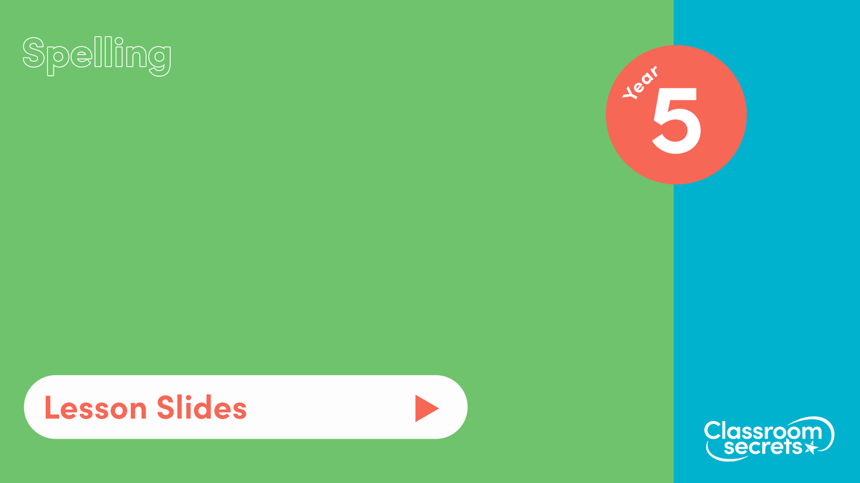
S37
Common exception words Pack 1

Slide 2

Let’s start with a question about common exception words and silent letters, which is linked to the new learning later in this lesson.

Slide 3
Use the letters in each grid to spell a common exception word or word which includes a silent letter. Some letters have been put in already to help you.
a | t | p
o | i | r
t | n | m
r | e | f
r | e | t
o | h | e
r | o
h | u
i
p
t
o
r
t
f
e
e | g | k
d | o | l
n | w | e
y | u
s | b
k
w
e
b
s

Slide 4
Use the letters in each grid to spell a common exception word or word which includes a silent letter. Some letters have been put in already to help you.
a | t | p
o | i | r
t | n | m
r | e | f
r | e | t
o | h | e
r | o
h | u
i
m
p
o
r
t
a
n
t
h
o
u
r
t
h
e
r
e
f
o
r
e
e | g | k
d | o | l
n | w | e
y | u
s | b
k
n
o
w
l
e
d
g
e
b
u
s
y

Slide 5
Now that we are ready to move on, we can learn about common exceptions words.

Slide 6
Common exception words are words where a spelling rule does not apply. They cannot be sounded out using our phonics skills.
We can learn how to spell these words by exposing ourselves to different texts so we can practice reading them, and in turn write them.
Examples of common exception words we have previously seen are:
we
are
this
remember
increase
there
circle
heart
I
his

Slide 7
We can learn how to spell common exception words using mnemonics. Mnemonics is a way to help you remember a spelling or phrase through a rhyme, poem or acronym.
For example:
answer
a | Andy’s
n | new
s | skateboard
w | was
e | extremely
r | rare
learn
l | Lucy
e | enjoys
a | a
r | rainy
n | night

Slide 8
Now that we have learnt how to use common exception words, let’s apply our learning.

Slide 9

The fabulous four are describing different common exception words. Spell the words they are describing.
A medium sized sailing boat.
A flash of light caused by the discharge of electricity from one cloud to another.
Are from, or have characteristics of, another country or language.
To describe an issue or give further details.

Slide 10
The fabulous four are describing different common exception words. Spell the words they are describing.
A medium sized sailing boat.
A flash of light caused by the discharge of electricity from one cloud to another.
yacht
lightning
Are from, or have characteristics of, another country or language.
To describe an issue or give further details.
foreign
explanation

Slide 11

You’re ready to progress!
Now apply your learning by trying some questions.

