Slide 1
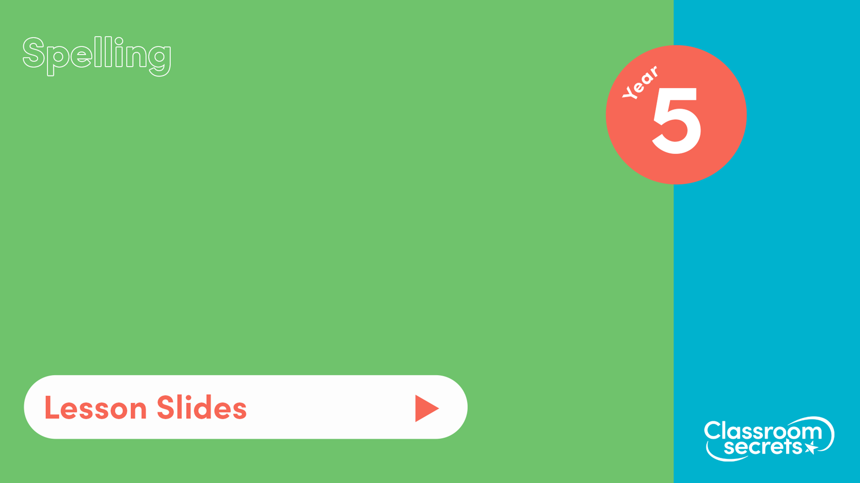
S37
Common exception words Pack 2

Slide 2

Let’s start with a question about previously learnt common exception words and silent letters words, which is linked to the new learning later in this lesson.

Slide 3

Help Dennis spell the words by solving the clues below.
A line of people waiting for their turn.
A pink fish which can be smoked, fried, roasted or grilled.
A seven-letter word that means to accomplish something.
Something we use to cut with that has two metal blades.

Slide 4
Help Dennis spell the words by solving the clues below.
A line of people waiting for their turn.
A pink fish which can be smoked, fried, roasted or grilled.
A seven-letter word that means to accomplish something.
Something we use to cut with that has two metal blades.
queue
salmon
achieve
scissors

Slide 5
Now that we are ready to move on, we can learn about common exception words.

Slide 6
Common exception words are words where a spelling rule does not apply. They cannot be sounded out using our phonics skills.
We can learn how to spell these words by exposing ourselves to different texts so we can practise to read and in turn write them.
We’ve seen many examples of common exceptions words such as:
parents | whole | possible
reign | busy | forwards
centre | therefore | beautiful

Slide 7
As well as learning them through reading and writing, we can learn them through mnemonics. A mnemonic is a way to help you remember a spelling or phrase through a rhyme, poem or acronym.
Examples of mnemonics are:
recent
r | Ryan's
e | extra
c | careful
e | entering
n | Ned’s
t | truck
height
h | hyenas
e | enjoy
i | invading
g | giddy
h | hippo’s
t | territory

Slide 8
Now that we have learnt how to spell common exception words, let’s apply our learning.

Slide 9
Unscramble the letters to correctly spell the common exception words.
a r w k w a d
m t n i e o n
s p r s u i r e
f m i a a i l r
q t a u e r r

Slide 10
Unscramble the letters to correctly spell the common exception words.
a r w k w a d awkward
m t n i e o n mention
s p r s u i r e surprise
f m i a a i l r familiar
q t a u e r r quarter

Slide 11

You’re ready to progress!
Now apply your learning by trying some questions.

