Slide 1
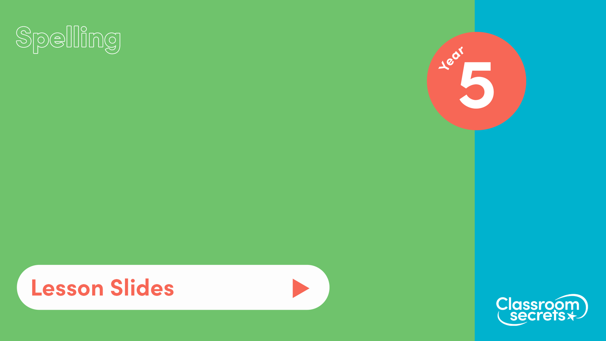
S37
Common exception words Pack 3

Slide 2

Let’s start with a question about previously learnt common exception words and silent letters words, which is linked to the new learning later in this lesson.

Slide 3

Help Abena identify the common exception words by solving the clues.
An area of land surrounded by water.
i _ _ _ _ _
A person who protects something or someone.
g _ _ _ _
To suddenly vanish.
d _ _ _ _ _ _ _ _
The third planet from the sun.
e _ _ _ _

Slide 4
Help Abena identify the common exception words by solving the clues.
An area of land surrounded by water.
island
A person who protects something or someone.
guard
To suddenly vanish.
disappear
The third planet from the sun.
earth

Slide 5
Now that we are ready to move on, we can learn about common exception words.

Slide 6
Common exception words are words where a spelling rule does not apply. They cannot be sounded out using our phonics skills.
We can learn how to spell these words by exposing ourselves to different texts so we can practise to read and in turn write them.
We’ve seen many examples of common exception words such as:
fruit | famous | perhaps
actual | different | popular
eight | guide | medicine

Slide 7
As well as learning them through reading and writing, we can learn them through mnemonics. A mnemonic is a way to help you remember a spelling or phrase through a rhyme, poem or acronym.
Examples of mnemonics are:
often
o | our
f | friend
t | Tom
e | enjoys
n | nachos
fruit
f | foxes
r | roam
u | under
i | icy
t | trees

Slide 8
Now that we have learnt how to spell common exception words, let’s apply our learning.

Slide 9
Solve the clues and unscramble the letters to correctly spell the common exception words.
To happen or take place.
cucor
To form an orderly line.
euequ
To use words that have the same final sound.
hryem
The number after thirty-nine.
rytfo

Slide 10
Solve the clues and unscramble the letters to correctly spell the common exception words.
To happen or take place.
cucor
occur
To form an orderly line.
euequ
queue
To use words that have the same final sound.
hryem
rhyme
The number after thirty-nine.
rytfo
forty

Slide 11

You’re ready to progress!
Now apply your learning by trying some questions.

