Slide 1
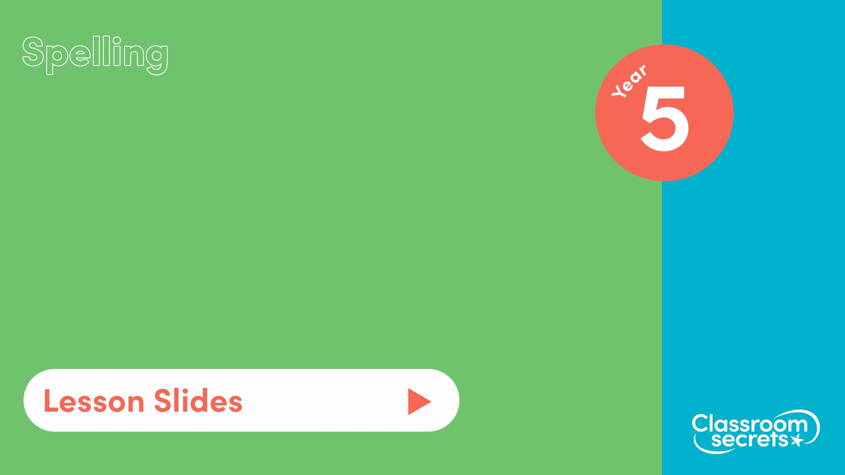
S37
Common exception words Pack 6

Slide 2

Let’s start with a question about silent letters, which is linked to the learning later in this lesson.

Slide 3
Use the function machine to select the correct missing silent letters and rewrite each word correctly.
_ n o w l e d g e
a
e
w _ i s t l e
w
b
h
r
d o u _ t
s
k
p a r l i _ m e n t

Slide 4
Use the function machine to select the correct missing silent letters and rewrite each word correctly.
_ n o w l e d g e
k n o w l e d g e
a
e
w _ i s t l e
w
b
w h i s t l e
h
r
d o u _ t
d o u b t
s
k
p a r l i _ m e n t
p a r l i a m e n t

Slide 5
Now that we are ready to move on, we can learn more about common exception words.

Slide 6
Common exception words are words that appear regularly, but which usual spelling rules do not apply. As these words cannot be decoded phonetically, other spelling strategies can be used to help remember them.
Here are some examples of Year 5 common exception words:
persuade
neighbour
amateur
shoulder
rhyme
government
restaurant
sufficient
cemetery

Slide 7

When a word is difficult to spell, we can use a word staircase to help remember it.
A word staircase can help us to remember how to spell a word by reminding us of the pattern of the letters.
For example:
l
l | e
l | e | i
l | e | i | s
l | e | i | s | u
l | e | i | s | u | r
l | e | i | s | u | r | e

Slide 8
Now that we have learnt more about common exception words, let’s apply our learning.

Slide 9
Which of the common exception words would fit into these word staircases?
s
s
 | t | o
s |  | o
 | t |  | m | a
s | t |  |  |  | c
 |  | o | m |  |  | h
h
h
 | a
 | a | r
 |  |  | a | s
h |  |  | a
q
 | e
q
 | u |  | u
q |  | e

Slide 10
Which of the common exception words would fit into these word staircases?
s
s | t
s | t | o
s | t | o | m
s | t | o | m | a
s | t | o | m | a | c
s | t | o | m | a | c | h
h
h | a
h | a | r
h | a | r | a
h | a | r | a | s
h | a | r | a | s | s
q
u | e
q | u | e
q | u | e | u
q | u | e | u | e

Slide 11

You’re ready to progress!
Now apply your learning by trying some questions.

