Slide 1

WHAT IS
ANIMAL
ASSISTED
EDUCATION?

Slide 2

Animal Assisted Education (AAE) is one of various terms within Animal Assisted Interventions.
AAE is used to describe the work educational professionals do with the support of animals.

Slide 3
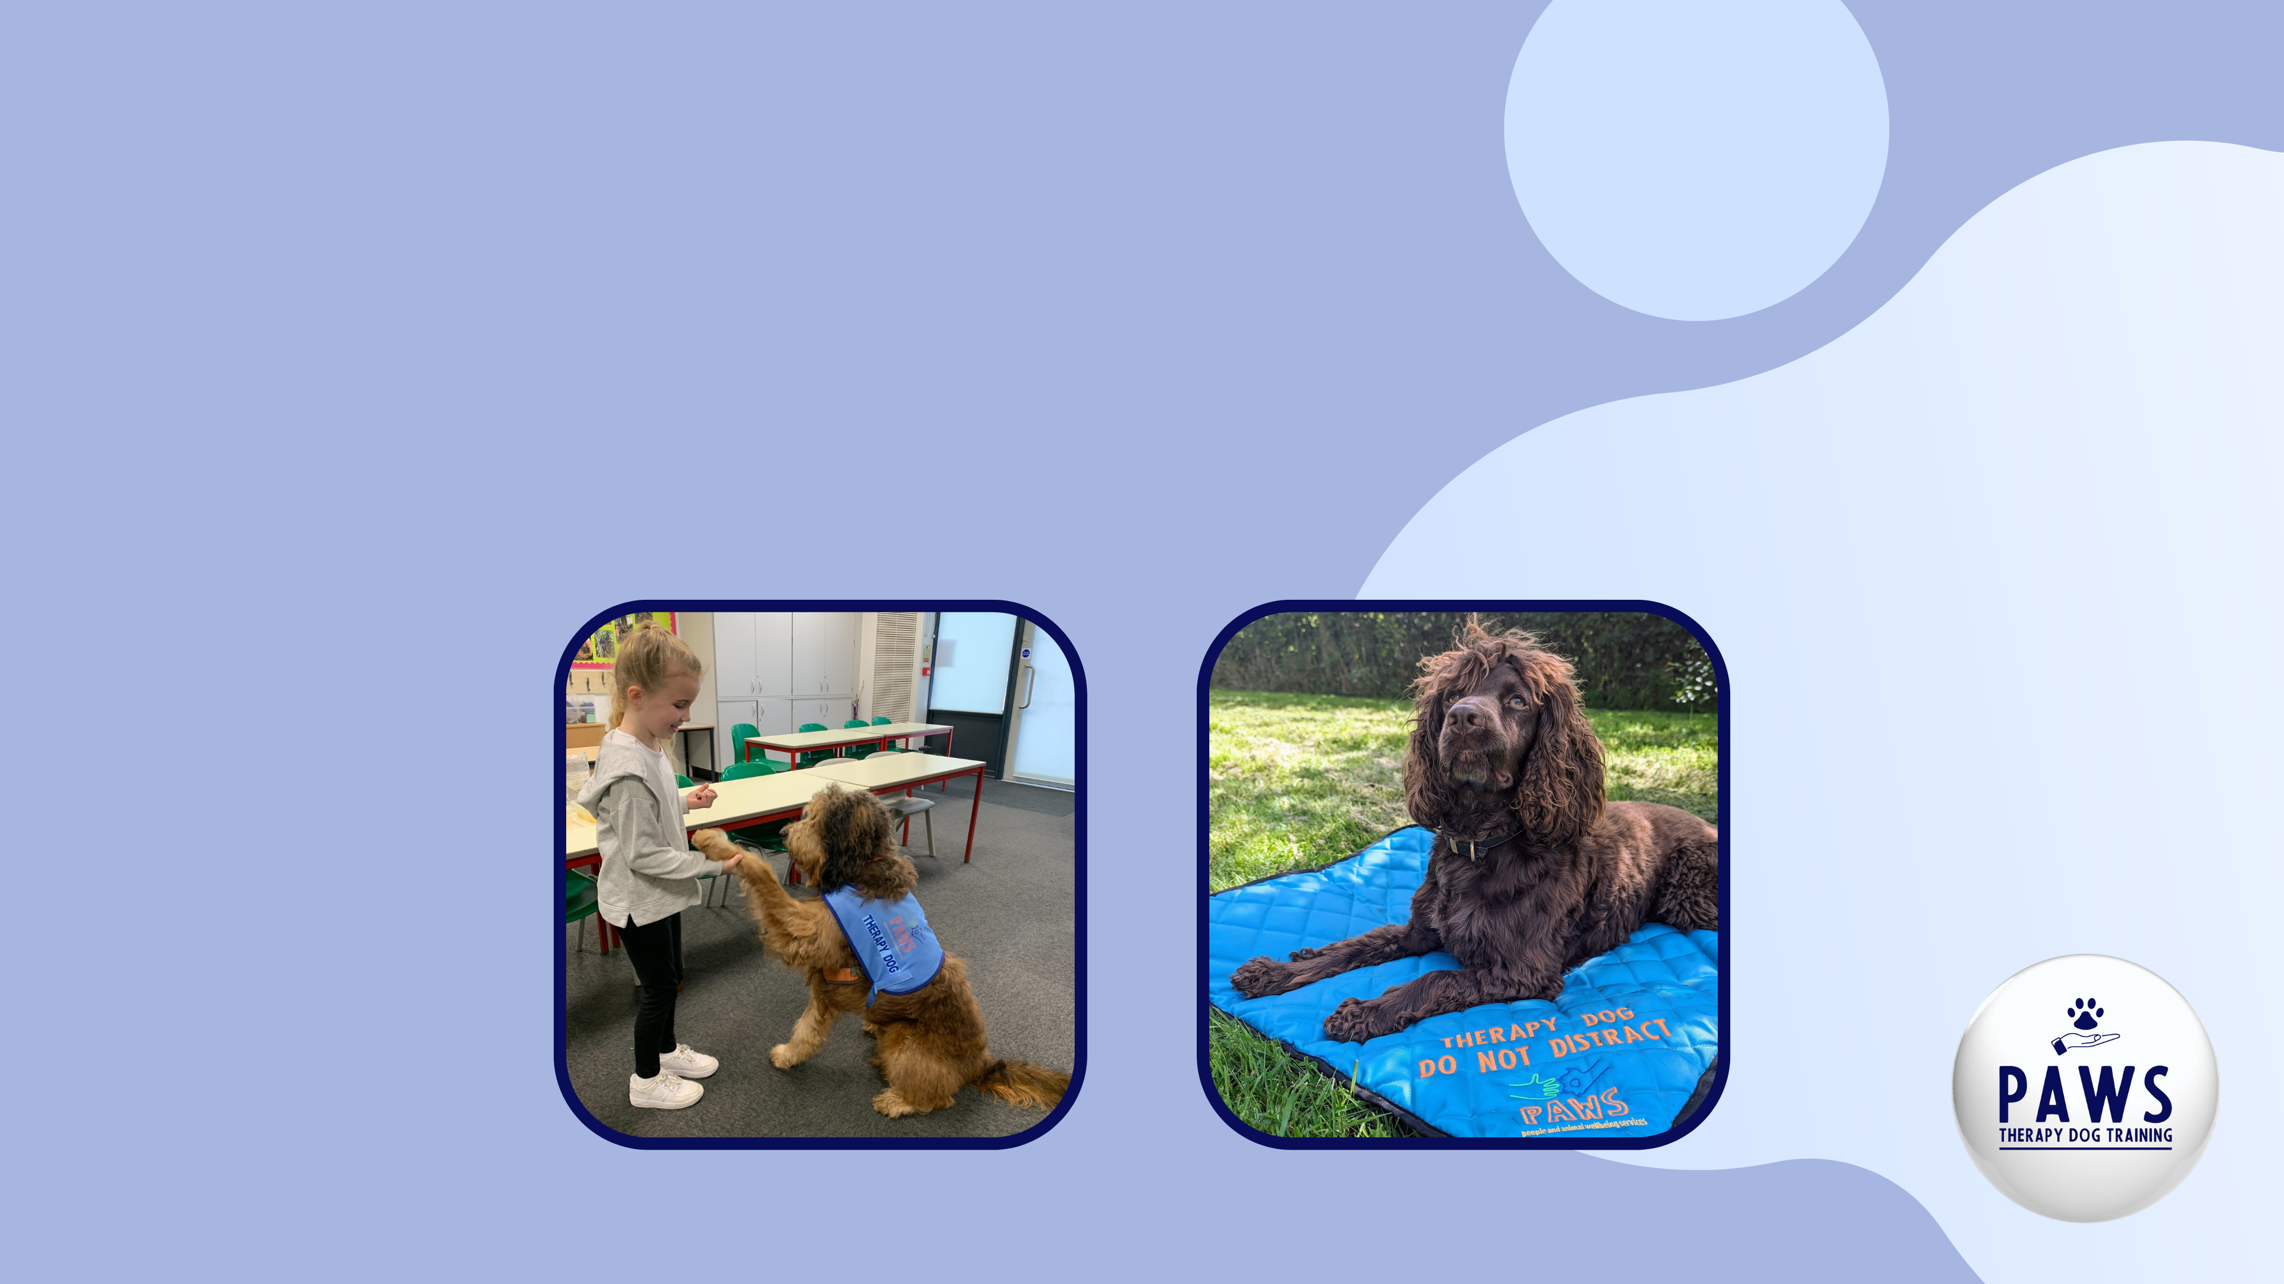
Animal Assisted Education aims to enhance the educational work by incorporating animals into the academic and emotional literacy process. The professional will work towards specific goals with each client.

Slide 4

What are the Benefits of Animal Assisted Education?

Slide 5
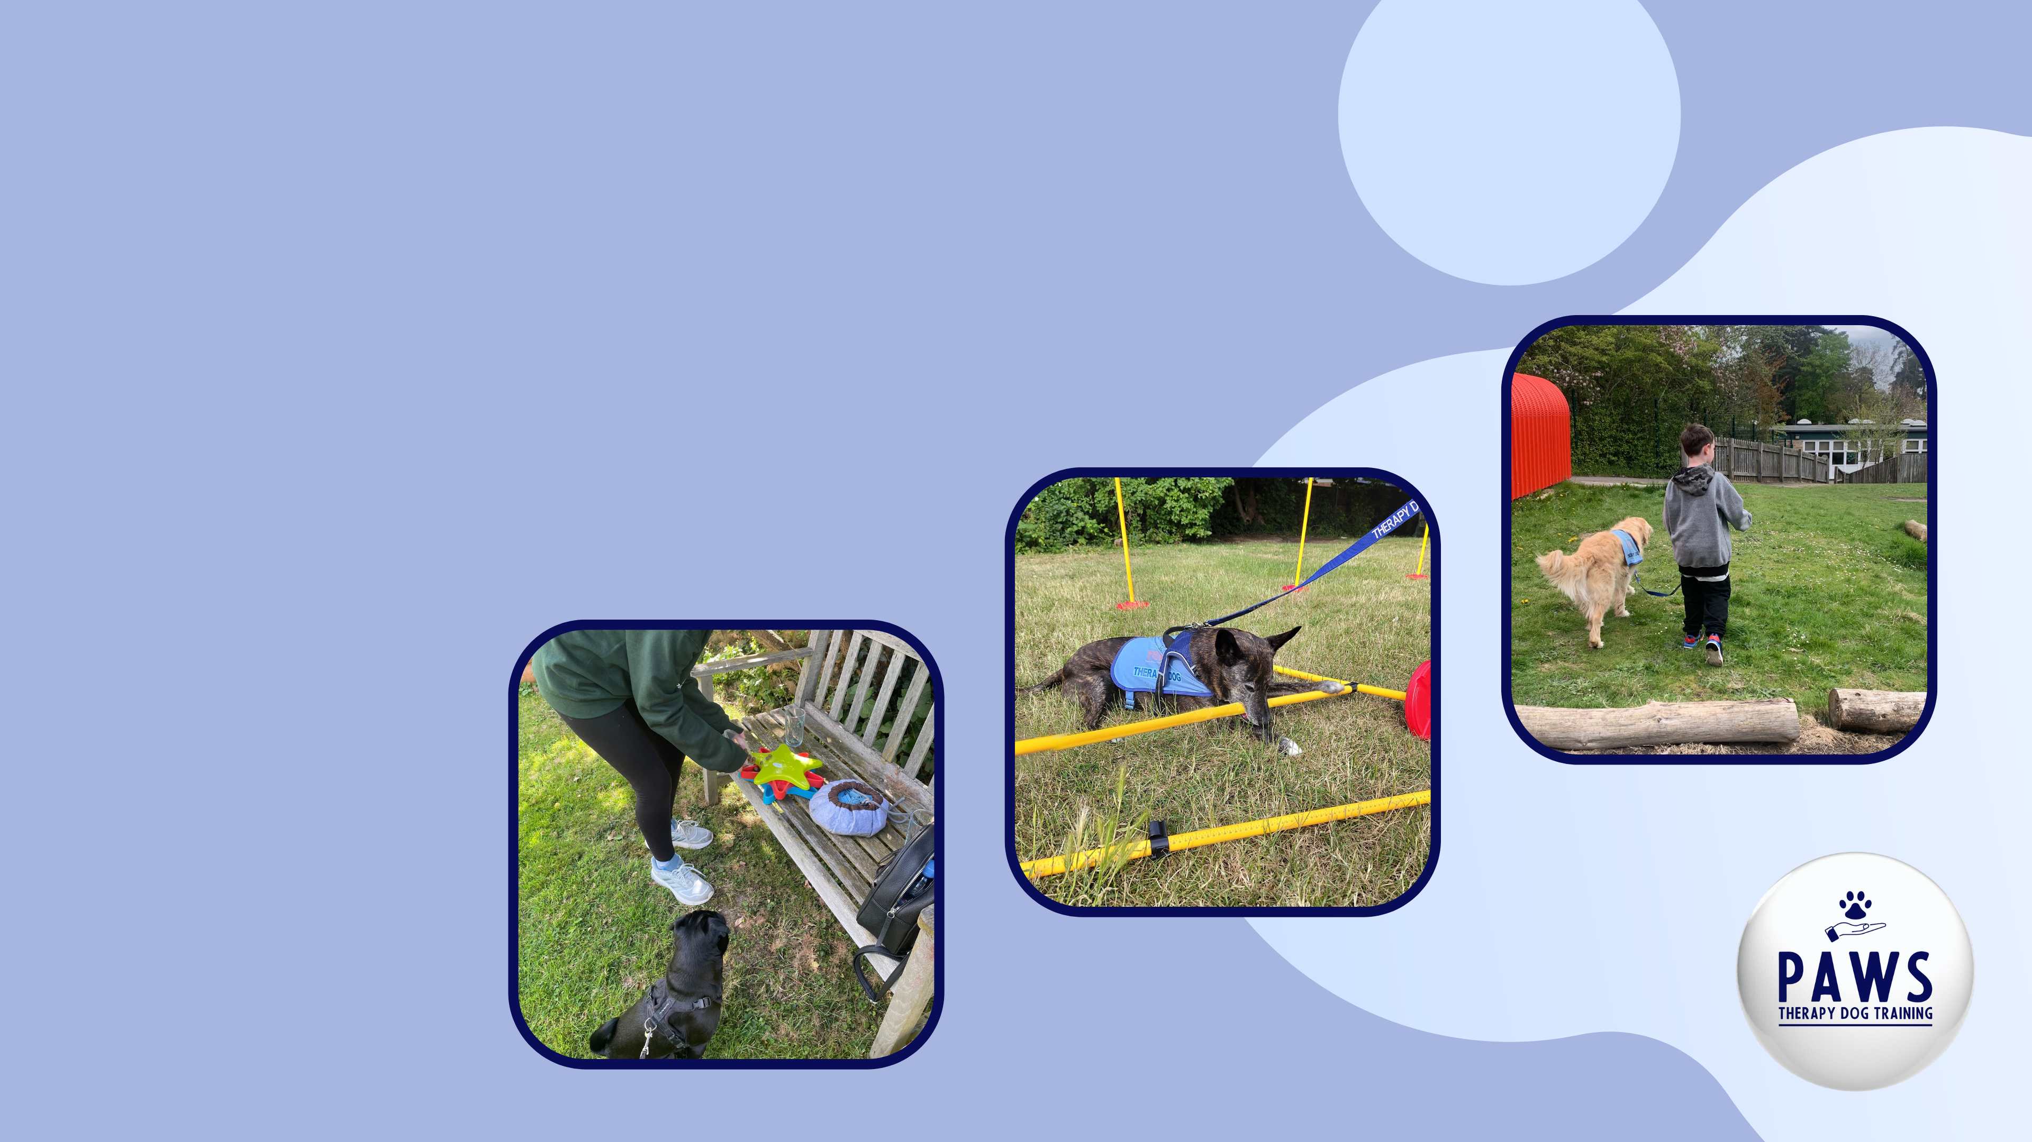
Some activities you might do with your school dog:
emotional regulation
learning about dog body language
creating an obstacle course
reading sessions
baking dog treats
mindful breathing
dog art

