Slide 1

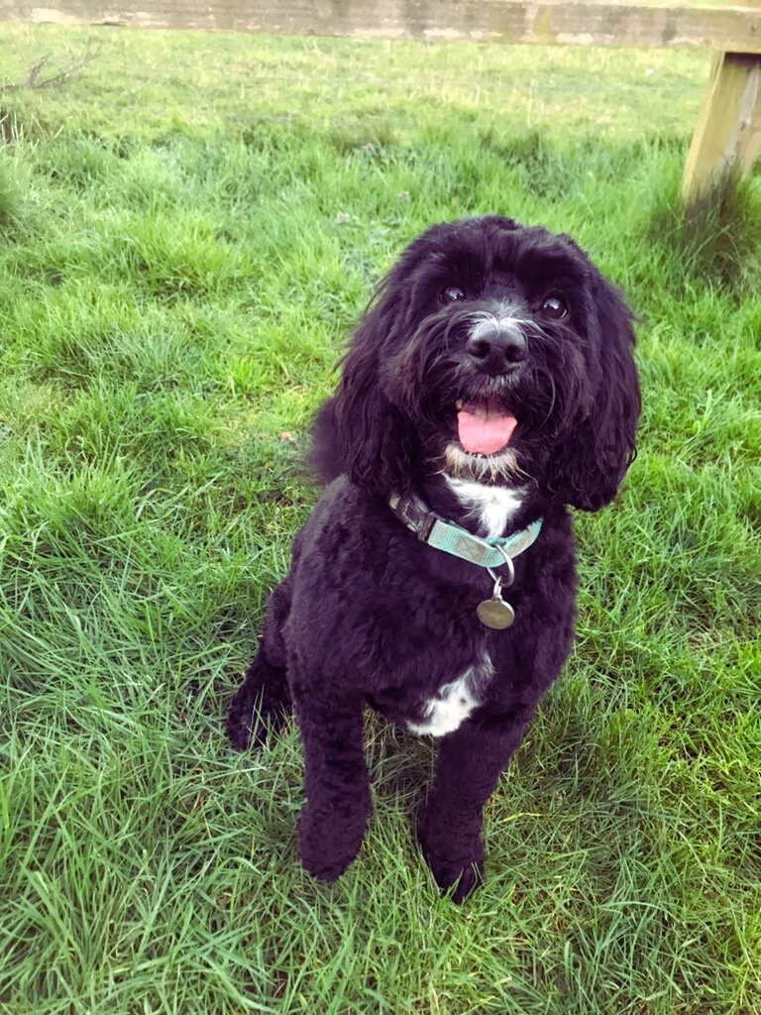
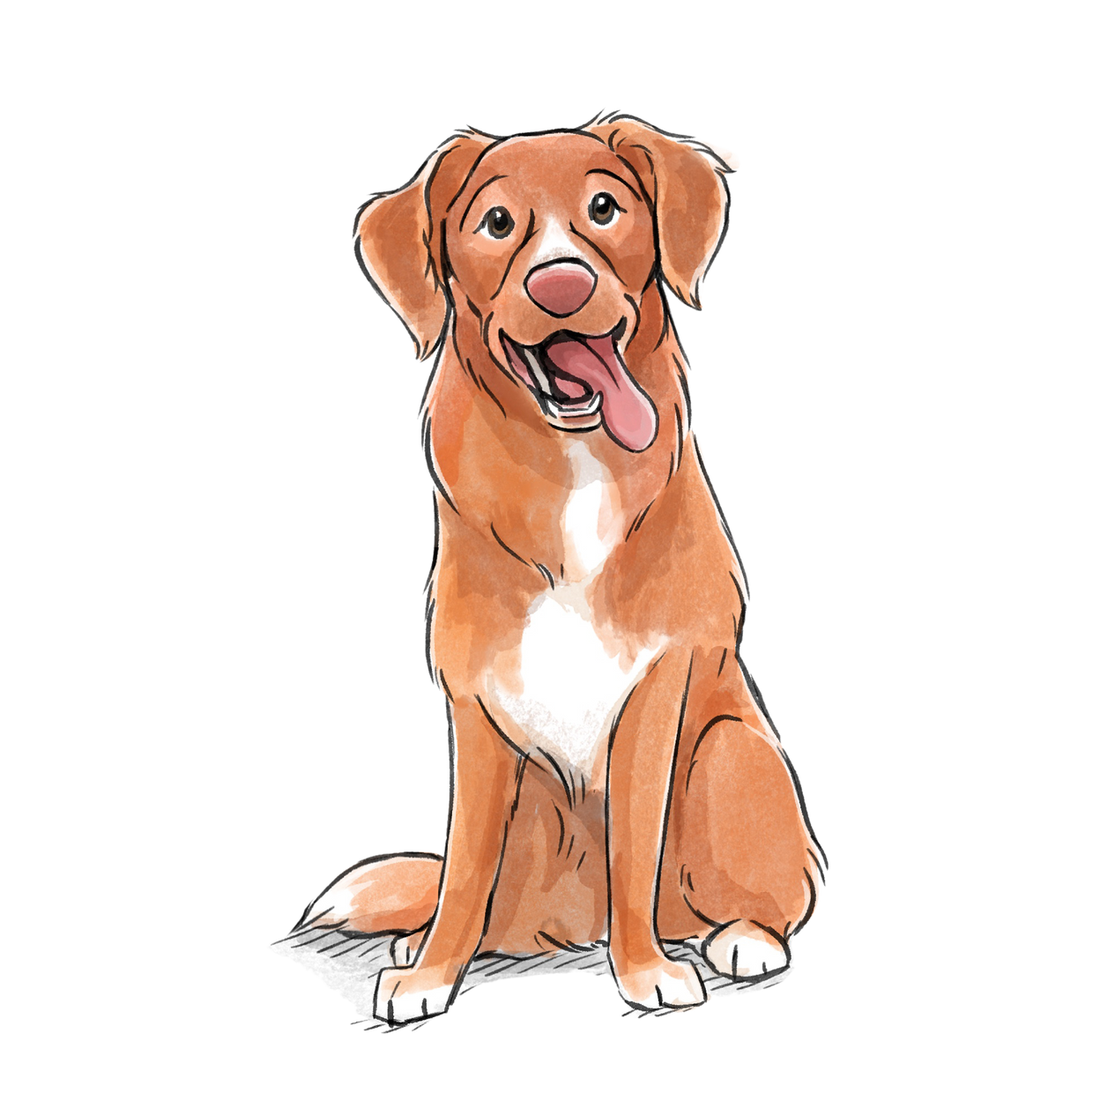


INTRODUCING
Our School Dog
Halle

Slide 2
Hi!
My name is Halle
I am a cockerpoo
I am four years old.

Slide 3
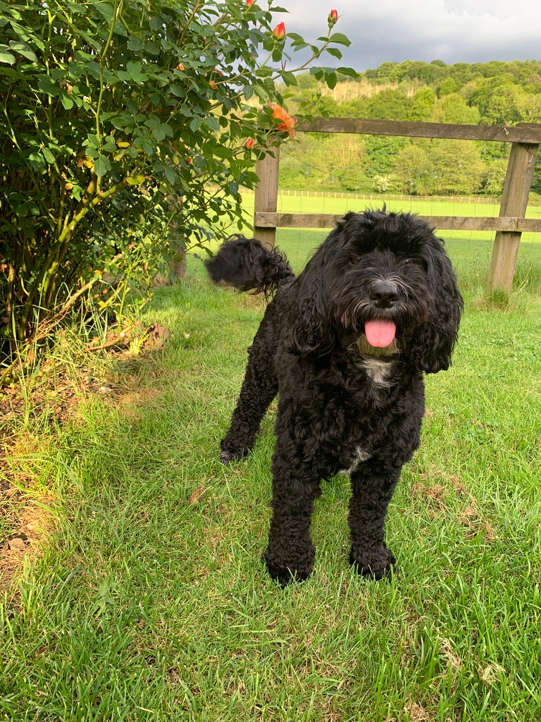
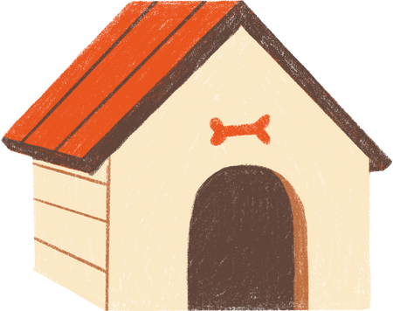
I live with Ms Holmes
and I will be working with you!

Slide 4
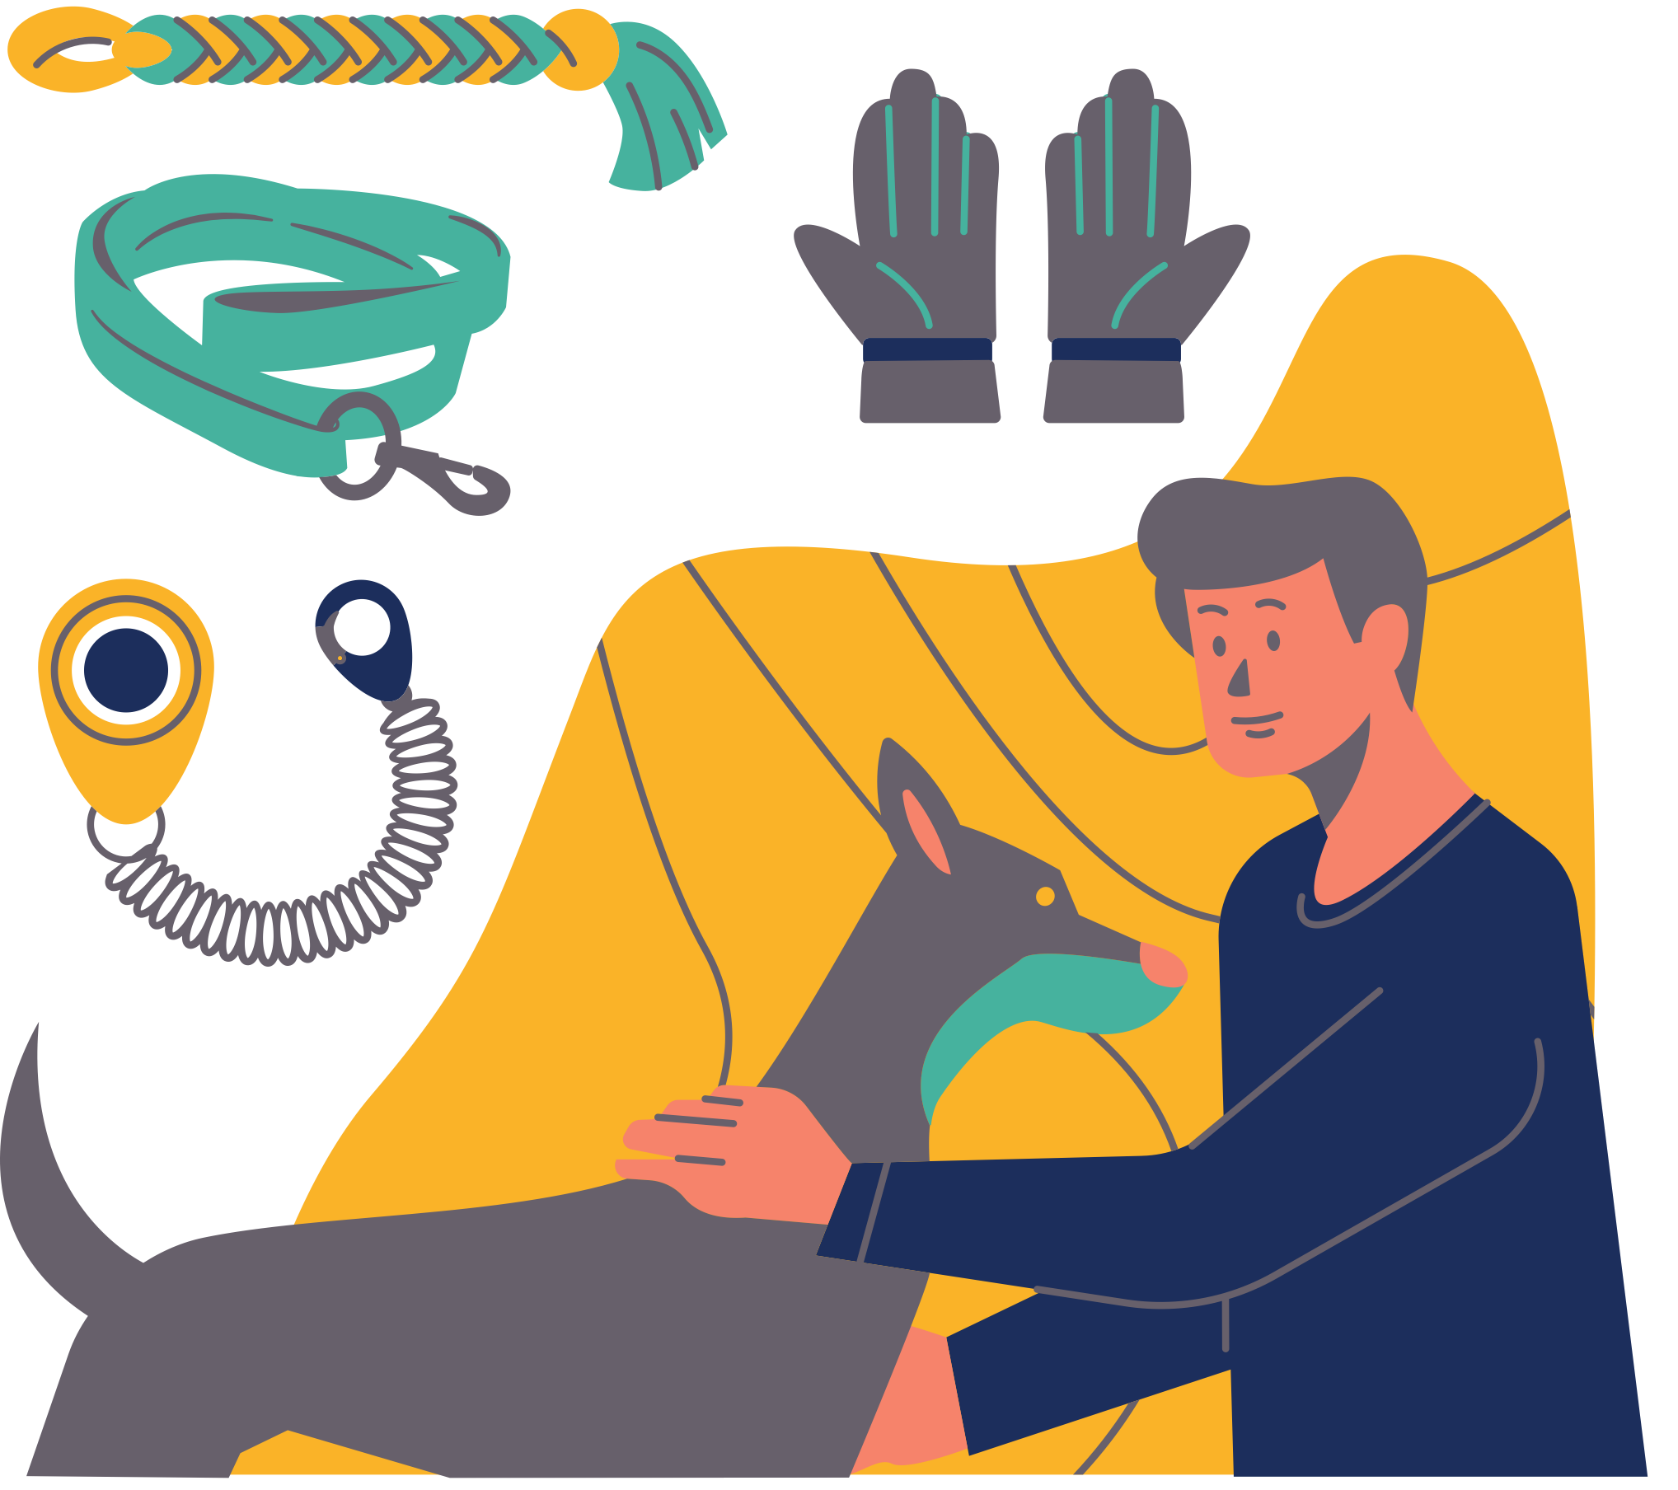
I’ve been working really hard training to be a school dog…
…but the training never stops!

Slide 5
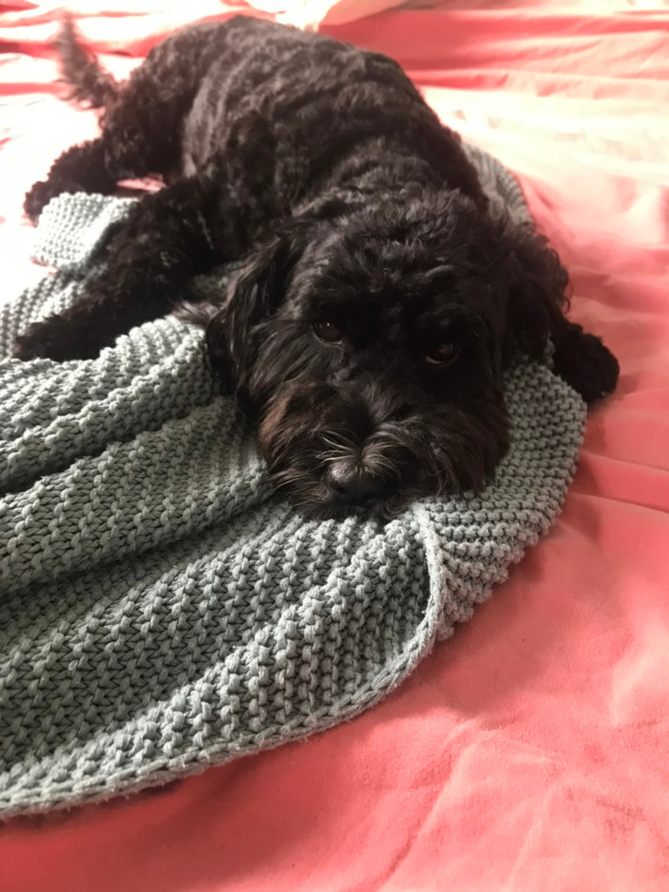
I need YOU to help me be the best school dog I can be.

Slide 6
These things can help:
  Please ask to say hello to me before saying my name or touching me
  Try not to leave food on the floor as it is very tempting for me to eat it and it could distract me.

Slide 7



These things can help:
  These foods are poisonous so please be extra safe with these
chocolate
raisins
caffeine

Slide 8
These things can help:
  When I am in the corridor or walking somewhere please don't distract me - I have a job to do. I will say hello to you another time
  When you come to say hello to me please listen to my body language and follow my lead. Do I want to be touched/stroked? How do you know?

Slide 9
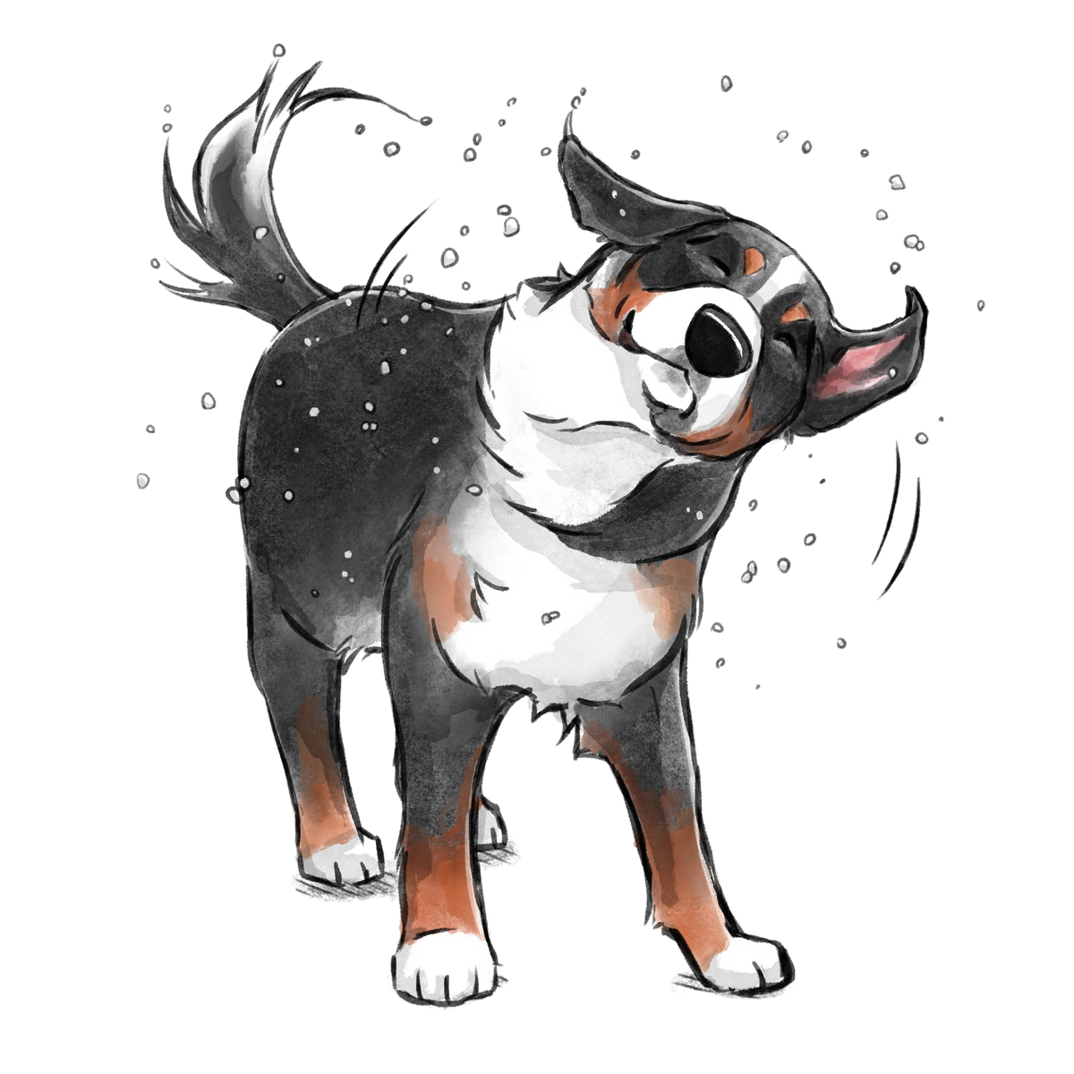


Watch this video it will help you learn some dog body language

Slide 10
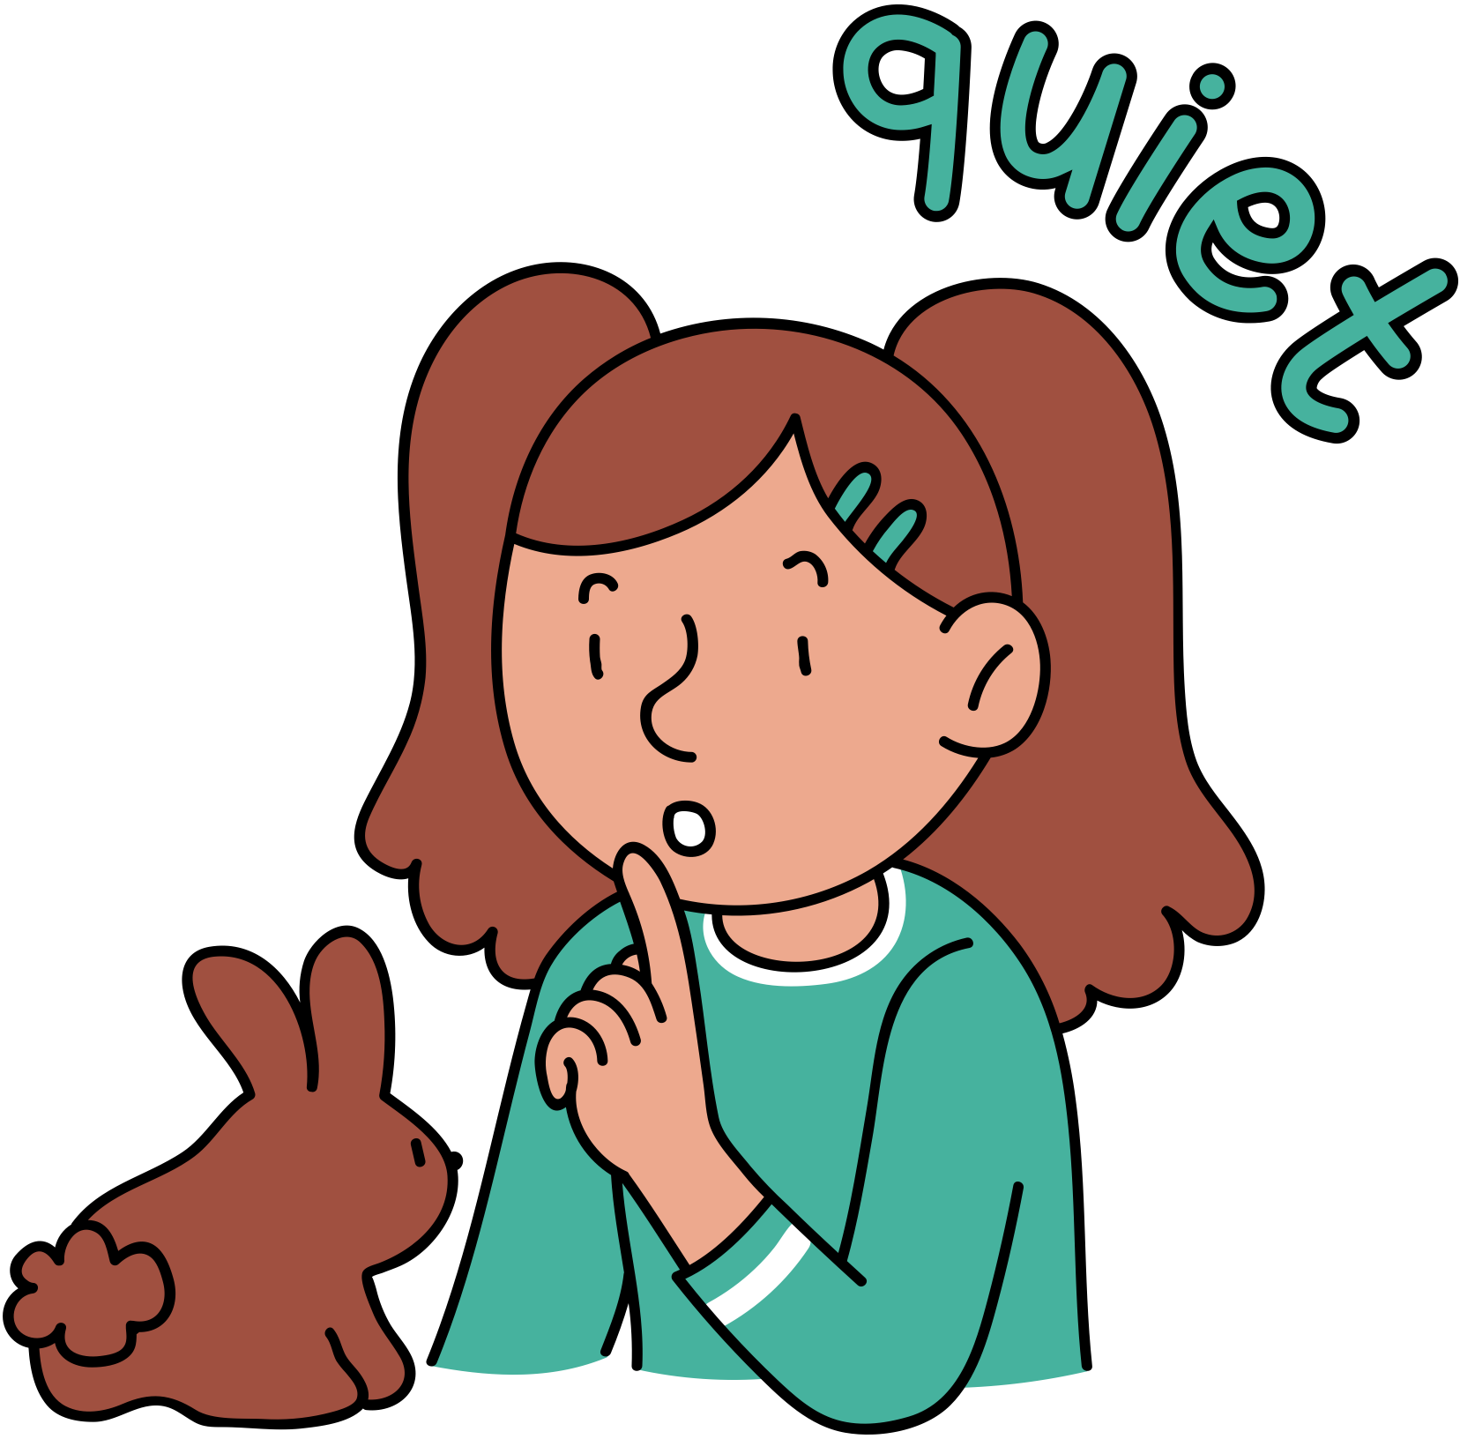
Dogs have very sensitive ears so being calm and quiet when near me will help

Slide 11

You will know when I'm at school because a sign will be up outside the school office
therapy dog at work

Slide 12
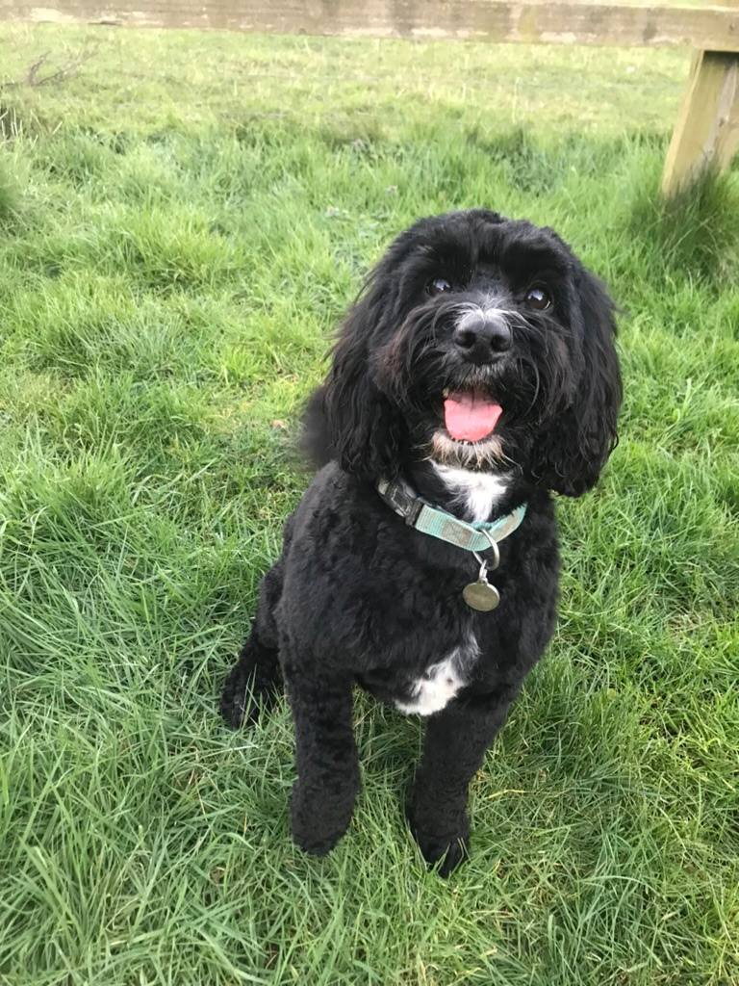
Thank you for helping me to settle into my new role.
Please be patient while I get used to coming to school.

Slide 13
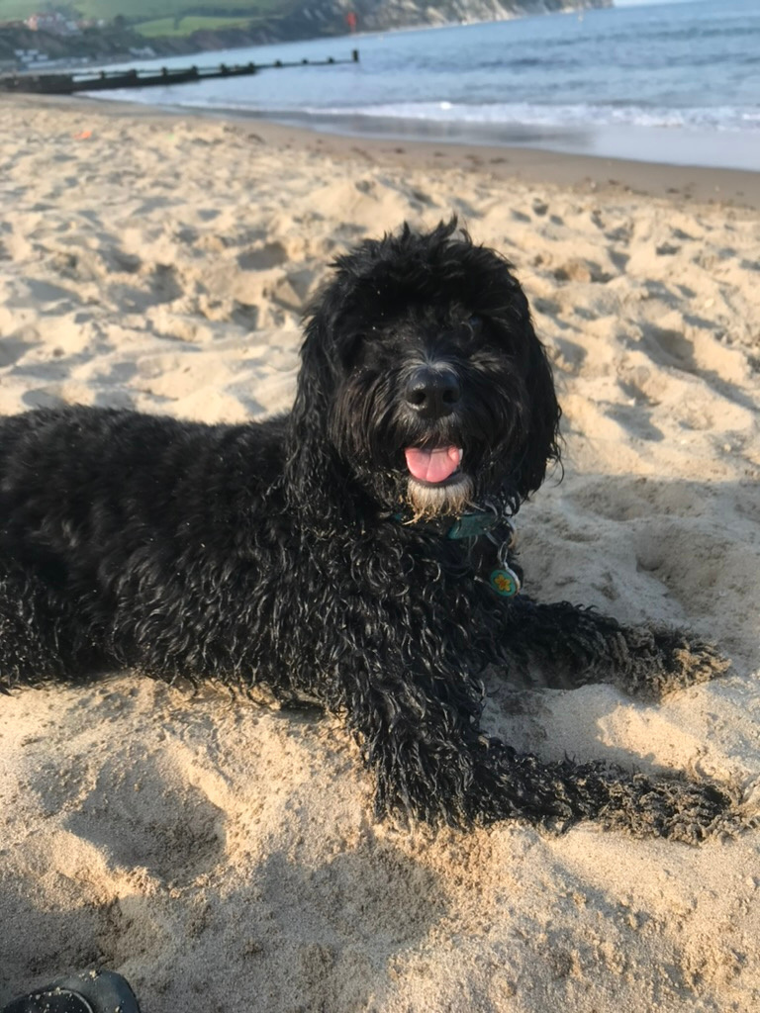
See you soon!

