Slide 1
Bus stop method

Slide 2
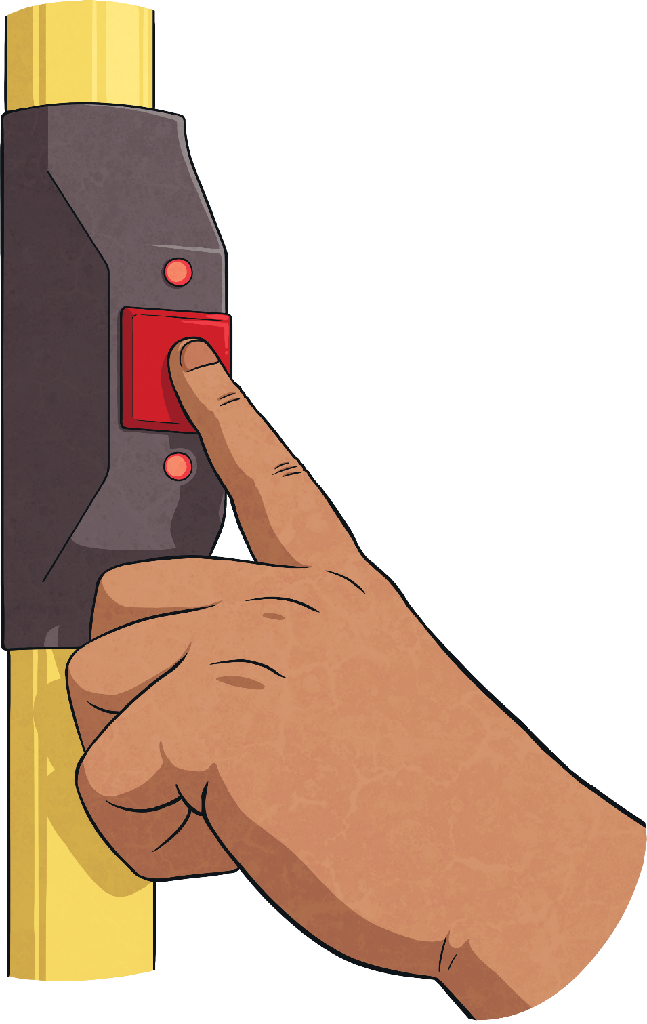
29
145 ÷ 5 =
0
2
9
5
1
1
4
4
5
How many are left over?
How many 5s are there in 1?
Great!
How many 5’s are there in 14?
How many 5s are there in 45?
How many are left over?

Slide 3
134
670 ÷ 5 =
1
3
4
5
6
1
7
2
0
How many are left over?
How many 5s are there in 20?
How many 5s are there in 6?
Great!
How many 5’s are there in 17?
How many are left over?

Slide 4
181
362 ÷ 2 =
1
8
1
2
3
1
6
2
How many 2’s are there in 16?
How many are left over?
How many 2s are there in 2?
How many 2s are there in 3?
Great!
How many are left over?

Slide 5
304
608 ÷ 2 =
3
0
4
2
6
0
8
How many 2s are there in 6?
How many 2’s are there in 0?
How many 2s are there in 8?
How many are left over?
Great!
How many are left over?

Slide 6
214
642 ÷ 3 =
2
1
4
3
6
4
1
2
How many 3s are there in 12?
How many 3’s are there in 4?
How many 3s are there in 6?
How many are left over?
Great!
How many are left over?

Slide 7
128
512 ÷ 4 =
1
2
8
4
5
1
1
3
2
How many 4’s are there in 11?
How many 4s are there in 32?
How many are left over?
How many 4s are there in 5?
Great!
How many are left over?

