Slide 2
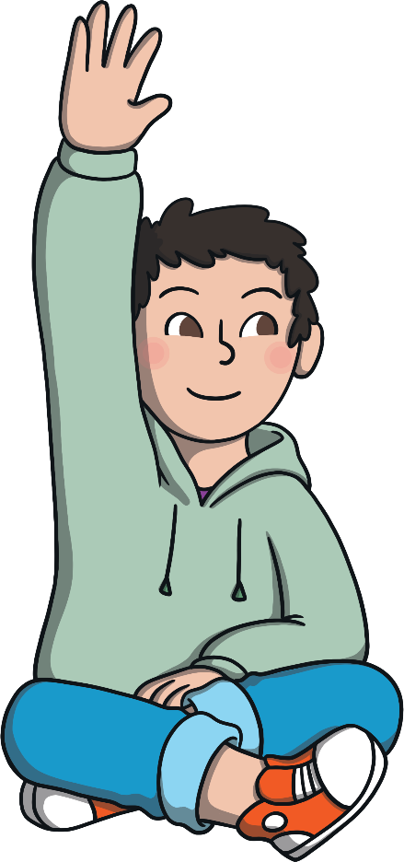
The boys put hands up at the same time.
there
A
their
B
they’re
C

Slide 3

“Look at that beautiful rainbow over !” she gasped.
there
A
their
B
they’re
C

Slide 4
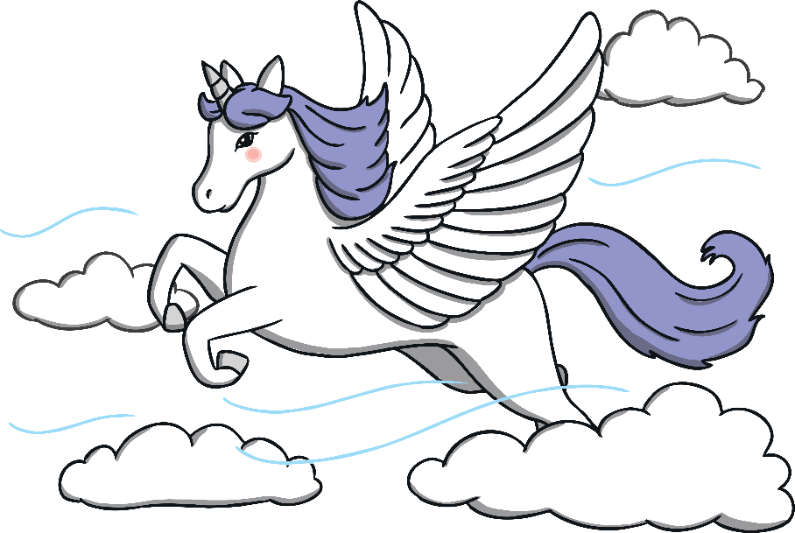
Are you sure not real?
there
A
their
B
they’re
C

Slide 5
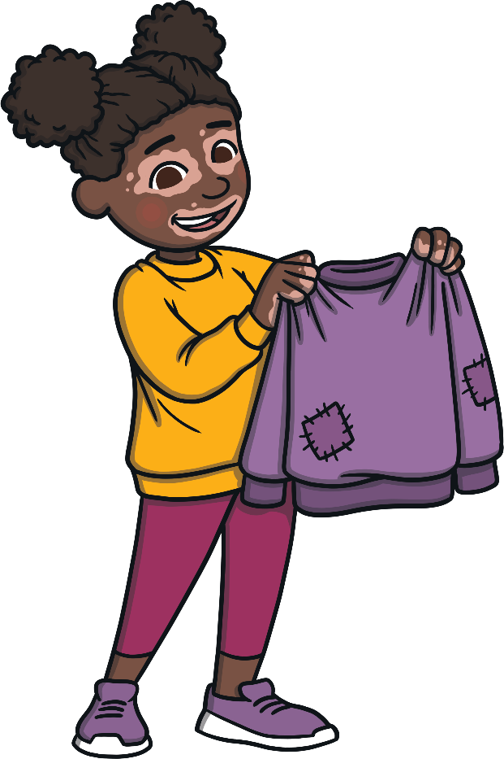
jumpers are on the pegs.
There
A
Their
B
They’re
C

Slide 6

going to be late!
There
A
Their
B
They’re
C

Slide 7

Put the book over on the shelf.
there
A
their
B
they’re
C

Slide 8
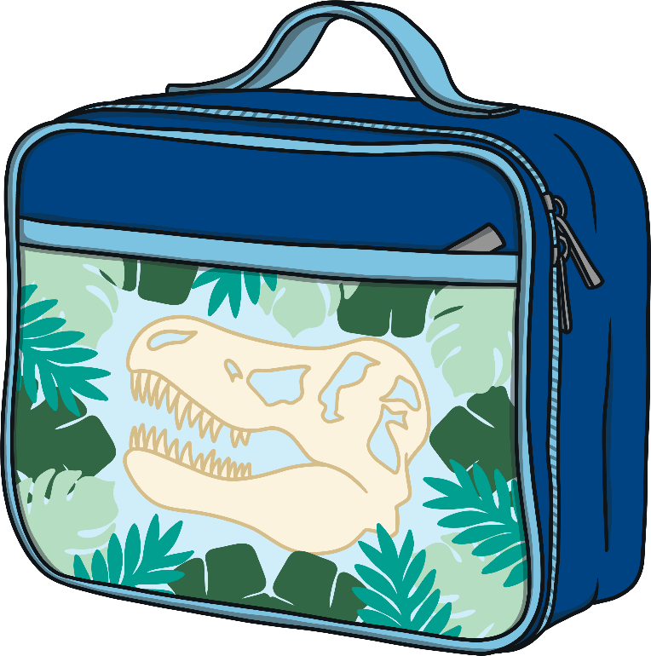
That lunch box is .
theres
A
theirs
B
they'res
C

Slide 9
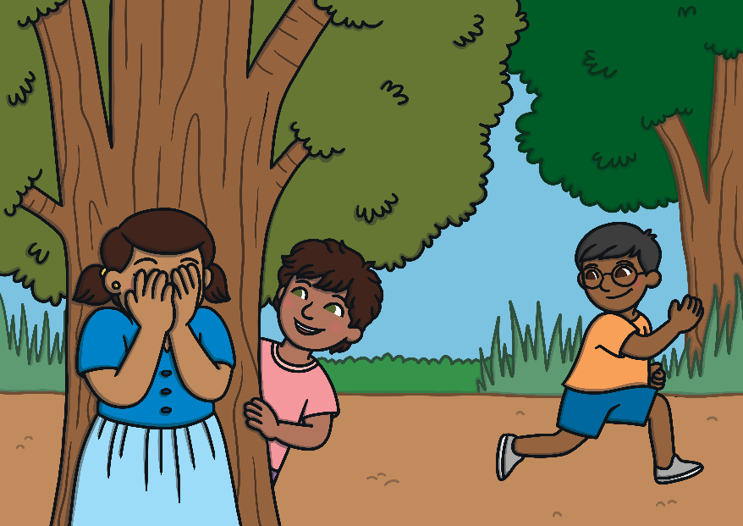
Do you think hiding?
there
A
their
B
they’re
C

Slide 10
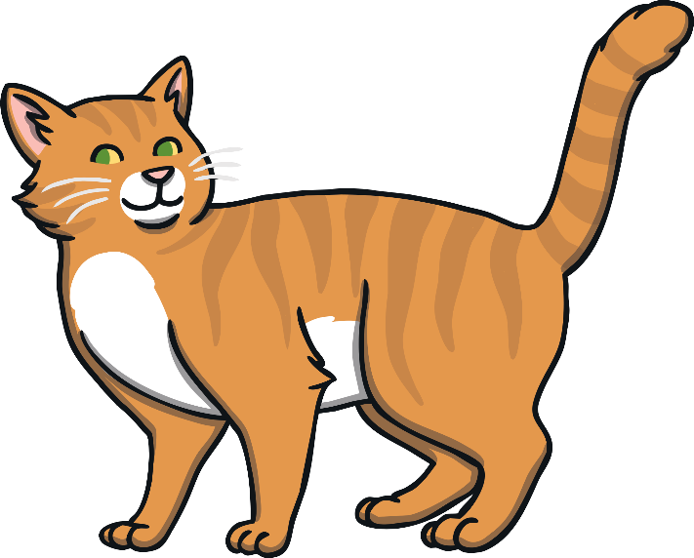
was a cat in the playground yesterday.
There
A
Their
B
They’re
C

Slide 11

I’m going to sit over .
there
A
their
B
they’re
C

Slide 12
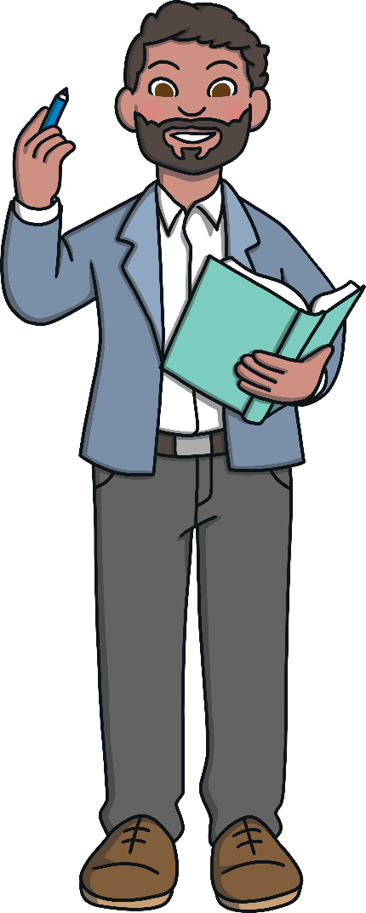
The teacher lost pen.
there
A
their
B
they’re
C

Slide 13
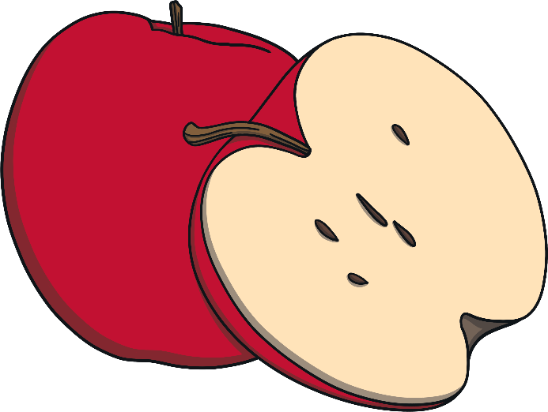
Apples are the best fruit. my favourite.
There
A
Their
B
They’re
C

