Slide 1



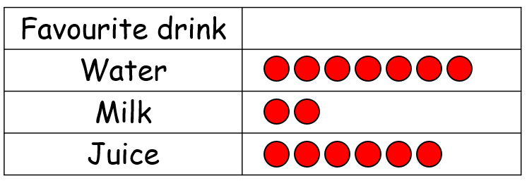

Year 2 | Week 9 | Day 2
1) Which fruit is to the left of the pear?
2) Which drink is least popular?
3) What time is shown?
4)
Order 62, 87 and 78 from smallest to greatest.

Slide 2
Year 2 | Week 9 | Day 2
1) Which fruit is to the left of the pear?
2) Which drink is least popular?
3) What time is shown?
4)
Milk
Quarter to 5
Order 62, 87 and 78 from smallest to greatest.
62, 78, 87

Slide 3
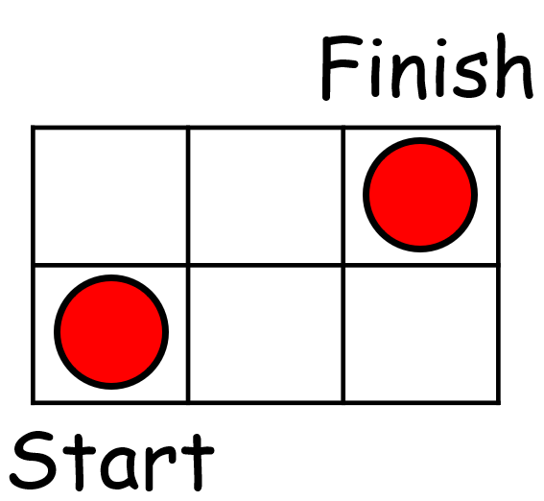
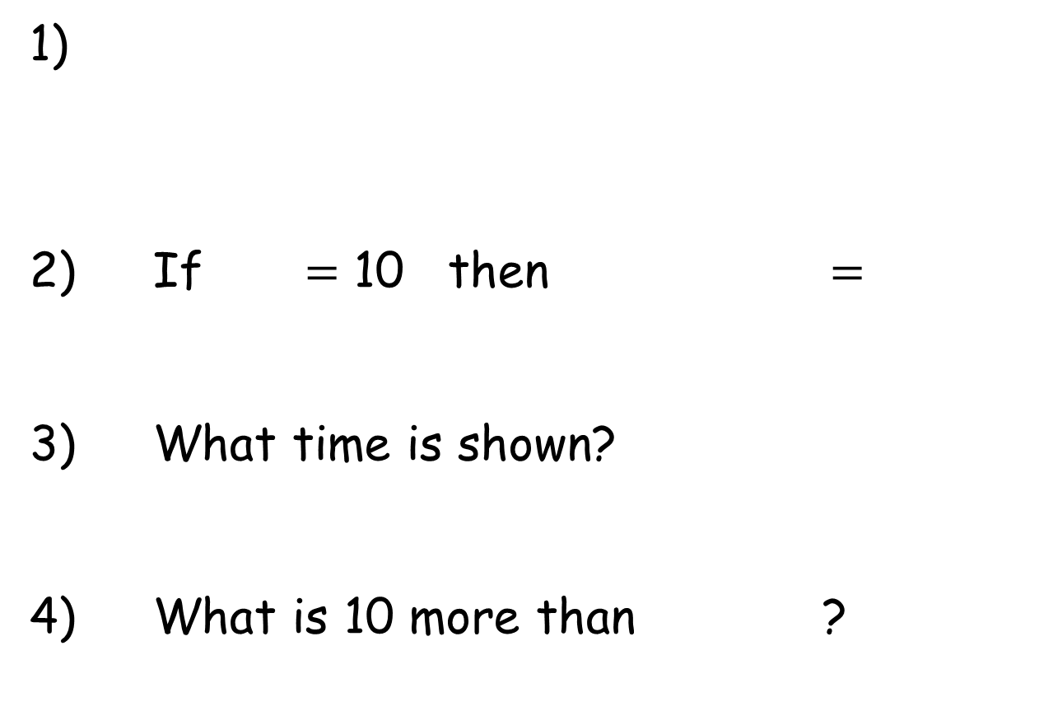
Year 2 | Week 9 | Day 4
The counter has moved 2 squares ______ and 1 square ______ .
1)
2) If $=$ 10 then $=$
3) What time is shown?
4) What is 10 more than ?

Slide 4
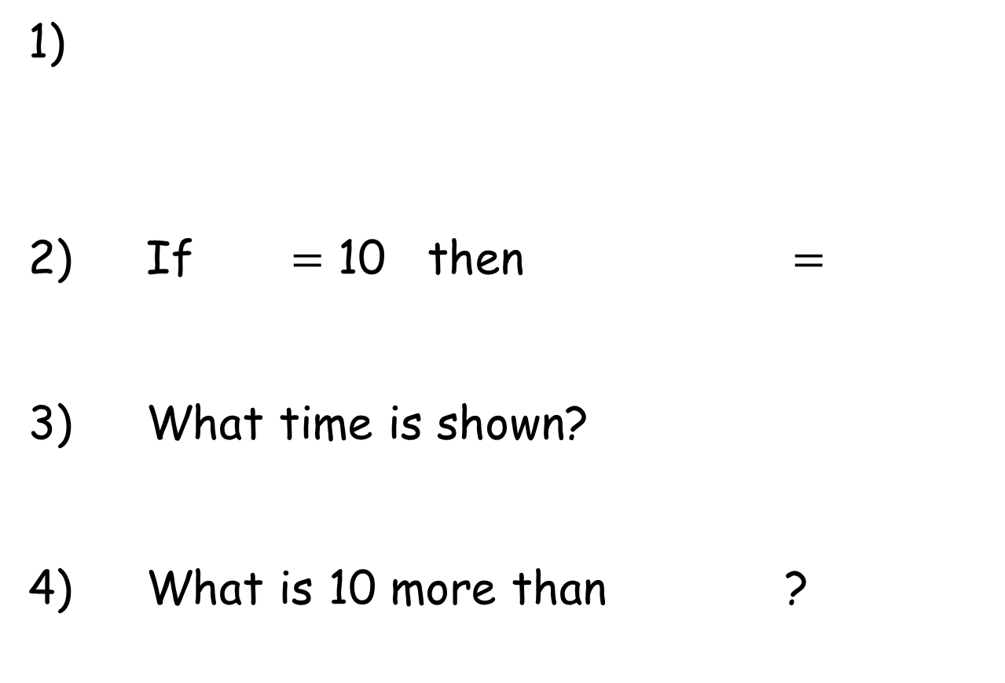
Year 2 | Week 9 | Day 4
The counter has moved 2 squares ______ and 1 square ______ .
1)
2) If $=$ 10 then $=$
3) What time is shown?
4) What is 10 more than ?
right
up
35
10 minutes to 9
53

Slide 5


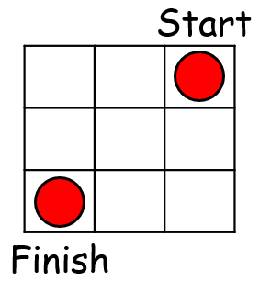
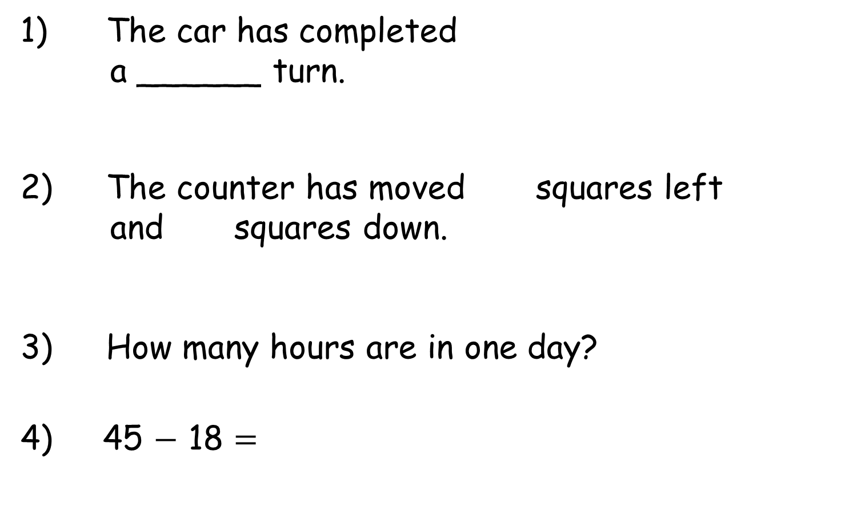
Year 2 | Week 10 | Day 2
1) The car has completed
a ______ turn.
2) The counter has moved squares left
and squares down.
3) How many hours are in one day?
4) 45 $−$ 18 $=$

Slide 6
Year 2 | Week 10 | Day 2
1) The car has completed
a ______ turn.
2) The counter has moved squares left
and squares down.
3) How many hours are in one day?
4) 45 $−$ 18 $=$
half
2
2
24 hours
27

