Slide 1
Welcome to our Parent Reading Workshop
24.9.24

Slide 2
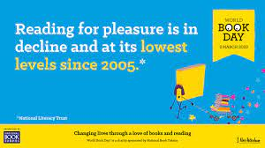
The survey of 71,400 children and young people by the National Literacy Trust early in 2023 has revealed that fewer than one in three children (28%) aged eight to 18 read daily for enjoyment.
This also links with writing!

Slide 3
Impact of reading – based on 180 days
Amount of reading | 20 mins | 5 mins | 1 min
Number of minutes per year | 3600 | 900 | 180
Number of words per year | 1.8 Million | 282,000 | 8000
Hours read by the end of primary school | 851 | 212 | 42
Performance on tests | 90% | 50% | 10%

Slide 4
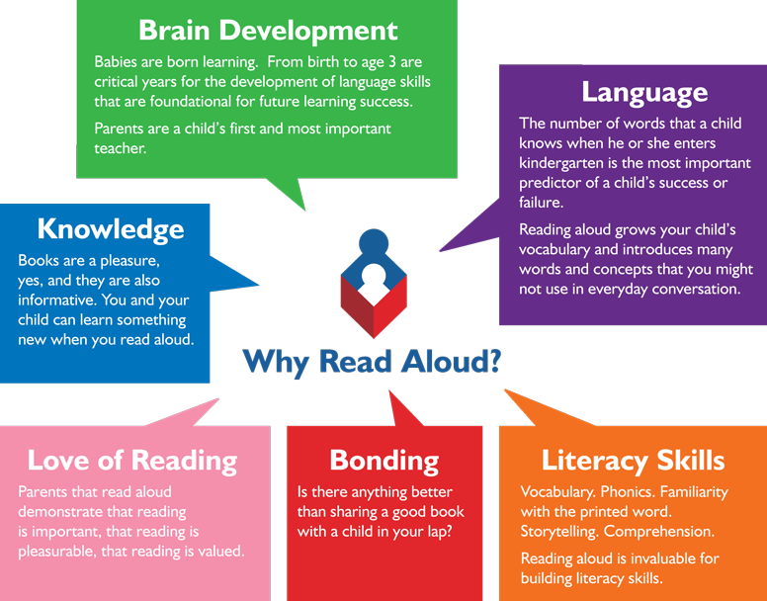
Reading from an early age and securing phonics
Reading from an early age is important.
In order to get children fluent in reading, their phonic knowledge must be embedded.
Read to children from day zero!

Slide 5
What is fluency and why is it important?
Fluent reading supports comprehension. When pupils read fluently, they can focus on comprehending the text rather than decoding.
For a child to be fluent, phonic knowledge is important.
When a child is fluent, we can focus on understanding and comprehension.
This is why we focus on phonics a lot in EYFS and KS1!

Slide 6
Phonics
Phonics is matching the sounds of spoken English with individual or groups of letters.
At St Nicolas, we follow ‘RWI phonics.’
We teach the initial letter sounds, followed by set 2 and set 3 (special friends).
Children learn to read by using Fred talk and then blending the sounds together.
Meet Fred! He can only say the sounds in a word.
If children get stuck, we say ‘special friends, Fred talk, read the word.
https://home.oxfordowl.co.uk/reading/reading-schemes-oxford-levels/read-write-inc-phonics-guide/

Slide 7

Special friends, Fred talk, read the word

Slide 8

Special friends, Fred talk, read the word

Slide 9
Phonics
If your child gets stuck on a word at home, use the phrase:
Special friends, Fred talk, read the word
Have a go using the books on your table.

Slide 10
Other ways you can help build fluency at home…
Read and follow – the adult reads the text and the child follows
along with their finger. This helps the child with word recognition and models to them how they should read with fluency.
2. My turn, your turn – take turns reading a page, paragraph or sentence. Here you are modelling how to read with fluency, flow and expression.
3. Echo Reading – as you read, the child copies with you. It is important here to pace yourself and read at a rate that your child can keep up with.
You can also echo read by you (the adult) reading a sentence/paragraph and then the child repeats.
Let’s have a go!

Slide 11
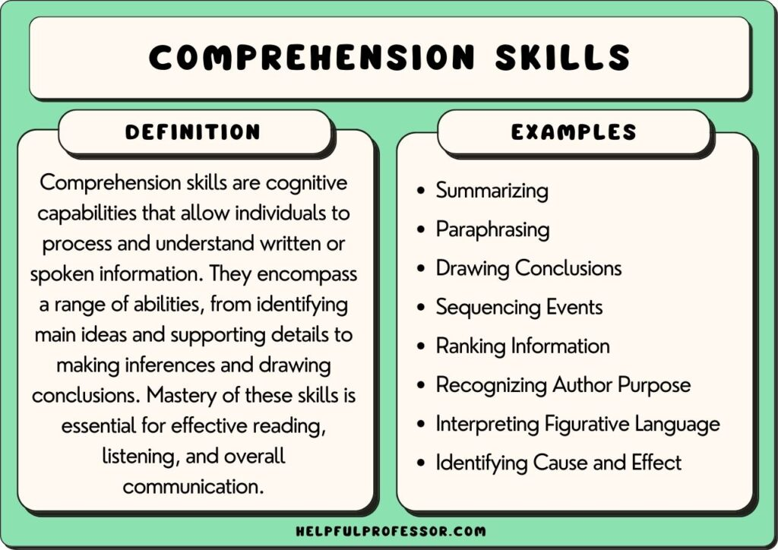
What is comprehension?
This refers to the understanding of a text.
There are cases of where children are able to read thanks to secure phonics knowledge and the ability to decode but do not understand what they have read.

Slide 12
Teaching comprehension
Asking children questions about what they have read is the best way to support comprehension at home. This can be a book they are reading but also if you are reading a book to your child.
Stop regularly to discuss what is happening – it doesn’t have to be a Q&A session, just a chat about how a character might be feeling, or relating it to something you may have done as a family.

Slide 13
What reading at home looks like
Reading is best in a quiet/calm space.
Find a time that works best for you and your child – routines!
Children need to be reading aloud to an adult – this is still important higher up the school as helps fluency – though doesn’t need to be every night!
Don’t make it a stressful experience – 1 page is better than no page!
Chat about the books they are reading to you.
Encourage children to re-read books, this develops their fluency.
Read books to your children (audio books in the car, a book on the go before bed).

Slide 14
How to encourage reading at home
Show that you love reading (even if you have to fake it!)
Take your child to the library regularly.
Book swaps between friends.
Exposing children to texts beyond novels. E.g. comics, magazines, non-fiction books.
Read to a pet.
Take control of how screen time is used.
Give children books that matter to them (hobbies, authors and characters, texts that excite them).
Class page has recommended reads.

Slide 15
For you to take…
-Sounds and the rhymes
-Comprehension questions
I shall put the PPT on our class page

Slide 16
Any questions?

