Slide 1
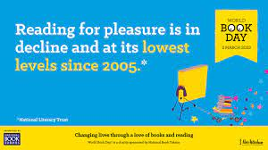
The survey of 71,400 children and young people by the National Literacy Trust early in 2023 has revealed that fewer than one in three children (28%) aged eight to 18 read daily for enjoyment.

Slide 2
Impact of reading
Amount of reading | 20 mins | 5 mins | 1 min
Number of minutes per year | 3600 | 900 | 180
Number of words per year | 1.8 Million | 282,000 | 8000
Hours read by the end of primary school | 851 | 212 | 42
Performance on tests | 90% | 50% | 10%

Slide 3
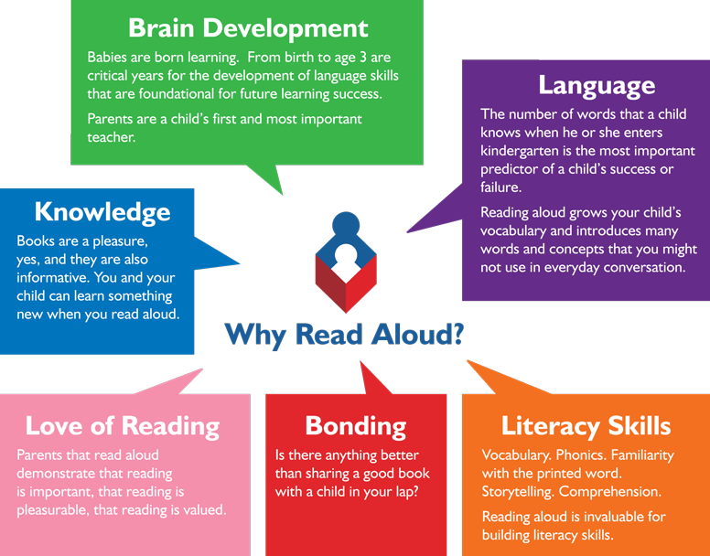
Reading from an early age and securing phonics
Reading from an early age is important.
In order to get children fluent in reading, their phonic knowledge must be embedded.
Read to children from day zero!

Slide 4
What is fluency and why is it important?
Fluent reading supports reading comprehension. When pupils read fluently, their cognitive resources can be redirected from focusing on decoding and onto comprehending the text.
For a child to be fluent, phonic knowledge is important.
When a child is fluent, we can focus on understanding and comprehension.
When comprehension is secure, the child will enjoy what they read.

Slide 5
Three ways you can help build fluency at home…
Read and follow – the adult reads the text and the child follows along with their finger. This helps the child with word recognition and models to them how they should read with fluency.
My turn, your turn – take turns reading a page, paragraph or sentence. Here you are modelling how to read with fluency, flow and expression.
Echo Reading – as you read, the child copies. It is important here to pace yourself and read at a rate that your child can keep up with.
Let’s have a go!

Slide 6
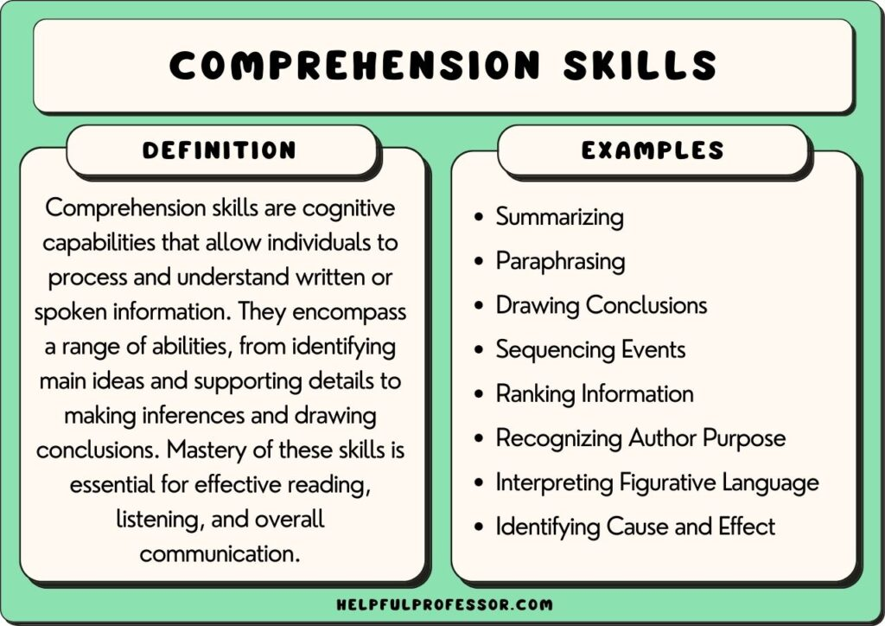
What is comprehension?
This refers to the understanding of a text.
There are cases of where children are able to read thanks to secure phonics knowledge and the ability to decode but do not understand what they have read.

Slide 7
What reading at home looks like
Reading is best in a quiet space
Find a time that works best for you and your child – routines!
Children need to be reading aloud to an adult – this is still important higher up the school as helps fluency – though doesn’t need to be every night!
Don’t make it a stressful experience – 1 page is better than no page!
Ask questions after your child has read.
Encourage children to re-read books, this develops their fluency.
Read books to your children (audio books in the car, a book on the go before bed).

Slide 8
How to encourage reading at home
Show that you love reading (even if you have to fake it!)
Take your child to the library regularly
Book swaps between friends
Exposing children to texts beyond novels. E.g. comics, magazines, non-fiction books
Read to a pet
Take control of how screen time is used
Give children books that matter to them (hobbies, authors and characters, texts that excite them)
Class page has recommended reads

