Slide 1



Slide 2
Mental Health – What can we all do to help our children?
Wednesday 28th November 2018
Jenny Hooper

Slide 3
What is Mental Health?
The strength and capacity of our minds to grow and develop, to be able to overcome difficulties and challenges and to make the most of our abilities and opportunities.
“Mental health is defined as a state of wellbeing in which every individual realises his or her own potential, can cope with the normal stresses of life, can work productively and fruitfully, and is able to make a contribution to her or his community.”
World health organisation 2014
Young Minds, 2006

Slide 4
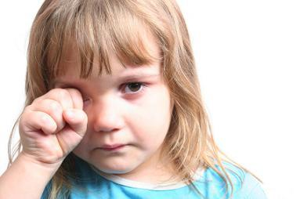
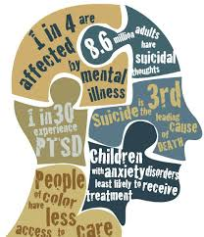
Facts and Figures
      28% of pre-school children face problems that have an impact on their psychological development
One in ten 5 to 16yr-olds has a mental disorder
There is a growing mental health crisis in our schools. An estimated three children in every classroom have a diagnosable mental health problem, rising to one in four when we include emotional distress.

Slide 5
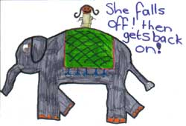
Mental Illness on a Continuum
Resilient
Vulnerable
Notes:
Introduce the idea of mental health upon a continuum and facilitate a discussion around recovery and the fact that it is possible to have good mental and emotional wellbeing despite having a diagnosis of a mental health disorder.
The emphasis is on the fact that we all have mental health challenges and various things affect our equilibrium. At any time in our lives we may be moving along the continuum.
Activity
Participants are asked to consider events and occurrences that would move them along the continuum.
The facilitator should make some suggestions such as bereavement pushing a person along towards the vulnerable end and winning the lottery placing you at the resilient end, or not?
Additional factors should be introduced and considered such as being made redundant, being bullied, achieving success in exams, feeling safe and secure and having someone to talk to who you can trust.

Slide 6
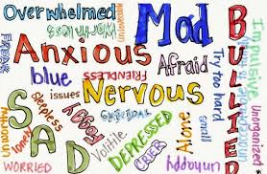
Anxiety – What are the signs?
‘Young people with Anxiety problems have ‘anxiety thermostats’ that are over-sensitive and ‘out of sync’ with the reality of the threat presented or remain on all the time’
– Carol Fitzpatrick, Helping Young People Manage Anxiety
In anxiety, the main feelings are of insecurity or fear.
As well as unpleasant feelings, anxiety can affect children in many other ways such as:
hyperventilating, rapid heart rate, dizziness,
trembling, nausea, stomach aches, head ache,
bed wetting , difficulty with sleeping,
nightmares, tics
and …

Slide 7
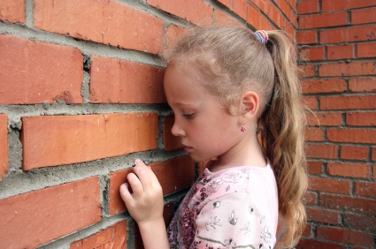
difficulty with concentration,
difficulty with making decisions,
becoming confused,
going blank,
distractibility,
obsessively hard working,
perceive work is not good enough,
trying to fade into the background (too quiet),
difficulty making and keeping friends,
bullied
physical or verbal aggression
They frequently feel like
they are ‘Going Mad’

Slide 8

At St Nicolas' staff are taught to use the following strategies to support children who feel stressed.
Be positive – smile when you see the child, show that you are pleased to see them, make every day a fresh start.
Listen – take time to find out how the day is going, what happened at the weekend, why playtime went wrong etc. If “now” is not the time, tell them when will be!
Talk to them – share your thoughts and experiences, be honest and open when possible, share your fears and anxieties, talk as a whole class about emotions.
Notice but don’t question –
‘I noticed that you seemed a bit stressed this morning.
Is there any way I can help?’
https://www.youtube.com/watch?v=nCrjevx3-Js&safe=true

Slide 9
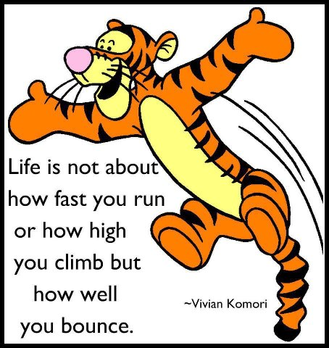
Teaching about Bouncebackability…
How to bounce back when life delivers you a set back, how to develop RESILIENCE.
Ensure children and young people know that not all stress is bad
eg a bit of adrenaline is good to enable high performance in sports /exams
Teach coping strategies for times when things are not going well
Help individuals to recognise their strengths
Problem solve with them - Actively listen then ask what they would ideally like to happen; help them to think about all possible approaches
Encourage rehearsal for how they would manage a stressful situation
Teach relaxation techniques and deep pressure activities

Slide 10
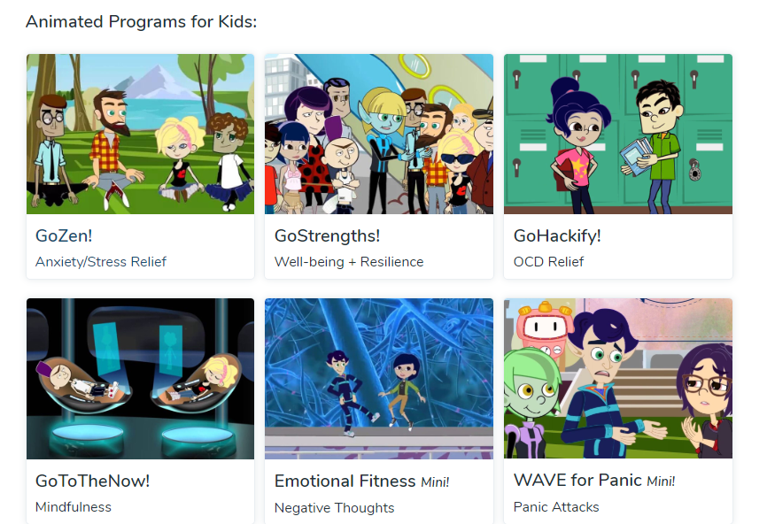
https://gozen.com/go/gozen/module1/1-4/

Slide 11

Teach children how to take care of their own mental health eg…
Five Ways to Positive Wellbeing
            Connect
            Be active
            Take notice
            Keep learning
            Give

