Slide 1
PHSE – Personal, Health and Social Education
Core areas -Health and well being, Relationships, Living in the wider world
Social and Emotional Aspects of Learning
Year Group | Term 1 | Term 2 | Term 3 | Term 4 | Term 5 | Term 6
Class 1 (R, 1, 2) | SEAL-New Beginnings Empathy • Self-awareness • Motivation • Social skills | SEAL-Getting on Falling out Anti-Bullying week Managing feelings • Empathy • Social skills | SEAL-Going For Goals Motivation • Self-awareness | SEAL-Good to be Me Self-awareness • Managing feelings • Empathy | SEAL-Relationships Self-awareness • Managing feelings • Empathy | SEAL-Changes Motivation • Social skills • Managing feelings
Year 3/ 4 | SEAL-New Beginnings Empathy • Self-awareness • Motivation • Social skills | SEAL-Getting on Falling out Anti-Bullying week Managing feelings • Empathy • Social skills | SEAL-Going For Goals Motivation • Self-awareness | SEAL-Good to be Me Self-awareness • Managing feelings • Empathy | SEAL-Relationships Self-awareness • Managing feelings • Empathy | SEAL-Changes Motivation • Social skills • Managing feelings
Year 5/ 6 | SEAL-New Beginnings Empathy • Self-awareness • Motivation • Social skills | SEAL-Getting on Falling out Anti-Bullying week Managing feelings • Empathy • Social skills | SEAL-Going For Goals Motivation • Self-awareness | SEAL-Good to be Me Self-awareness • Managing feelings • Empathy | SEAL-Relationships Self-awareness • Managing feelings • Empathy | SEAL-Changes Motivation • Social skills • Managing feelings

Slide 2
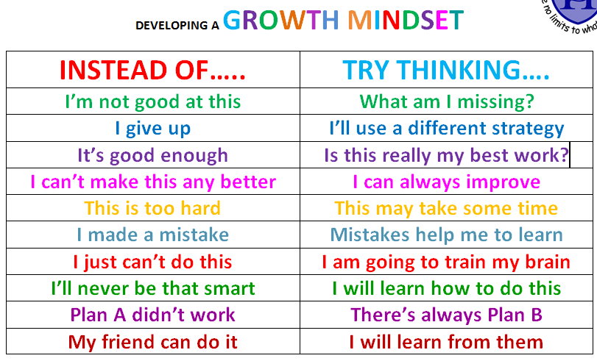
Well Being in school
Growth Mindset – promoting positive thinking.

Slide 3
What is class dojo?
Class dojo is a points system used for growth mindset and positive behaviour development.
Children get specific feedback for the learning behaviors.
It provides incentives for children to have a growth mindset.
Children achieve an individual certificate bronze, silver, and gold for gaining 25, 50,100 dojo points.
They can win or achieve experiences for earning the points as a class - extra playtime, an art afternoon, DVD, class picnic.
Children achieve a collective award as a class to enjoy.

Slide 4
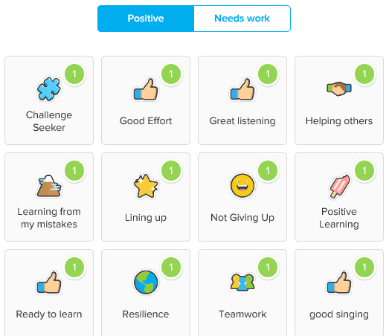
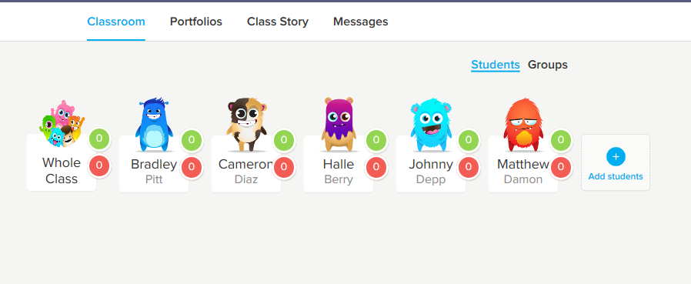
Well Being in School
Dojo points
Behaviours to build confidence and resilience
Class Page example
https://www.youtube.com/watch?v=Rzzb5cmNoc0

Slide 5
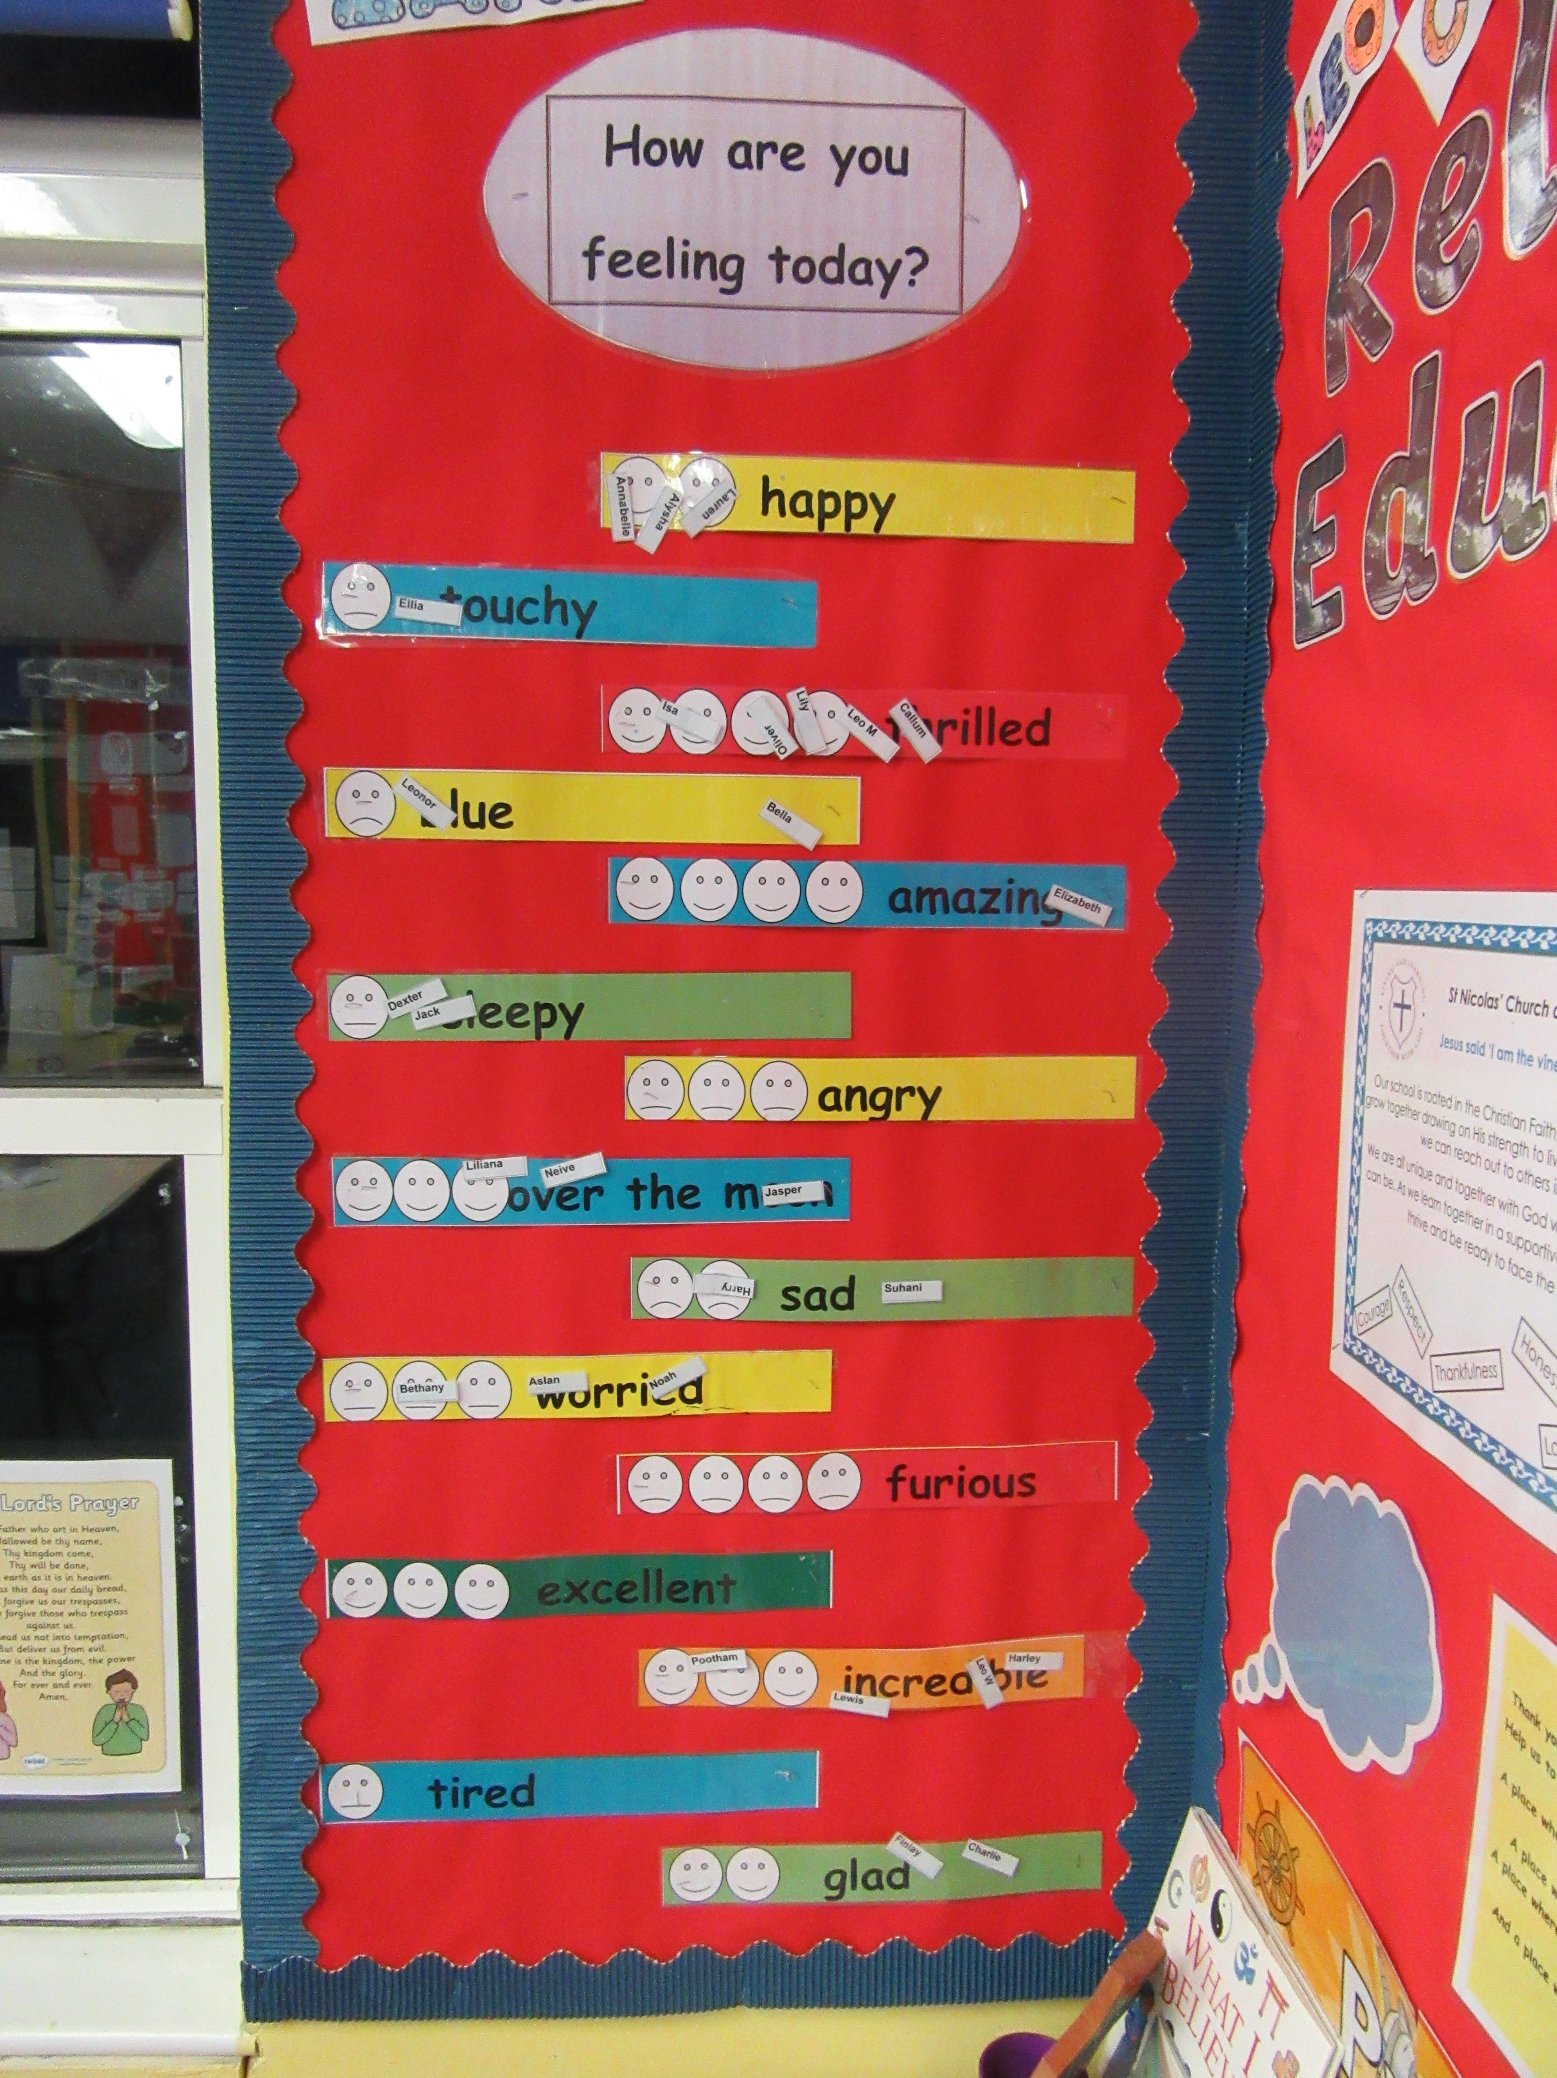
Mood Board or Mountain
Each class has a mood board or mountain for children to indicate how they are feeling on entering school in the morning and after lunch.
Teachers and LSA’s at a glance can see where children are and support them.

Slide 6
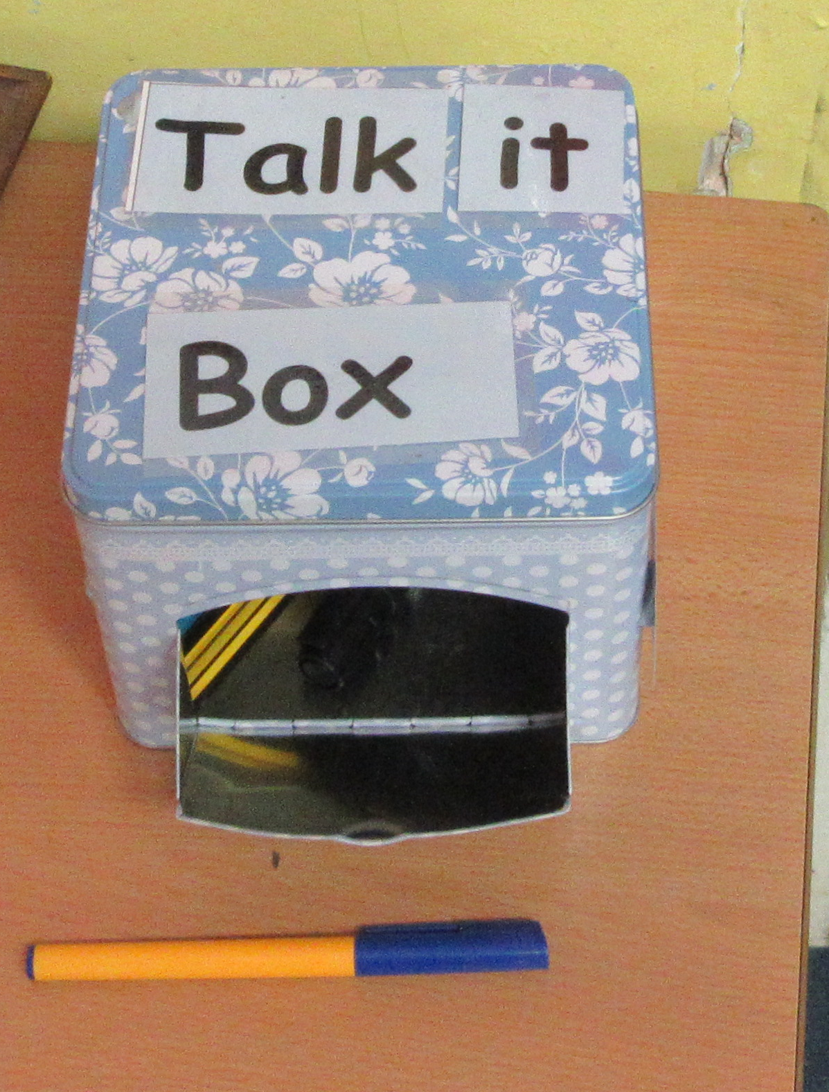
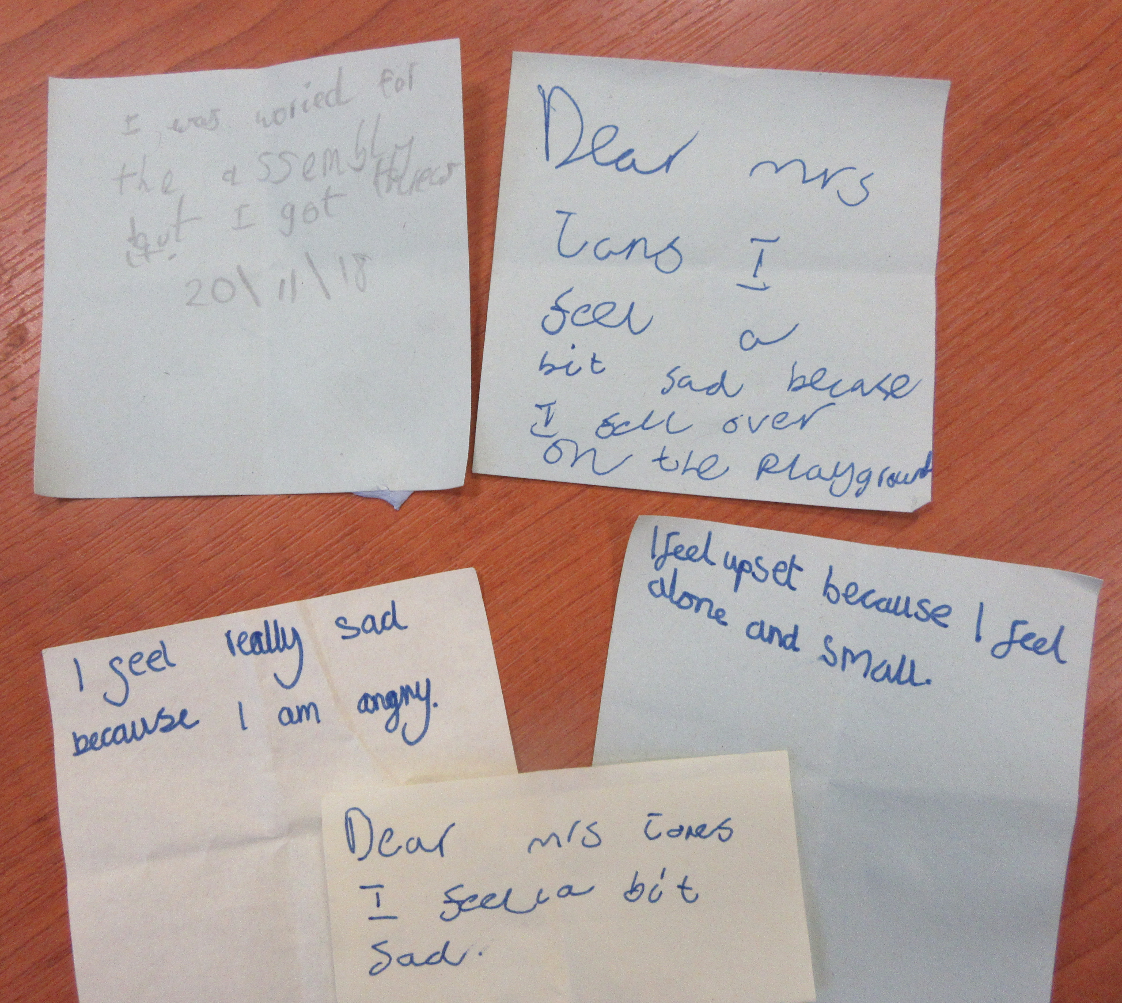
Talk/Message Box
Each class has a message box where children can write any concerns that they have or just things they would like to tell an adult but not in front of the whole class. We encourage children to put their names on the message but they do not have to.
These are checked by class teachers/LSA’s.

Slide 7

Resolving a problem at Play time
At playtimes include others.
Ask if not sure about a game. Listen calmly, be clear and honest.
Explain if you are leaving a game.
Let others know if you do not like what they do or say. Include how this makes you feel.
If they continue – walk away.
If they follow and continue tell a teacher/lunchtime supervisor. Say ‘We’ve tried to sort out a problem but we need help.’
Lunch time supervisor/teacher inform class teacher.
If other children try to get involved say thank you for trying to help. Make it clear to them that you are trying to sort out a problem.
Think about how our actions affect others both friends/peers and adults/teachers. (Empathy)

