Slide 1

St Nicolas’ Taplow
Single Academy Trust
Solar PV and TESLA battery storage project

Slide 2
Original project plan
Project inception – 2020
Covid delayed project to 2021 and install to Aug 2022
Baseline annual electric usage 32MWh
Annual bill @ 21-22 £5k based on 16p per KWh
Choice of technology and funding

Slide 3
Installation – Technology - SolarEdge
68 x Solar panels
2 x Inverters, 1 x 16Kwh & 1 x 9KWh
68 x Optimizers
24.91 MWh annual energy production
Cost £28k
ROI expected at 5 years based on 30p KWh

Slide 4
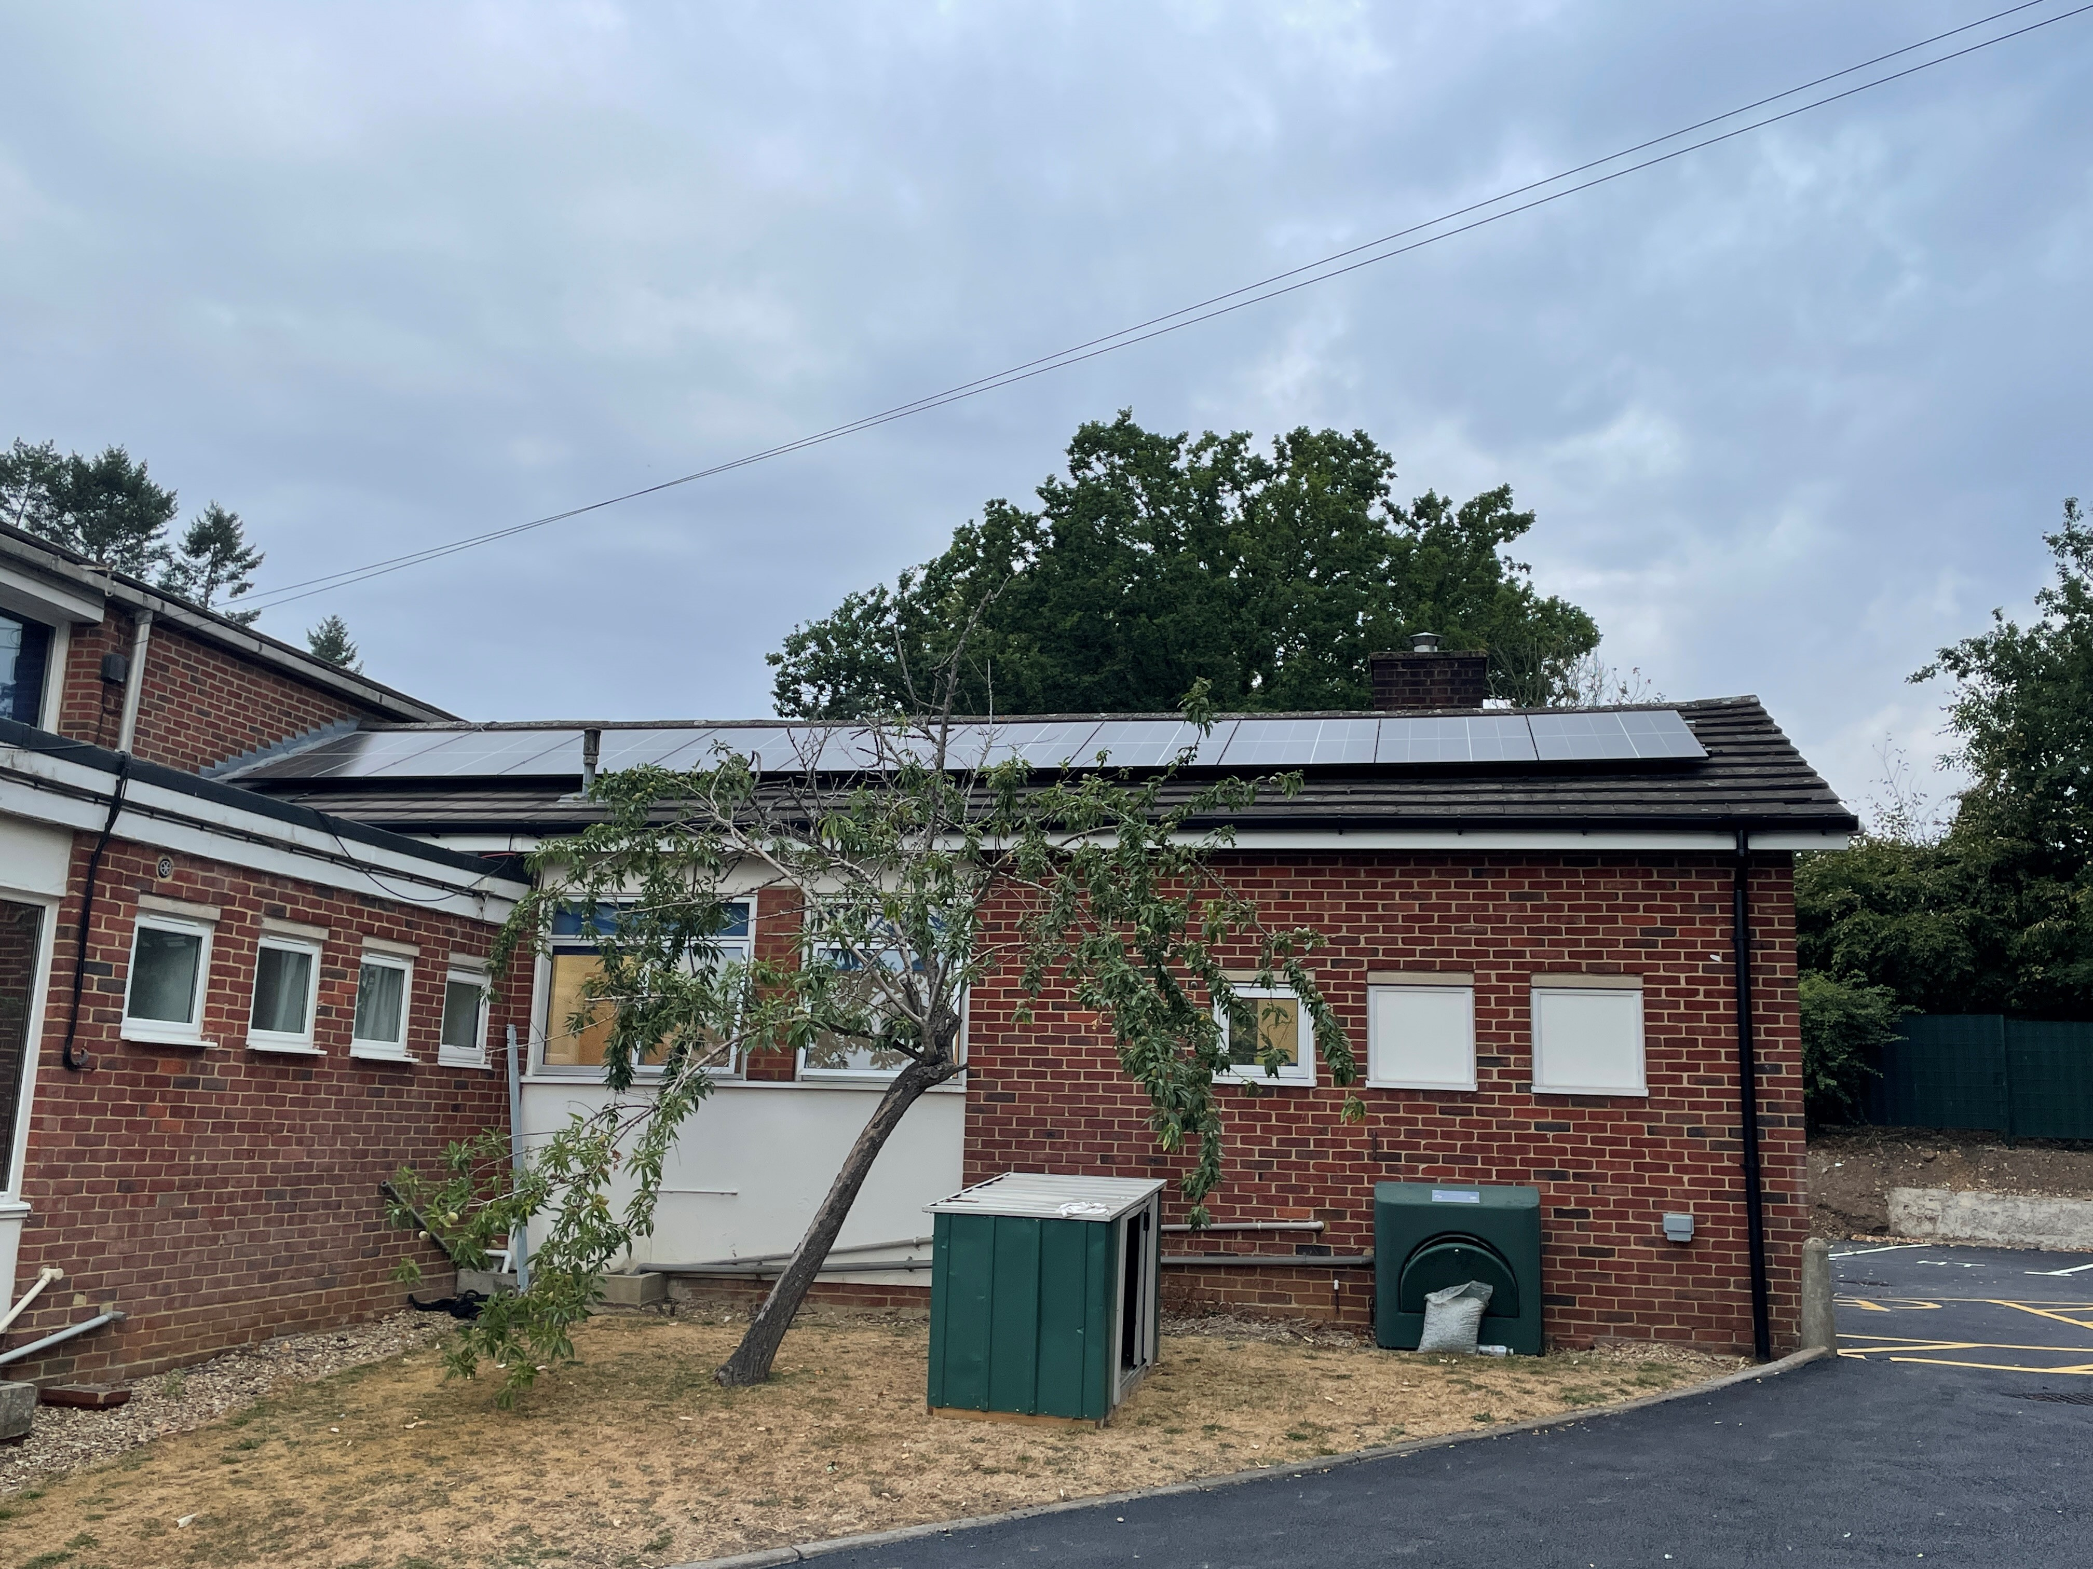

Slide 5
22-23 First Year – No batteries
First full month Sep 22 reduced import from 3.1MWh to 1.2MWh
Coincided with new electric contract, affected by energy crisis, which raised unit day rate cost to 68p, night rate 65p.
Raised full cost budget for year to £24k
  22-23 – Solar PV saved £11k
  23-24 – Solar and batteries budget £12k

Slide 6
23-24 Second Year – Batteries installed
3 x TESLA Powerwall AC2
13.5KWh storage each with a 5KWh inverter
£11k per battery, total project cost £33k
Battery warranty 10 years, service life 15 – 20 years
ROI expected at 10 years however solar PV profit after ROI achieved will reduce this to 7 years

Slide 7
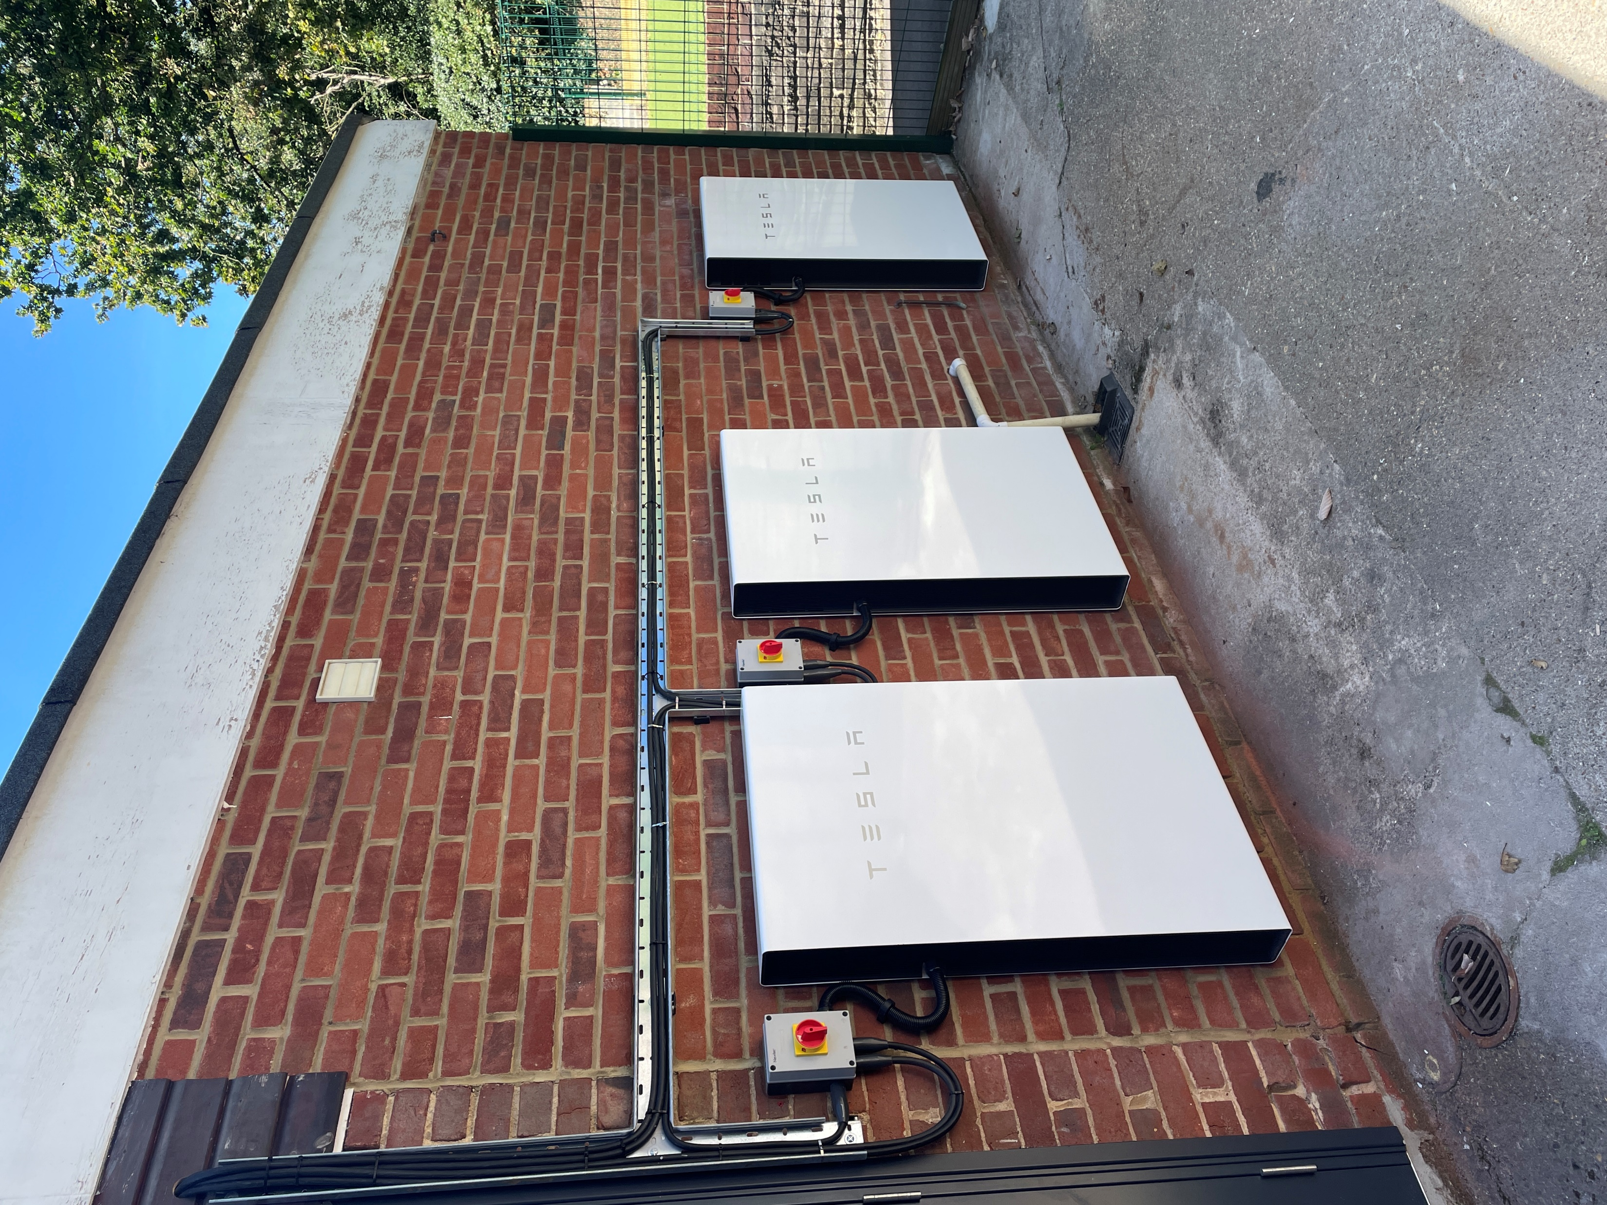
TESLA Powerwall install – Currently 3

Slide 8
Battery Benefits
Saves an additional 500 units import per month
Charge & discharge during the day
Batteries give you protection from grid outage
During winter months charge from grid at night saves £25 a month
School off grid for summer months May – Sep*

Slide 9
Solar project initial six year savings projections

Slide 10
Environmental Benefits - Since Aug 22
6,863 Kg of CO2 emissions saved
415 equivalent trees planted

Slide 11
Export Income
Export income – Yes or No?

