Slide 1




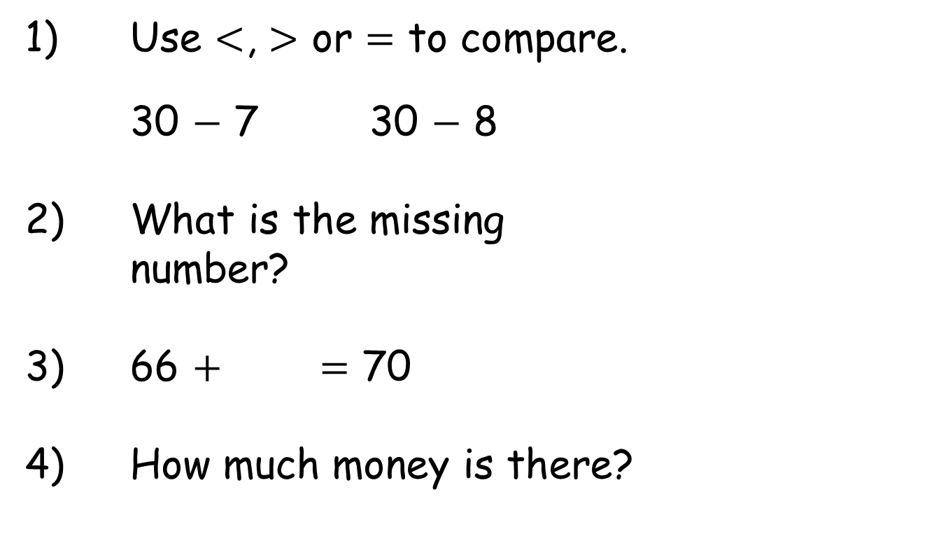
Year 2 | Week 10 | Day 1
1) Use $<$, $>$ or $=$ to compare.
30 $−$ 7 30 $−$ 8
2) What is the missing
number?
3) 66 $+$ $=$ 70
4) How much money is there?
45
27

Slide 2
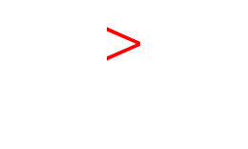
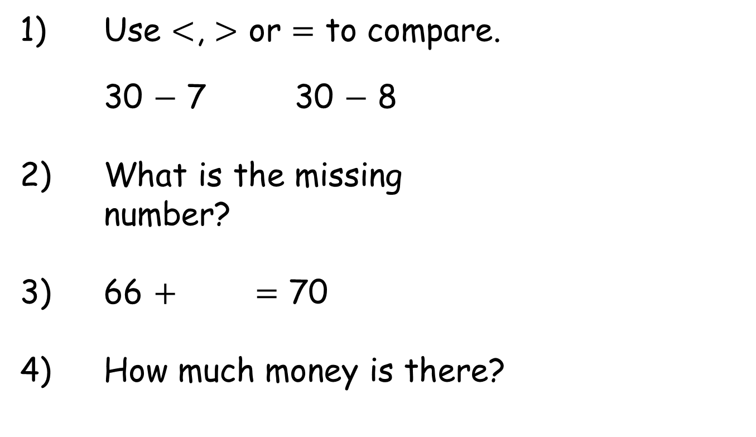
Year 2 | Week 10 | Day 1
1) Use $<$, $>$ or $=$ to compare.
30 $−$ 7 30 $−$ 8
2) What is the missing
number?
3) 66 $+$ $=$ 70
4) How much money is there?
$$>$$
45
27
18
4
37p

Slide 3
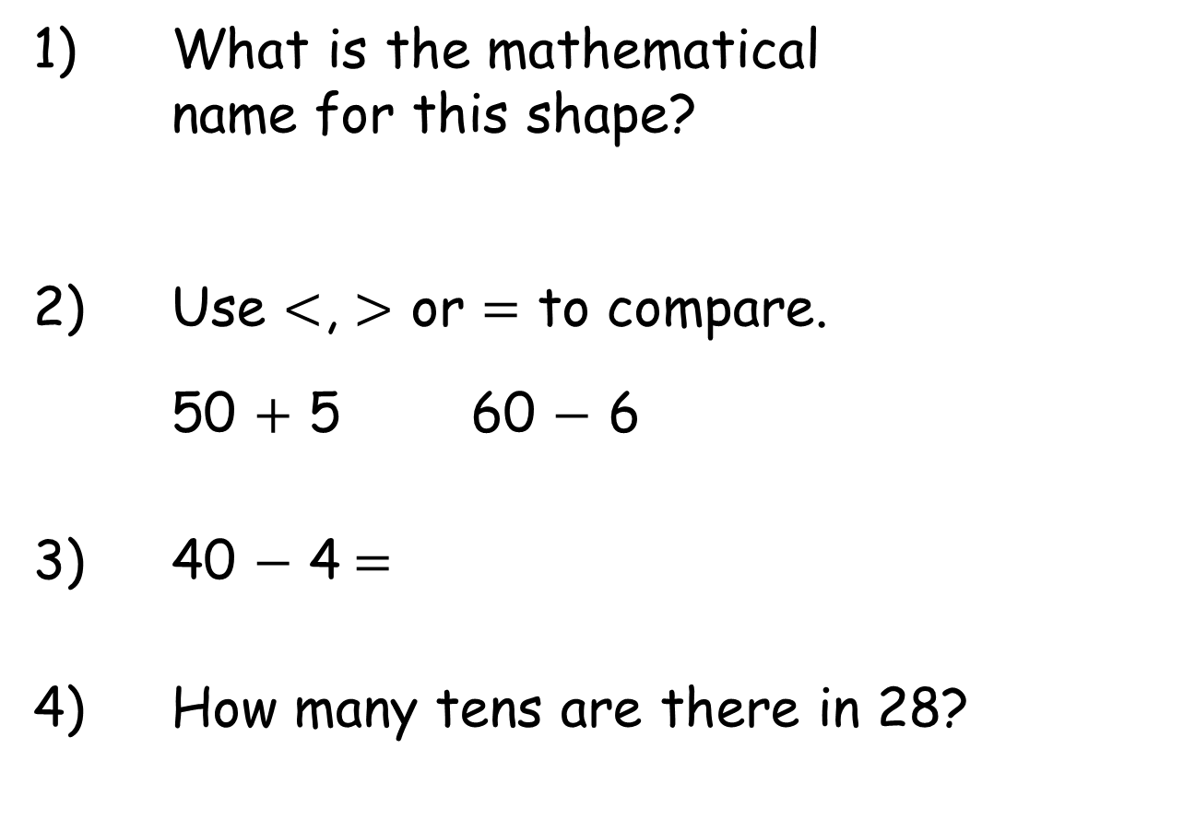
Year 2 | Week 10 | Day 2
1) What is the mathematical
name for this shape?
2) Use $<$, $>$ or $=$ to compare.
50 $+$ 5 60 $−$ 6
3) 40 $−$ 4$=$
4) How many tens are there in 28?

Slide 4
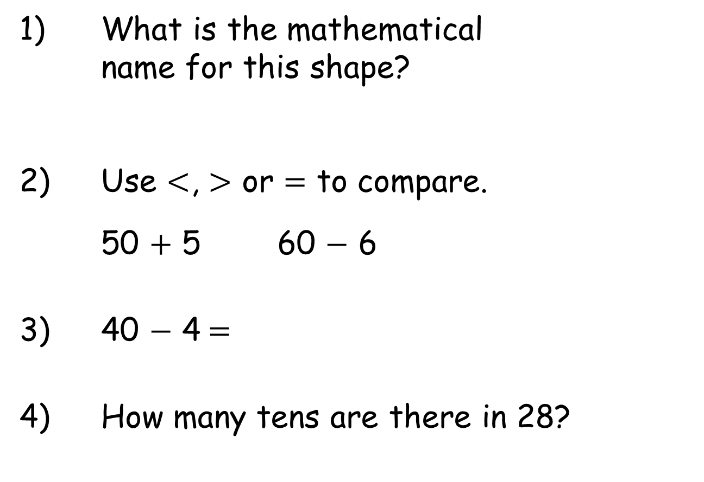
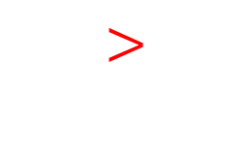
Year 2 | Week 10 | Day 2
1) What is the mathematical
name for this shape?
2) Use $<$, $>$ or $=$ to compare.
50 $+$ 5 60 $−$ 6
3) 40 $−$ 4$=$
4) How many tens are there in 28?
triangle
$$>$$
36
2

Slide 5
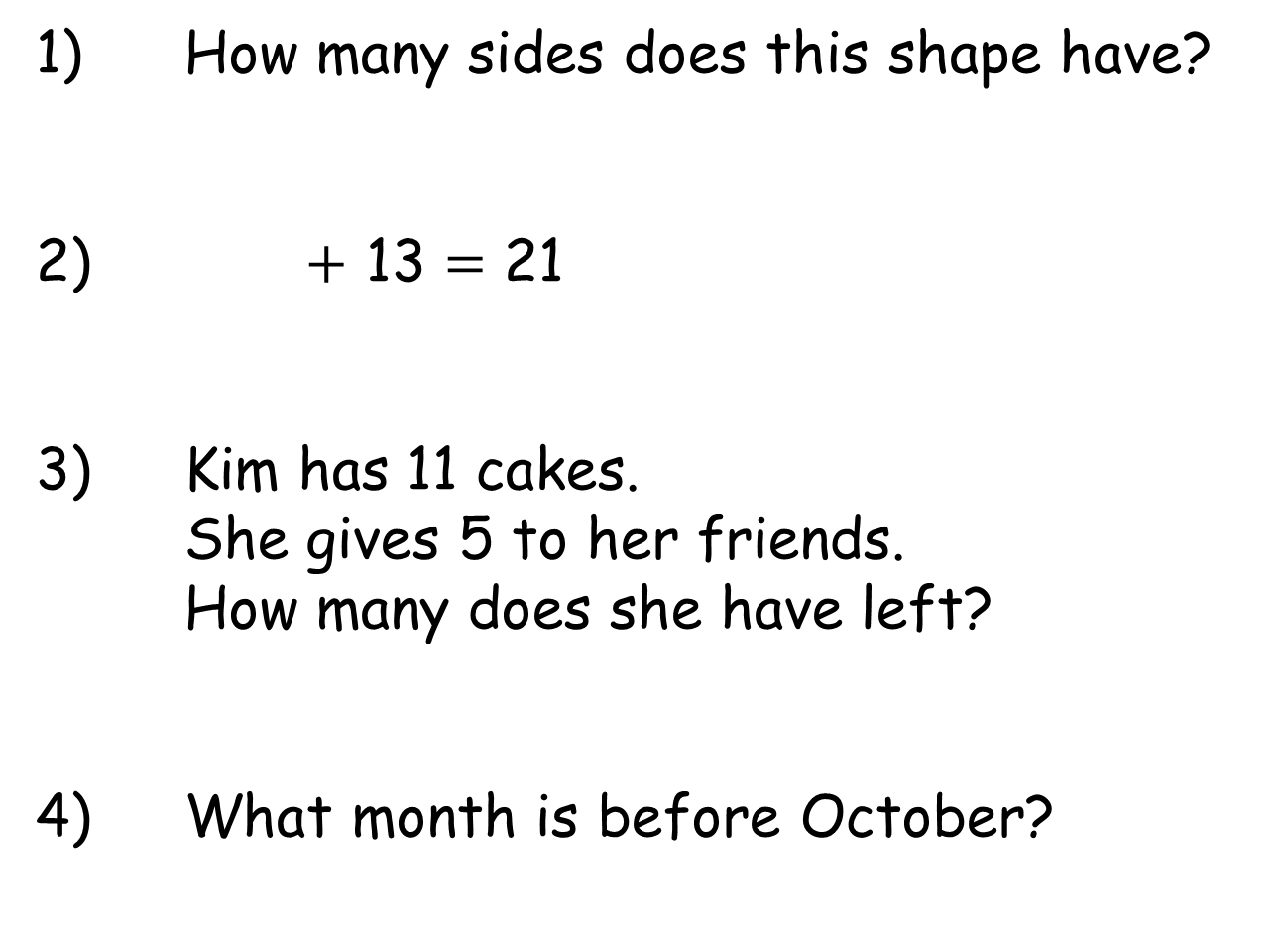
Year 2 | Week 10 | Day 3
1) How many sides does this shape have?
2) $+$ 13 $=$ 21
3) Kim has 11 cakes.
She gives 5 to her friends.
How many does she have left?
4) What month is before October?

Slide 6
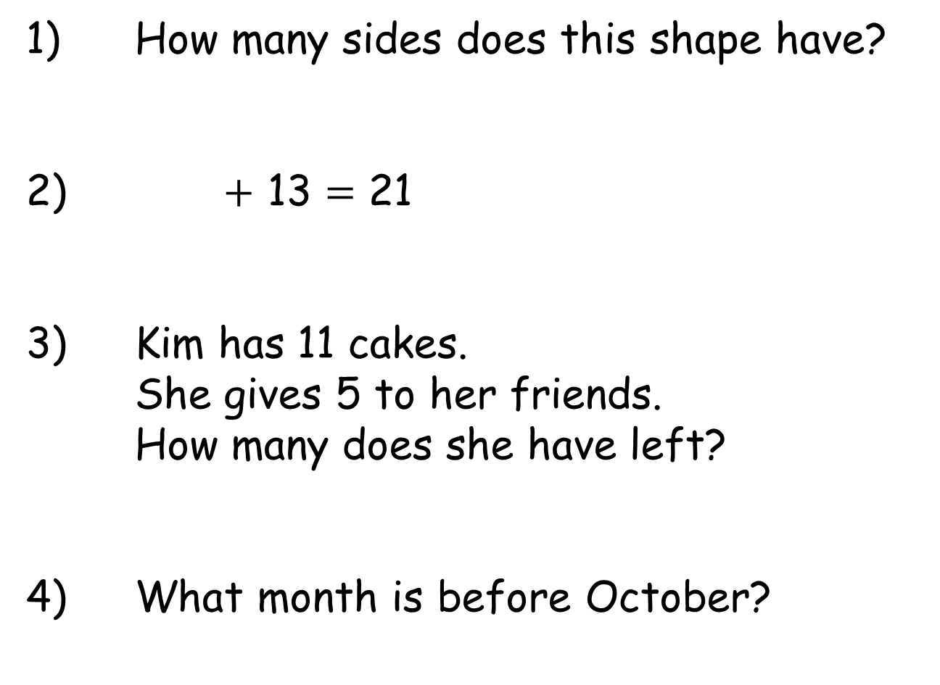
Year 2 | Week 10 | Day 3
1) How many sides does this shape have?
2) $+$ 13 $=$ 21
3) Kim has 11 cakes.
She gives 5 to her friends.
How many does she have left?
4) What month is before October?
5
8
6
September

Slide 7
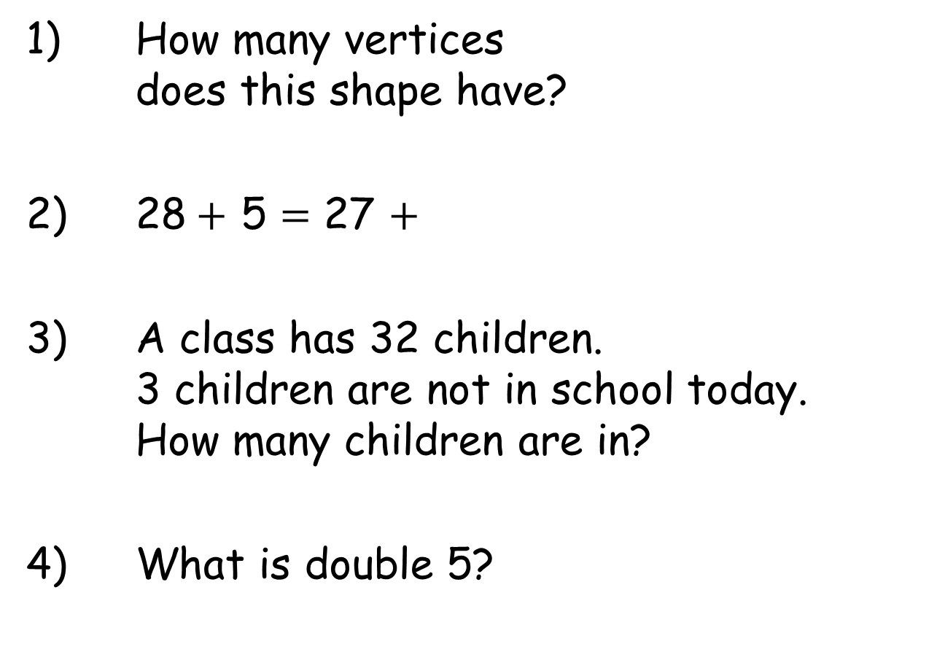
Year 2 | Week 10 | Day 4
1) How many vertices
does this shape have?
2) 28$+$ 5 $=$ 27 $+$
3) A class has 32 children.
3 children are not in school today.
How many children are in?
4) What is double 5?

Slide 8
Year 2 | Week 10 | Day 4
1) How many vertices
does this shape have?
2) 28$+$ 5 $=$ 27 $+$
3) A class has 32 children.
3 children are not in school today.
How many children are in?
4) What is double 5?
6
6
29
10

Slide 9
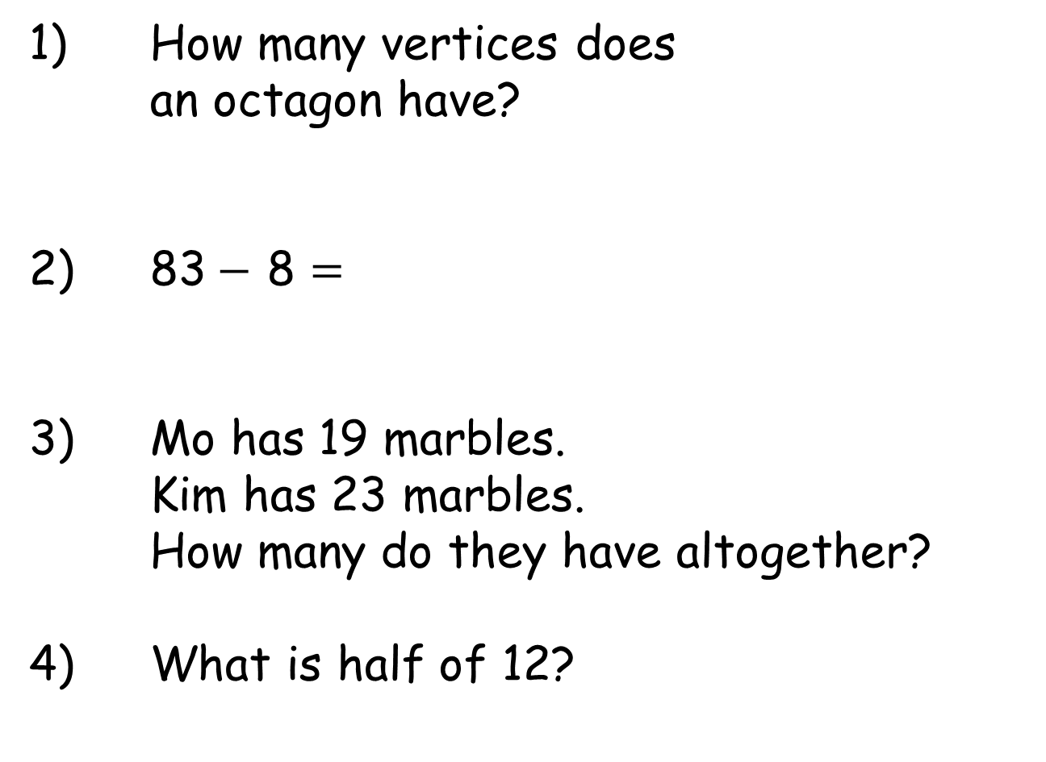
Year 2 | Week 10 | Day 5
1) How many vertices does
an octagon have?
2) 83$−$ 8 $=$
3) Mo has 19 marbles.
Kim has 23 marbles.
How many do they have altogether?
4) What is half of 12?

Slide 10
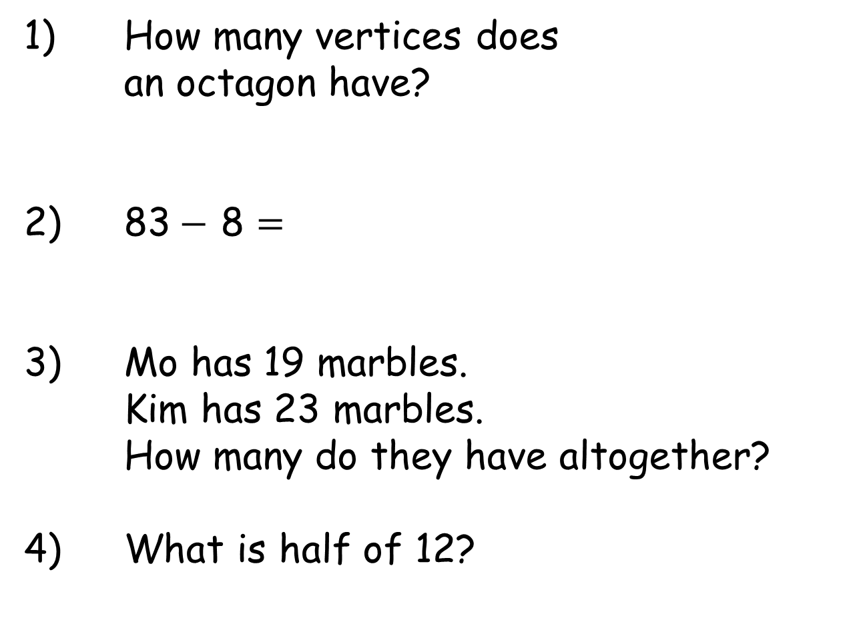
Year 2 | Week 10 | Day 5
1) How many vertices does
an octagon have?
2) 83$−$ 8 $=$
3) Mo has 19 marbles.
Kim has 23 marbles.
How many do they have altogether?
4) What is half of 12?
8
75
42
6

