Slide 1
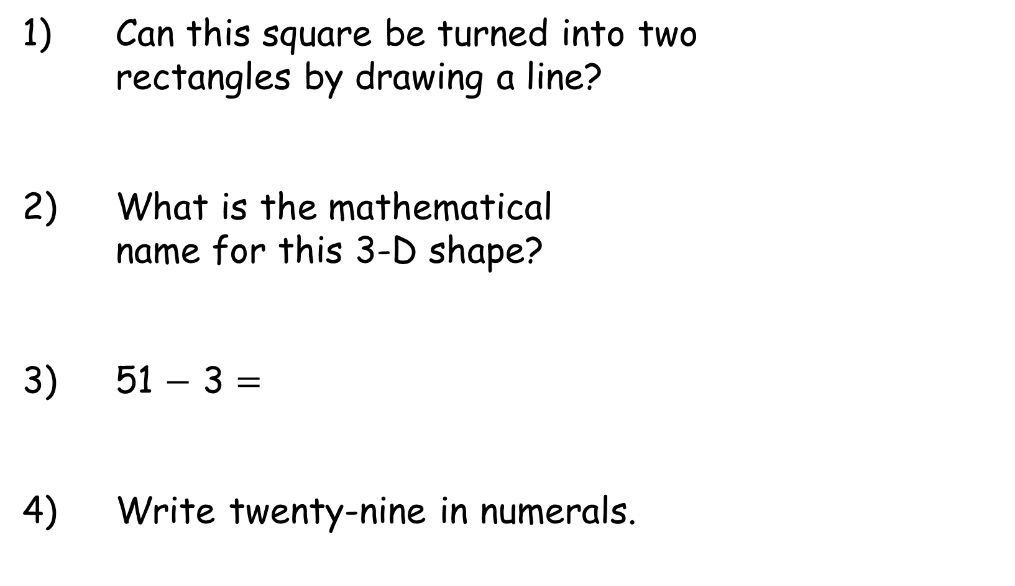
Year 2 | Week 11 | Day 1
1) Can this square be turned into two
rectangles by drawing a line?
2) What is the mathematical
name for this 3-D shape?
3) 51 $−$ 3 $=$
4) Write twenty-nine in numerals.

Slide 2
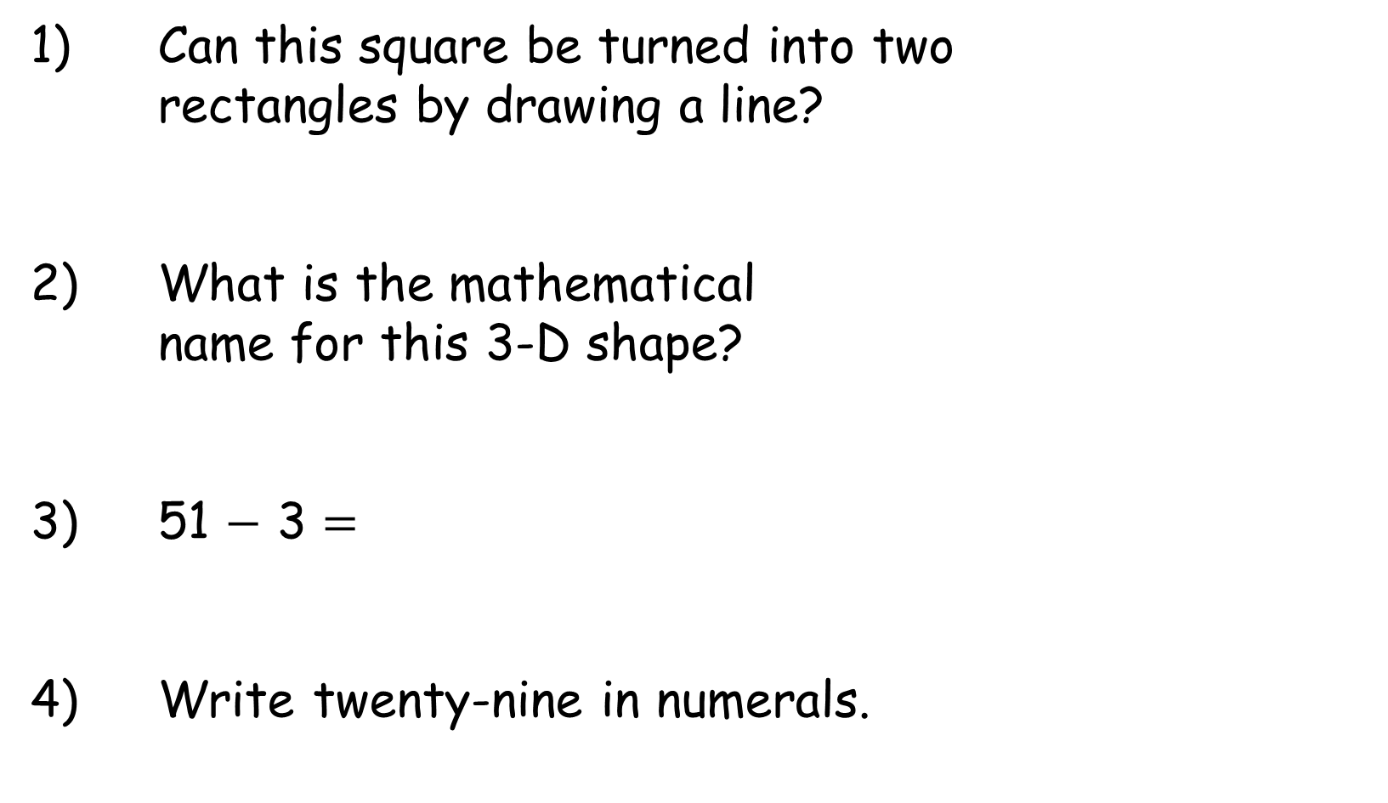
Year 2 | Week 11 | Day 1
1) Can this square be turned into two
rectangles by drawing a line?
2) What is the mathematical
name for this 3-D shape?
3) 51 $−$ 3 $=$
4) Write twenty-nine in numerals.
Yes
cube
48
29

Slide 3
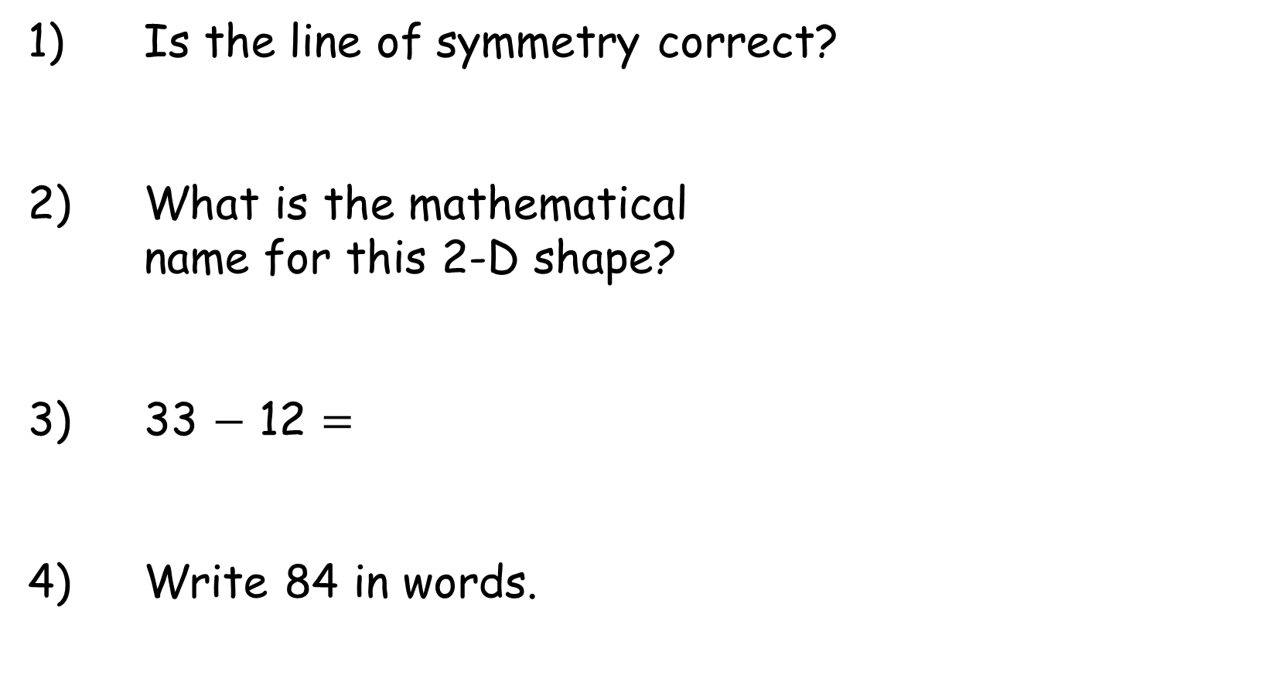
Year 2 | Week 11 | Day 2
1) Is the line of symmetry correct?
2) What is the mathematical
name for this 2-D shape?
3) 33 $−$ 12 $=$
4) Write 84 in words.

Slide 4
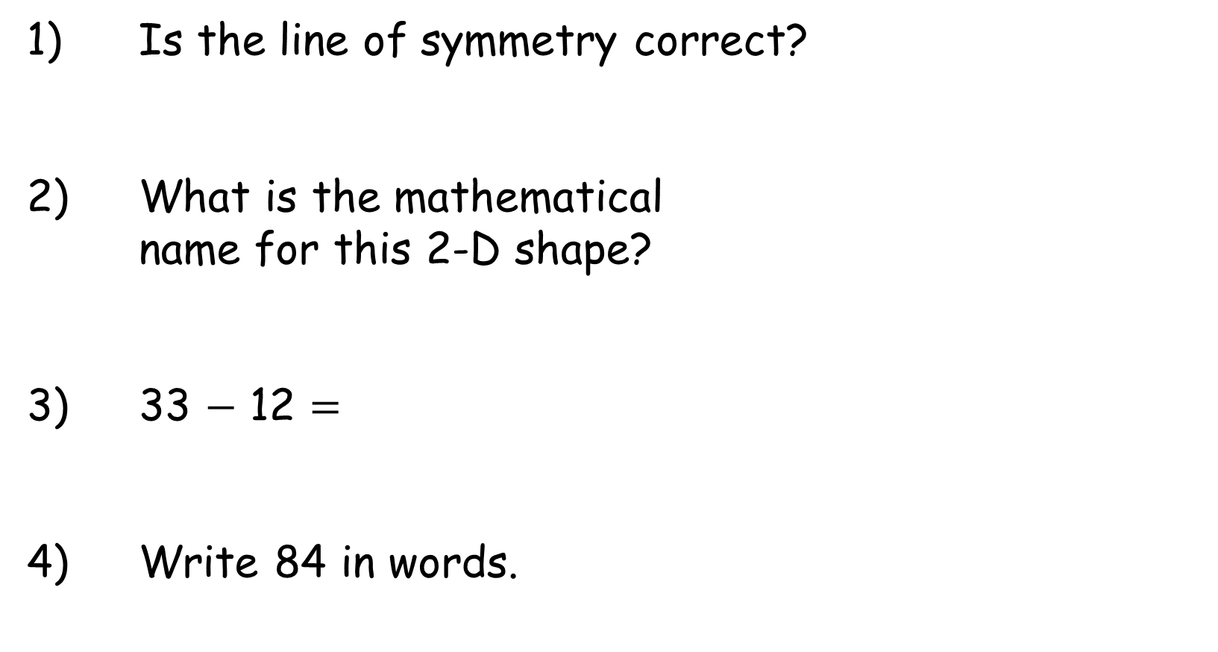
Year 2 | Week 11 | Day 2
1) Is the line of symmetry correct?
2) What is the mathematical
name for this 2-D shape?
3) 33 $−$ 12 $=$
4) Write 84 in words.
Yes
octagon
21
eighty-four

Slide 5
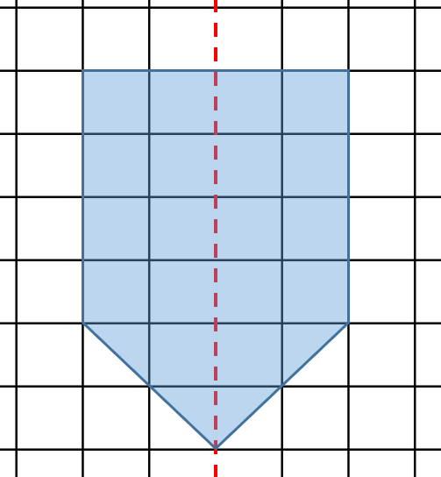

Year 2 | Week 11 | Day 3
1) Has Mo completed this
shape in the mirror line
correctly?
2) How many sides does a pentagon have?
3) There are 45 cows in a field.
27 cows are moved to another field.
How many cows are left?
4) How much money is there?

Slide 6
Year 2 | Week 11 | Day 3
1) Has Mo completed this
shape in the mirror line
correctly?
2) How many sides does a pentagon have?
3) There are 45 cows in a field.
27 cows are moved to another field.
How many cows are left?
4) How much money is there?
Yes
5
18
8p

Slide 7
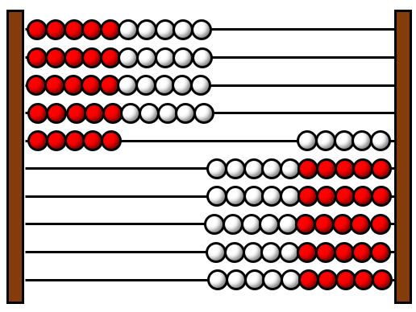
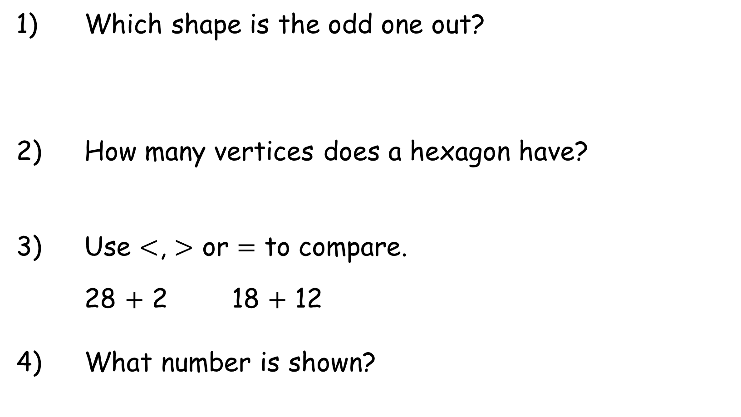
Year 2 | Week 11 | Day 4
1) Which shape is the odd one out?
2) How many vertices does a hexagon have?
3) Use $<$, $>$ or $=$ to compare.
28 $+$ 2 18 $+$ 12
4) What number is shown?

Slide 8
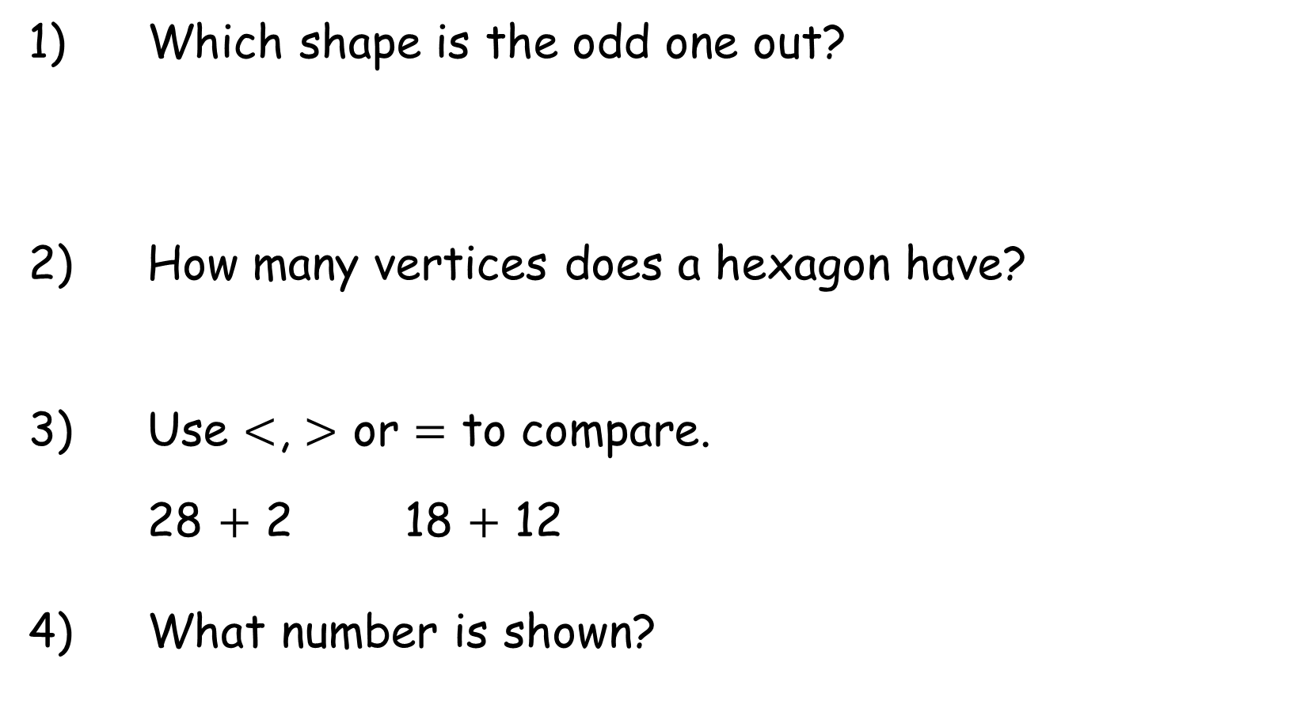

Year 2 | Week 11 | Day 4
1) Which shape is the odd one out?
2) How many vertices does a hexagon have?
3) Use $<$, $>$ or $=$ to compare.
28 $+$ 2 18 $+$ 12
4) What number is shown?
6
$$=$$
45

Slide 9
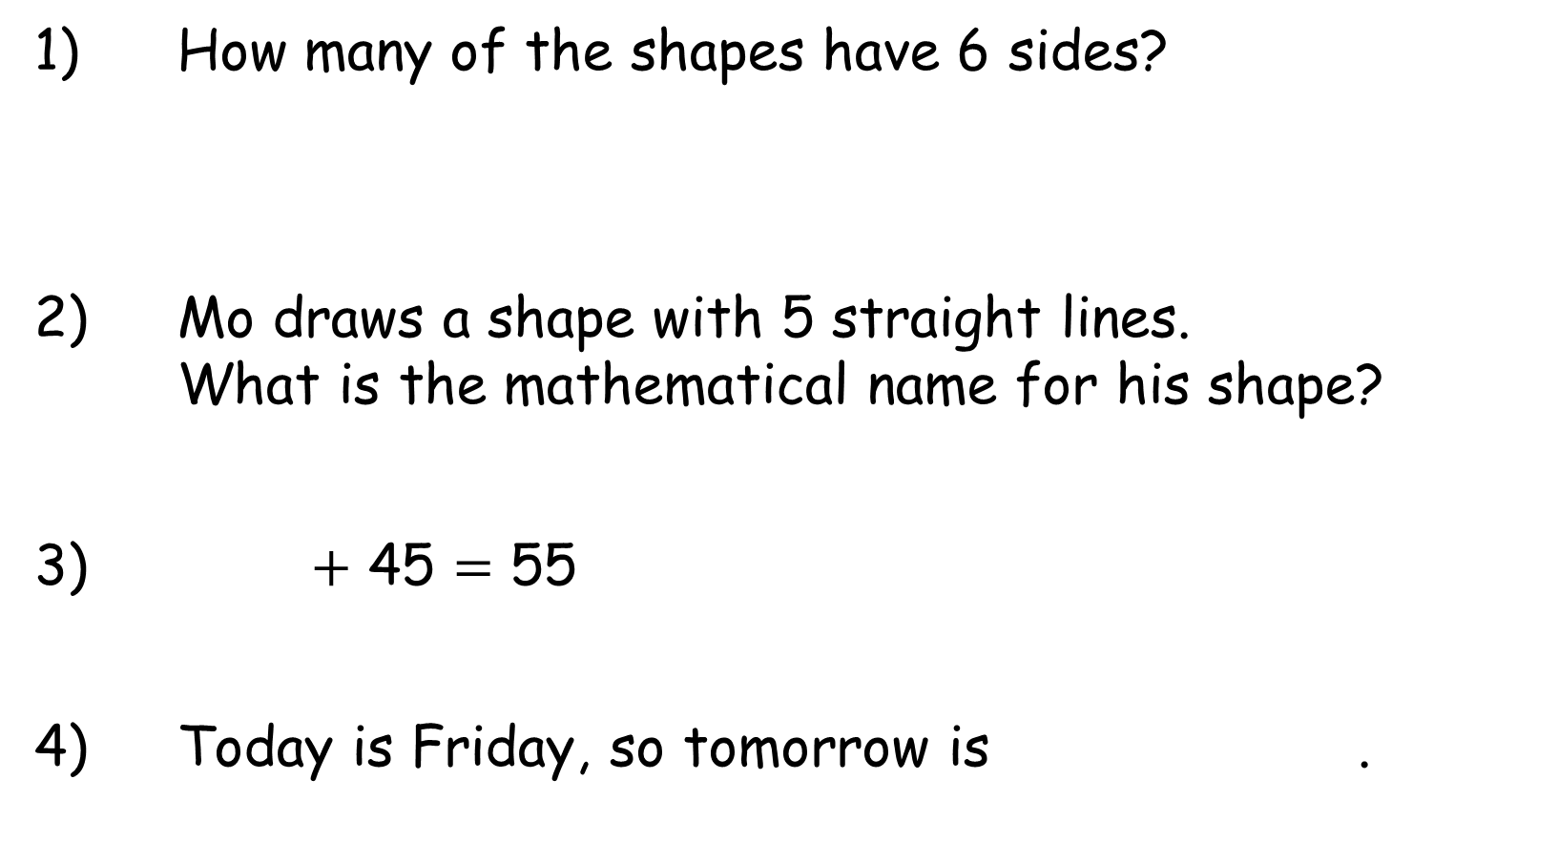
Year 2 | Week 11 | Day 5
1) How many of the shapes have 6 sides?
2) Mo draws a shape with 5 straight lines.
What is the mathematical name for his shape?
3) $+$ 45 $=$ 55
4) Today is Friday, so tomorrow is .

Slide 10
Year 2 | Week 11 | Day 5
1) How many of the shapes have 6 sides?
2) Mo draws a shape with 5 straight lines.
What is the mathematical name for his shape?
3) $+$ 45 $=$ 55
4) Today is Friday, so tomorrow is .
2
pentagon
10
Saturday

