Slide 1





Year 2 | Week 1 | Day 1
1) Which shape comes next?
2) How many sides?
3)
4) How many dots?
96
−
=
53

Slide 2
Year 2 | Week 1 | Day 1
1) Which shape comes next?
2) How many sides?
3)
4) How many dots?
sphere
6 sides
96
−
43
=
53
12 dots

Slide 3



Year 2 | Week 1 | Day 2
1) Count the money.
2)
3)
4) Which is longer?
The has vertices.
46 + 29 =
20 minutes
1 hour

Slide 4
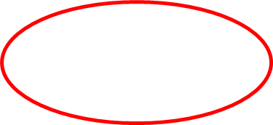
Year 2 | Week 1 | Day 2
1) Count the money.
2)
3)
4) Which is longer?
31p
The has vertices.
pentagon
5
46 + 29 =
75
20 minutes
1 hour

Slide 5



Year 2 | Week 1 | Day 3
1) How much altogether?
2) How many faces does a cube have?
3) What is the missing part?
4)
86
39
+
60
=
100

Slide 6
Year 2 | Week 1 | Day 3
1) How much altogether?
2) How many faces does a cube have?
3) What is the missing part?
4)
£18
6 faces
47
86
39
40
+
60
=
100

Slide 7

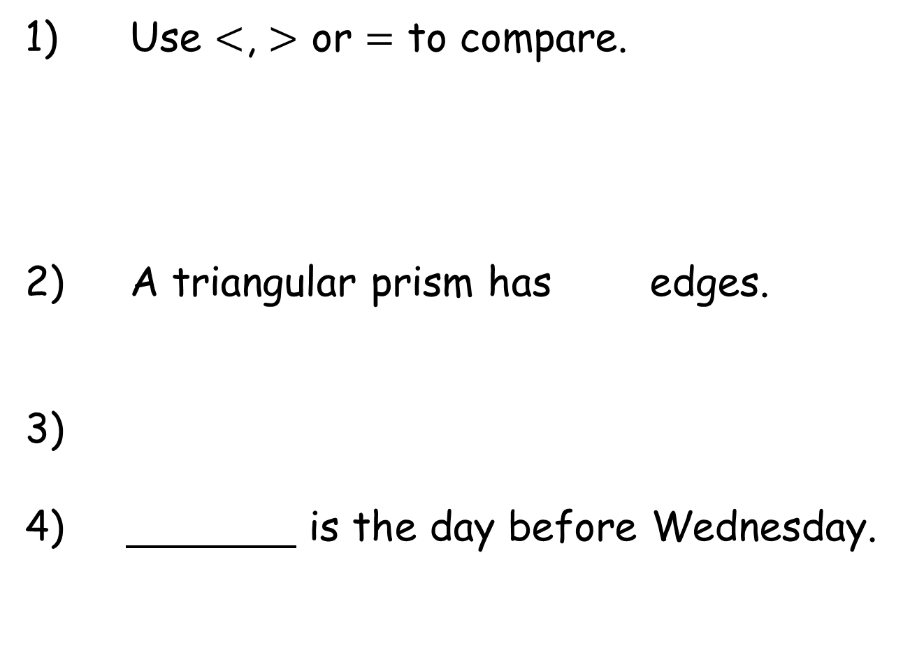
Year 2 | Week 1 | Day 4
1) Use $<$, $>$ or $=$ to compare.
2) A triangular prism has edges.
3)
4) is the day before Wednesday.
36 + 24 = 48 +

Slide 8
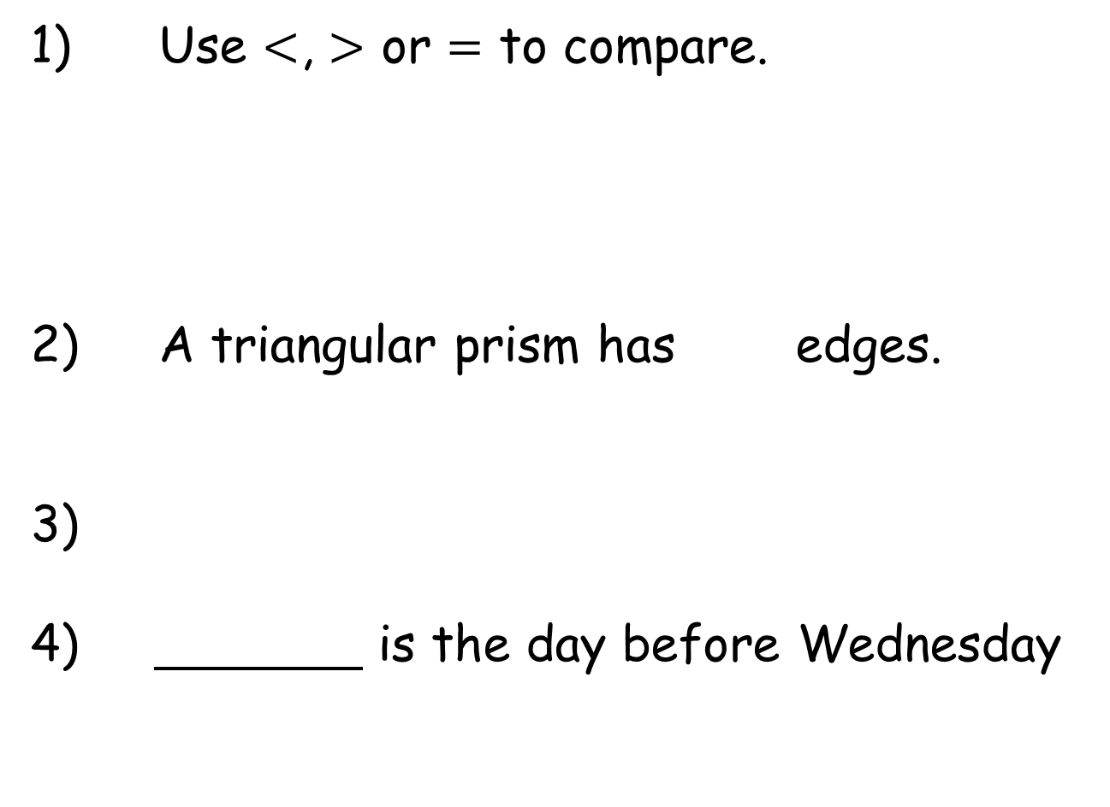

Year 2 | Week 1 | Day 4
1) Use $<$, $>$ or $=$ to compare.
2) A triangular prism has edges.
3)
4) is the day before Wednesday
$$<$$
9
36 + 24 = 48 +
12
Tuesday

Slide 9
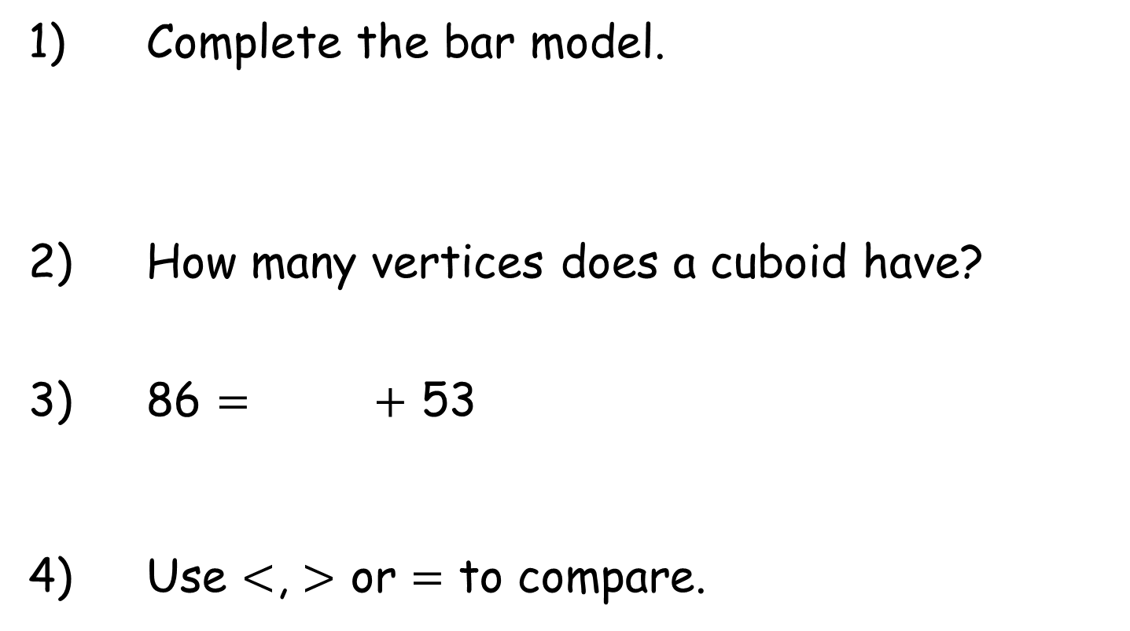
Year 2 | Week 1 | Day 5
1) Complete the bar model.
2) How many vertices does a cuboid have?
3) 86 = + 53
4) Use $<$, $>$ or $=$ to compare.
£20
34 + 10
44

Slide 10
Year 2 | Week 1 | Day 5
1) Complete the bar model.
2) How many vertices does a cuboid have?
3) 86 = + 53
4) Use $<$, $>$ or $=$ to compare.
£20
£5
£5
8
33
34 + 10
=
44

