Slide 1




Year 2 | Week 2 | Day 1
1) Which is the odd one out?
2) What will the next shape be?
3)
4) What is half of 24?
28 | 26 |  | 22 | 20

Slide 2

Year 2 | Week 1 | Day 1
1) Which is the odd one out?
2) What will the next shape be?
3)
4) What is half of 24?
hexagon
28 | 26 |  | 22 | 20
24
18
12

Slide 3



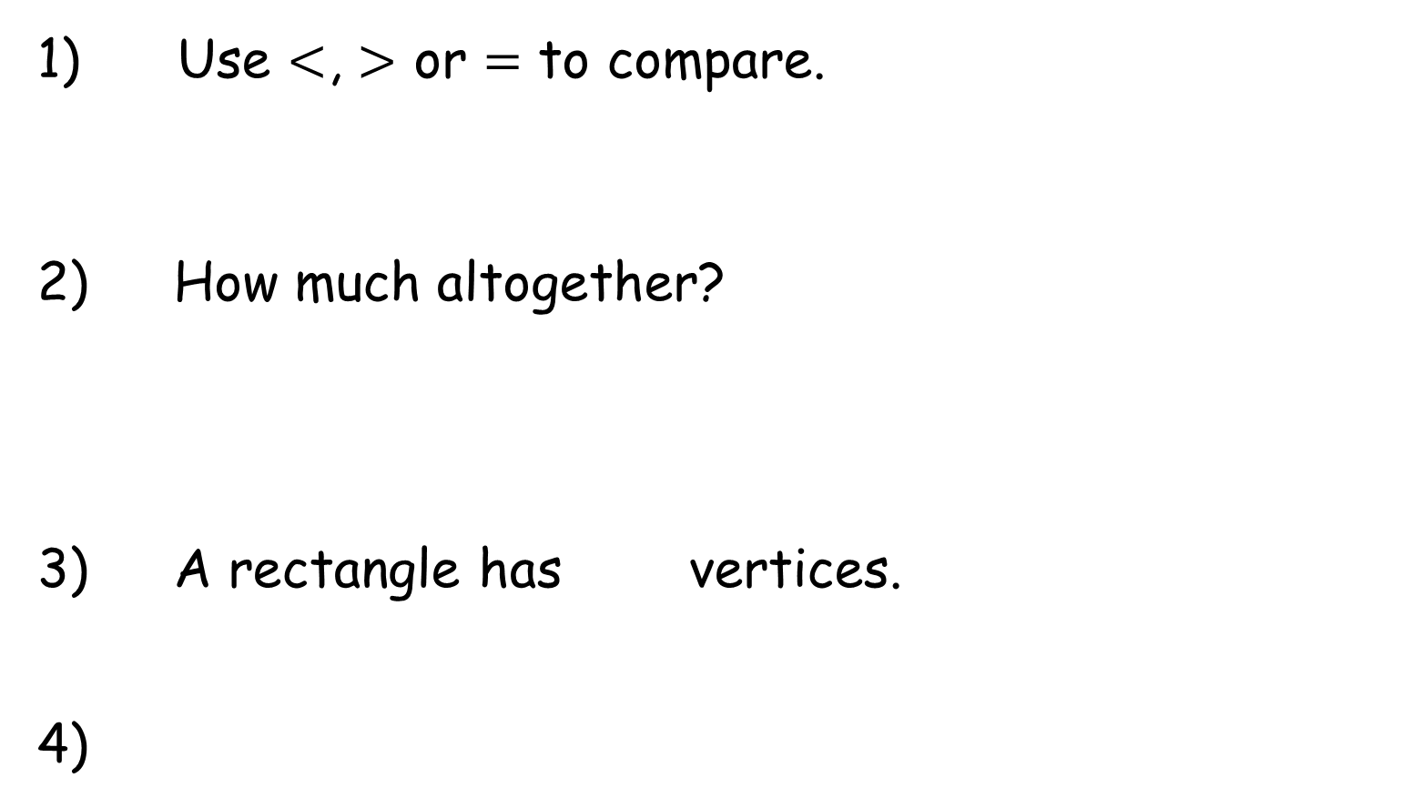
Year 2 | Week 2 | Day 2
Use $<$, $>$ or $=$ to compare.
2) How much altogether?
3) A rectangle has vertices.
4)
£5 + 50p 50p + £2 + £1 + £2
55 | 50 | 45 |  | 35 | 30

Slide 4
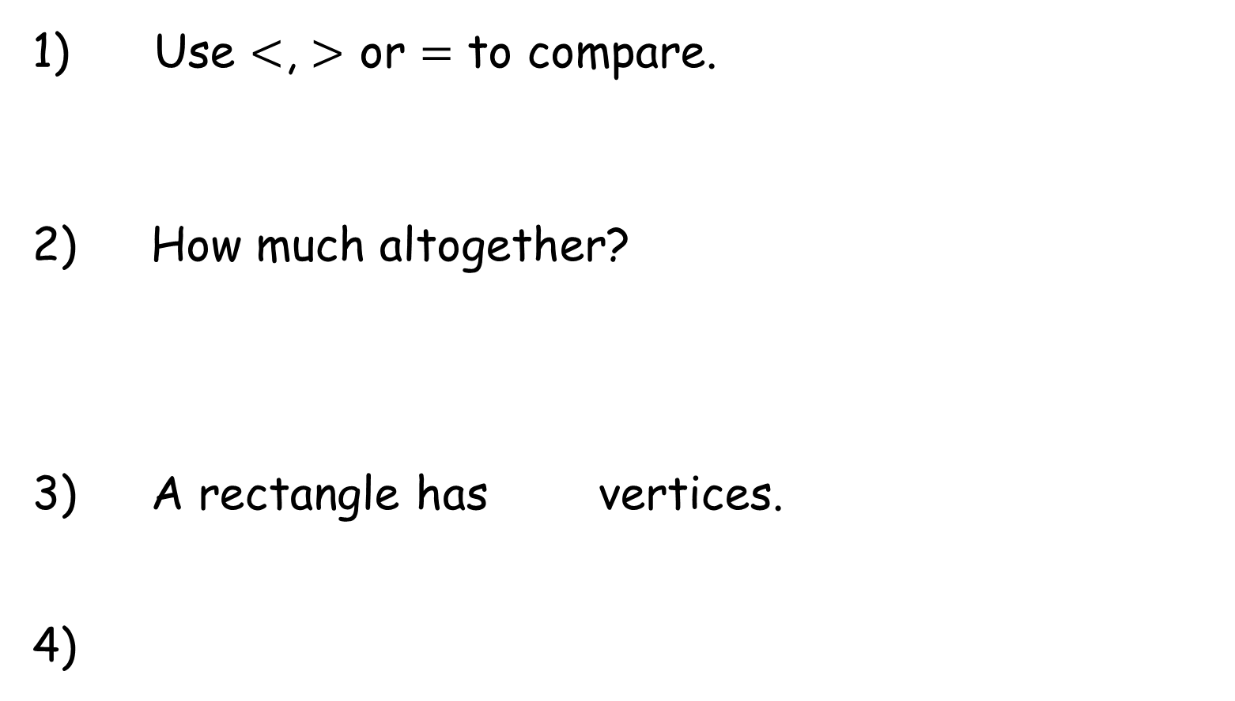

Year 2 | Week 2 | Day 2
Use $<$, $>$ or $=$ to compare.
2) How much altogether?
3) A rectangle has vertices.
4)
$$=$$
£5 + 50p 50p + £2 + £1 + £2
37p
4
40
55 | 50 | 45 |  | 35 | 30

Slide 5




Year 2 | Week 2 | Day 3
1) How much more does the drink cost?
2) £5 + £5 + 20p = £ and p
How many faces?
4) I can make equal groups of 4
50p
75p

Slide 6
Year 2 | Week 2 | Day 3
1) How much more does the drink cost?
2) £5 + £5 + 20p = £ and p
How many faces?
4) I can make equal groups of 4
25p
50p
75p
10
20
5
4

Slide 7




Year 2 | Week 2 | Day 4
1) Complete the bar model.
2) Find the total.
3) How many edges?
4) A quarter is 4, what is the whole?
£1
 | 75p

Slide 8
Year 2 | Week 2 | Day 4
1) Complete the bar model.
2) Find the total.
3) How many edges?
4) A quarter is 4, what is the whole?
£1
 | 75p
25p
£40
8 edges
16

Slide 9


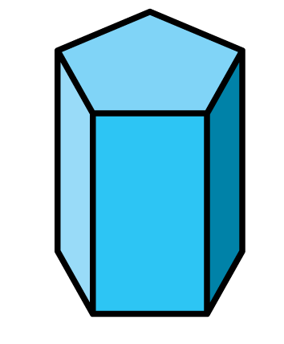
Year 2 | Week 2 | Day 5
1) How much change?
2) Which does not show 30p?
3) How many vertices?
4) 100 = + 70
30p

Slide 10
Year 2 | Week 2 | Day 5
1) How much change?
2) Which does not show 30p?
3) How many vertices?
4) 100 = + 70
30p
70p
10
30

